Slide 1
Post EYE-TA
Notes:
Welcome!
The Post EYE-TA is the last step of your year-long EYE-TA journey!

Slide 2
What will you learn?
Which children to reassess in the Post EYE-TA
Understanding the Post EYE-TA Child and Class Reports
Using the Post EYE-TA Child Action Plan to track progress and share information with the child’s next teacher
Identify helpful resources
Notes:
We’ll look at which children will be reassessed in the Post EYE-TA, we’ll review the Post EYE-TA Child and Class Reports, we’ll discuss how to use the Post EYE-TA Child Action Plan to track progress and share information with the child’s next teacher and finally, identifying helpful resources.

Slide 3

What are some benefits of the Post EYE-TA?
Gauging the effectiveness supports
Supporting the transition to Grade 1
Notes:
The post EYE-TA helps gauge the effectiveness and appropriateness of supports provided throughout the year.
It also supports the transition to Grade 1 by informing the Grade 1 teacher about the learning needs of the children who will soon be in their class and helps with planning classroom composition and resource distribution.

Slide 4

What does the Post EYE-TA look like?
The Pre and Post EYE-TA are essentially the same, with one important exception:
In most cases, not all the children will be reassessed.
  Let’s take a closer look…
Notes:
What does the Post EYE-TA look like? CLICK
The Post EYE-TA is administered the same way as the Pre EYE-TA, with one important exception: CLICK
In most cases, not all the children will be reassessed. CLICK
The children identified with RTI Tier 2 and 3 learning needs are the ones who are recommended for a Post EYE-TA.
Let’s take a closer look at this…

Slide 5
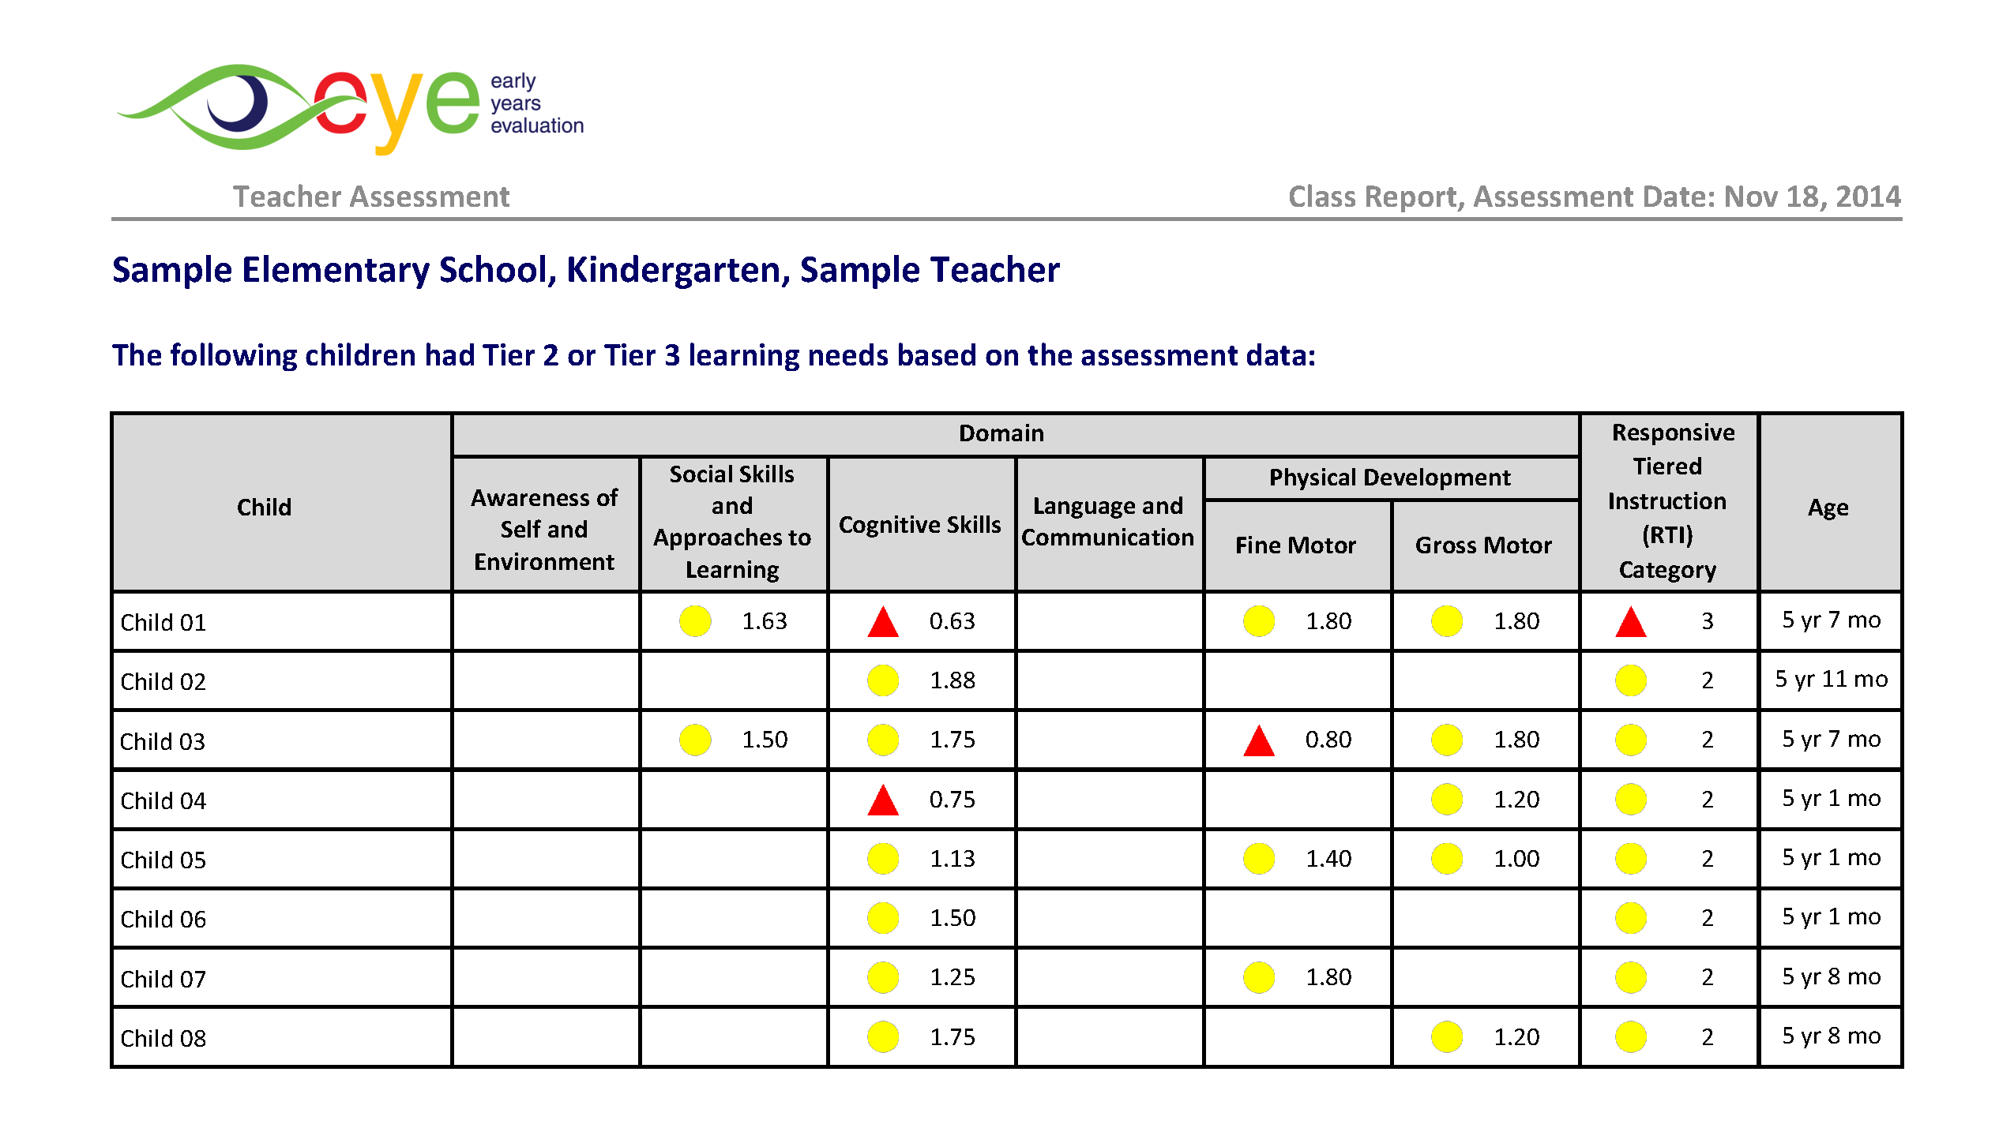
Where can I find the list of children who are recommended for reassessment in my class?
The Pre EYE-TA Class Report includes a table that lists the children with Tier 2 and Tier 3 learning needs (yellow and red RTI).
Notes:
Where can I find the list of children who are recommended for reassessment in my class? CLICK
The EYE-TA class report from your Pre EYE-TA will contain a list of all children identified with Tier 2 and Tier 3 learning needs. This table is typically on page 4 of the report.
These are the children recommended for a Post EYE-TA .

Slide 6
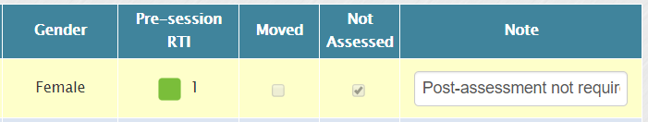
Can I reassess a child with Tier 1 learning needs (green RTI) if I feel it is necessary?
Yes, simply uncheck the child in the ‘Not Assessed’ column. Enter their data as you would for the other reassessed children.
Notes:
Can I reassess a child with Tier 1 learning needs (green RTI) if I feel it is necessary? CLICK
Once the session is open, our system automatically checks off ‘Not Assessed’ for the children with Tier 1 learning needs in the ‘Manage Class List’ section of the data entry site. “Post Assessment Not Required” is also entered in the notes section.
If you feel it is necessary to reassess a child, just uncheck the box and remove the note, then administer the Post EYE-TA for that child along with the other children you are reassessing.

Slide 7
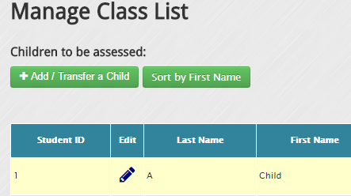
Can I add a new child to the Post EYE-TA?
Yes, simply click on ‘Add / Transfer a Child’ to add the child to your class list.
Notes:
Can I assess a child who is new to my class? CLICK
Yes, you can add any new children to your class yourself and assess them in the Post EYE-TA, just by clicking CLICK on the green Add/Transfer a Child button on the ‘Manage Class List’ page.

Slide 8
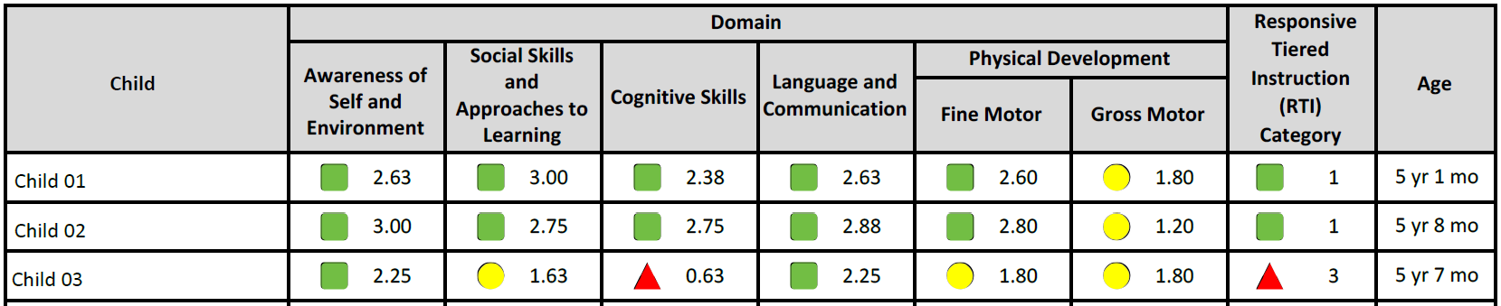
Do I have to reassess the children on all domains?
Yes, this will allow you to:
see the growth in each domain and a possible new RTI result
have a complete Post EYE-TA Child Report
Notes:
Do I have to reassess the children on all domains, even if they received some green domain results? CLICK
For those children indicated for the Post EYE-TA , all domains should be reassessed. This will ensure the domain averages that are used to calculate the RTI results are available. This will also provide individual child reports that are complete across all domains. This is helpful for teachers when sharing results with families and multidisciplinary teams. Assessing a child across all five domains also serves as a way to observe if the child has shown improvement, even if it is modest.

Slide 9
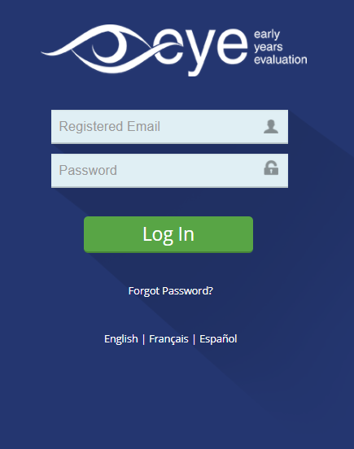
Should I use the same password I used for the Pre EYE-TA?
Yes!
If you forgot your password, simply click on “Forgot Password?” on the login page.
Notes:
Should I use the same password I used for the Pre EYE-TA ? CLICK
If you already have an EYE account, you can use your previously chosen password to log in. CLICK
If you have forgotten your password or want to reset it, you can do so by going to the data entry site and clicking the “Forgot Password” link.

Slide 10
Interpreting the Pre-Post EYE-TA results
Notes:
Let’s see what your Post EYE-TA results will look like and how to interpret them.

Slide 11
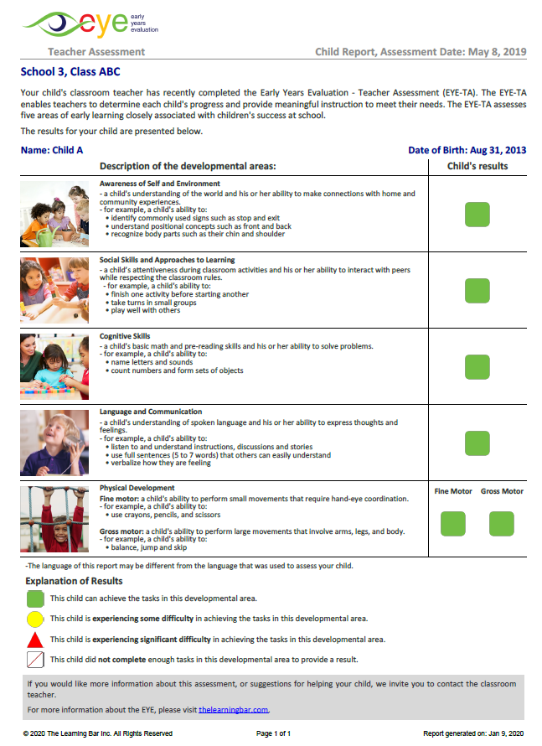
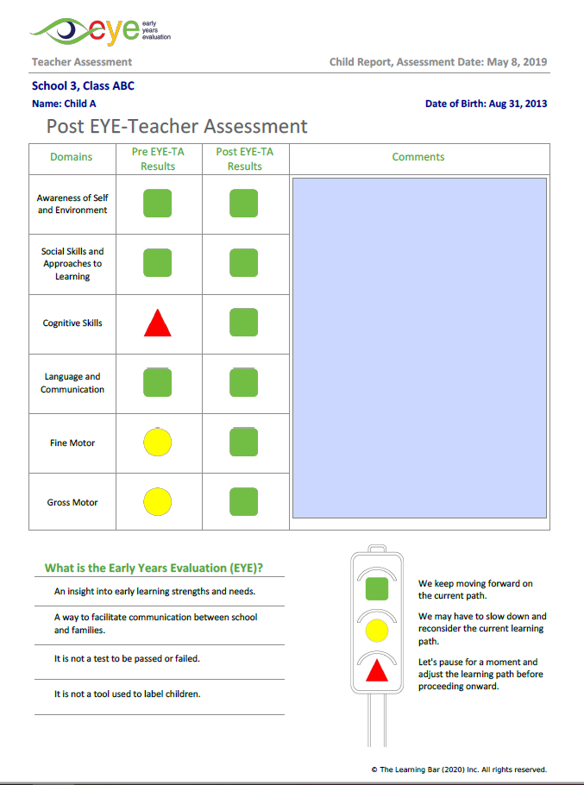
Post EYE-TA Child Report
Page 1 of the Post EYE-TA Child Report has the same format as the one from your pre-session
Page 2 has side-by-side Pre-Post results
Notes:
Let’s look at the Post EYE-TA Child Report CLICK
The first page looks exactly like the first page of the Pre EYE-TA Child Report CLICK
The second page – if chosen by your jurisdiction – shows the Pre-Post results side-by-side. This allows you and others using this report, to quickly see the growth made during the year.

Slide 12
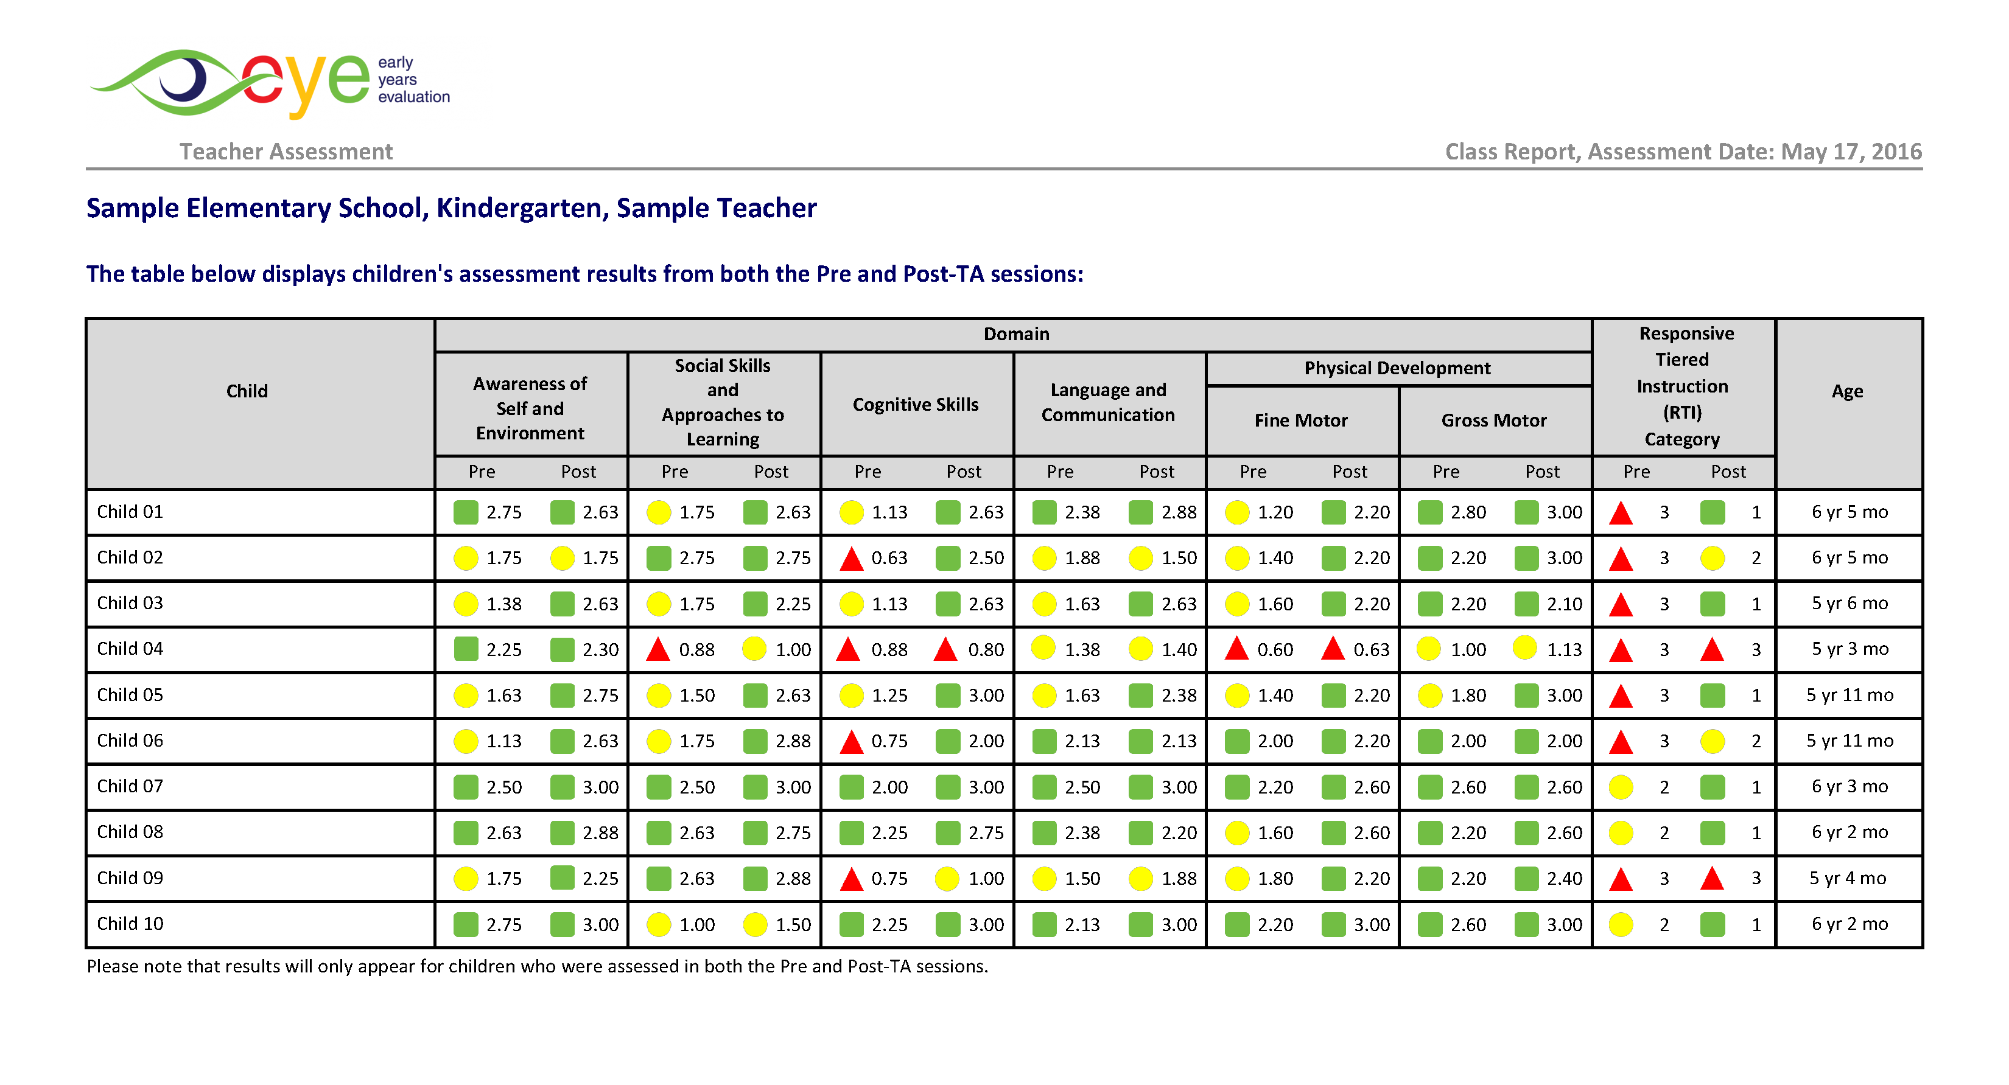
Post EYE-TA Class Report
Notes:
Let’s take a quick look at a sample class report for context, before going into the details of interpreting the results. In this report, we find the domain and RTI results from the Pre-session, along with the results from the Post session.

Slide 13
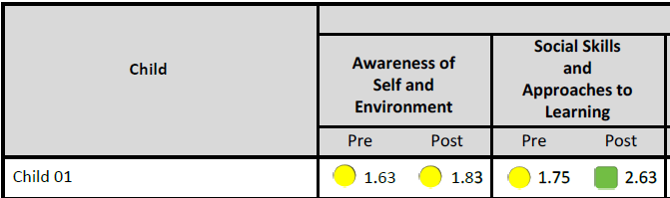
Interpreting the Pre-Post EYE-TA results
Look for changes in domain scores…both the coloured results and the numerical scores.
Notes:
While we know that children tend to demonstrate progress over the course of the school year, moving from one domain colour to the next (for example red to yellow, or yellow to green) is not always the case. CLICK
However, growth is sometimes subtle and is seen within the colour instead CLICK For example, in this case, the domain result remained yellow, but we see an increase in the numerical score from 1.63 to 1.83. Each child is unique. For some children, these results may indicate that the supports have not been effective or that additional supports are required for the child. While for other children, these results may indicate and account for the supports being effective, appropriate, and responsive. Remember, a single assessment does not provide a comprehensive view of children’s learning and development. We encourage you to consider the results in the context of ongoing evaluations and responsiveness to assessment and instruction.

Slide 14
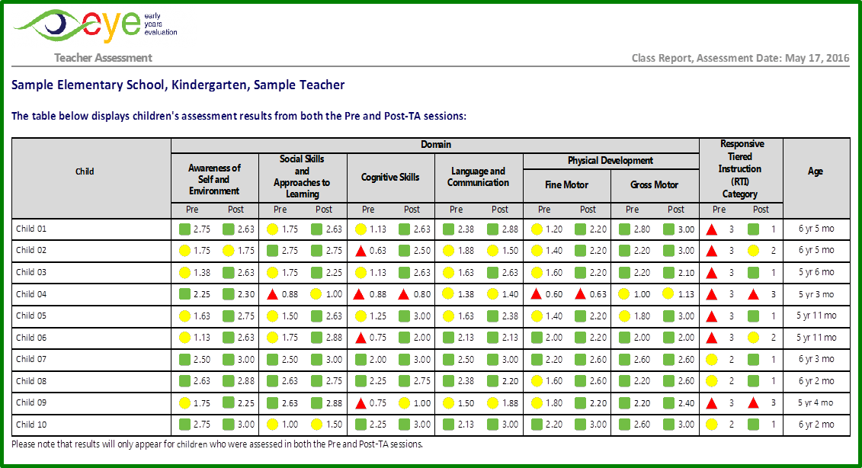
Gauging the effectiveness of supports provided
The side-by-side Pre-Post results allow you to see the effectiveness of support for each child in your class.
Notes:
Teachers can evaluate the effectiveness of supports and how children are progressing with the side-by-side results posted in the class report.
(1) CLICK Child 1’s results suggest that the supports in place are effective and responsive to the child’s strengths and needs.
(2) CLICK Child 9’s results suggest that some supports are effective however, the supports will need to be reviewed for additional appropriate responses.
(3) CLICK Child 4’s results suggest that the team will need to review and evaluate the supports in place to create a new plan that is appropriate and responsive to the needs of the child.

Slide 15
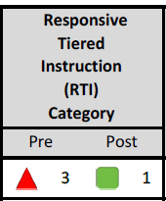
Does moving to Tier 1 mean that the child no longer needs the same type of support?
Not necessarily. This tells us the supports were effective. Maintain these supports to assure continued growth.
Notes:
Does moving to Tier 1 mean that the child no longer needs the same type of support? CLICK
Not necessarily. The Post EYE-TA results assist teachers in determining the effectiveness of the supports and how children are responding to them. While there are a number of factors to consider, these results suggest that the child is responding well to the supports implemented.
It is important to continue with supports that are effective and responsive to the child’s strengths and needs. For example, if the child is responding well to small group instruction, continued use of small group instruction would be beneficial and considered an effective support. A change in a child’s RTI results from Tier 3 (red) to Tier 1 (green) learning needs does not necessarily mean the child no longer requires support; rather, it means that the supports are working and should continue to be provided.

Slide 16
Sharing the results: facilitating the transition to Grade 1

Slide 17

Sharing information with Grade 1 teachers
Supports?
What worked?
What didn’t?
Interests?
Interventions?
Accommodations?
Notes:
The Pre‐Post EYE‐TA results provide educators and multidisciplinary teams with information about children’s strengths and areas of need in kindergarten. As children transition from kindergarten, the information can be shared with Grade 1 educators to establish effective supports and develop a transition plan ensuring that resources are in place to support the children the moment they enter Grade 1.
Some questions to consider when sharing results with Grade 1 teachers:
• What supports were implemented in kindergarten?
• What worked well to meet the child’s needs?
• What supports and responses did not work well and why?
• What are the child’s interests?
• What interventions will need to be put in place to support the child in the transition to Grade 1?
• Are there any environmental accommodations? Visual supports?
The EYE Child Action Plan helps you capture and share this information with next year’s teacher.

Slide 18
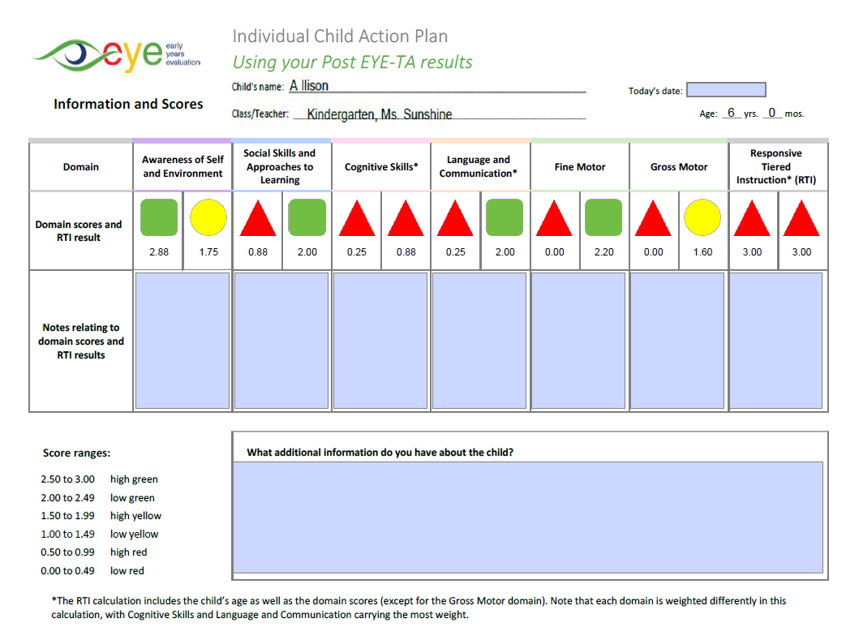
Post EYE-TA Child Action Plan – page 1
Information
Scores
Domain and RTI comments
General comments
Notes:
We’ve created a Child Action Plan for the Post EYE-TA.
You’ll get general info on the child CLICK and see the pre-populated pre and post-scores CLICK. You’ll have a chance to enter comments about the domains and the RTI, CLICK and finally, enter general comments CLICK. This is a helpful overview of the child’s results.

Slide 19
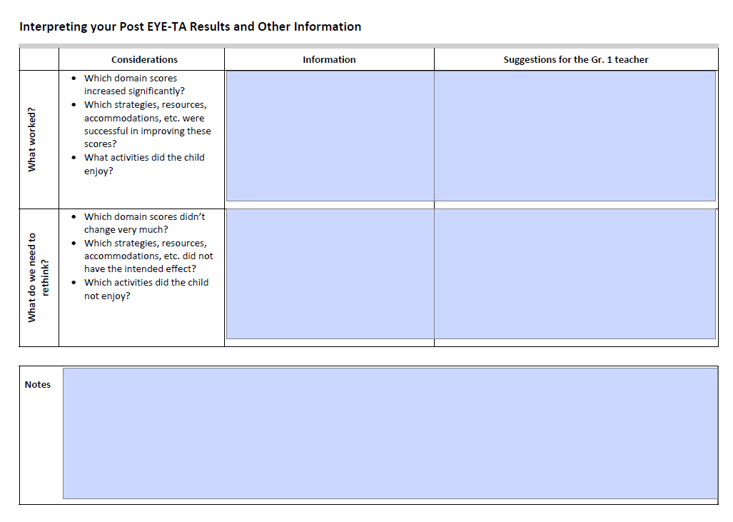
Post EYE-TA Child Action Plan – page 2
What worked?
What should be changed?
What do you recommend to the next year’s teacher?
Notes:
The second page of the Child Action Plan provides an opportunity to analyze the pre and post-results to see what worked well CLICK, what didn’t quite work as planned and what needs to be changed CLICK. Finally, in the last column CLICK, you can note what you would recommend the child’s next teacher do to either continue with what worked well or what you feel they should try instead.

Slide 20
Resources

Slide 21
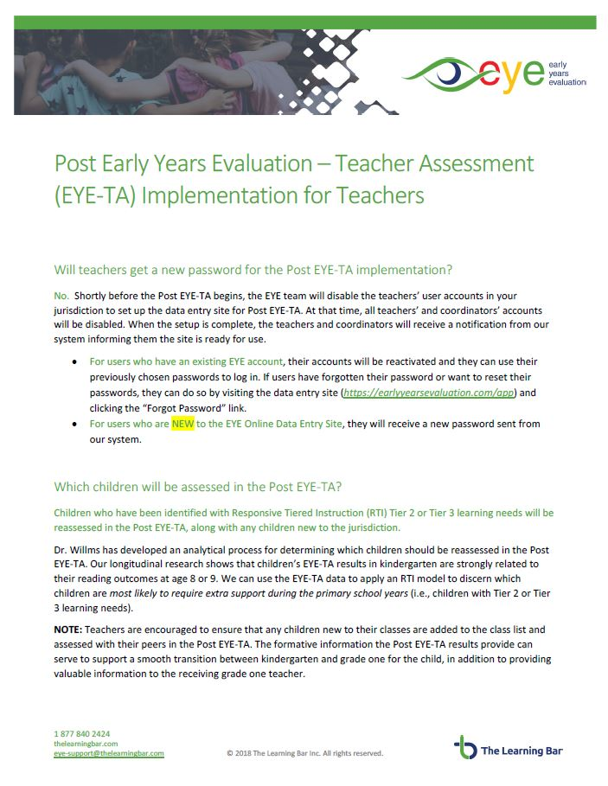
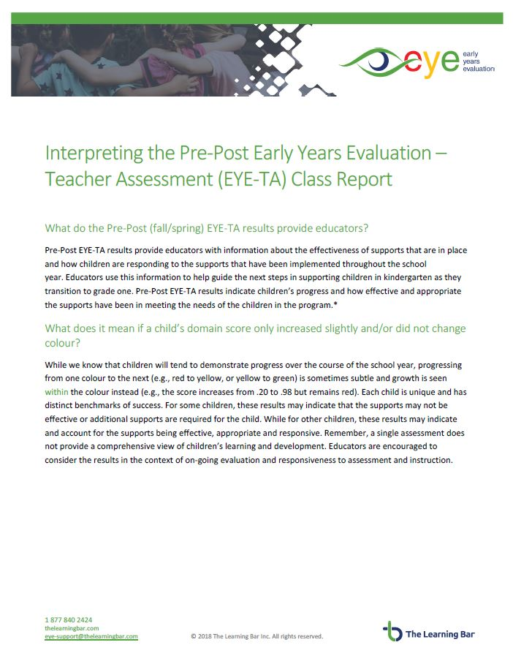
Helpful FAQ documents
Post EYE-TA Implementation for Teachers
Interpreting the Pre-Post EYE-TA Class Report
Notes:
We have created some resources to help you get the most of your Post EYE-TA:
Post EYE-TA Implementation for Teachers
Interpreting the Pre-Post EYE-TA Class Report

Slide 22


Thank You!
Any questions?
eye-support@thelearningbar.com
506 458 9311
1 877 840 2424

