Slide 1
Responding to EYE-TA Results
Notes:
Welcome!

Slide 2
What will you learn?
Making the most of your EYE Class Reports
Using the EYE-100 Domain-Strengthening Activities to boost children’s skills
Notes:
In this session, we’ll look at how to make the most of your EYE Class Reports and how the EYE 100 Domain-Strengthening Activities can help you boost children’s skills

Slide 3
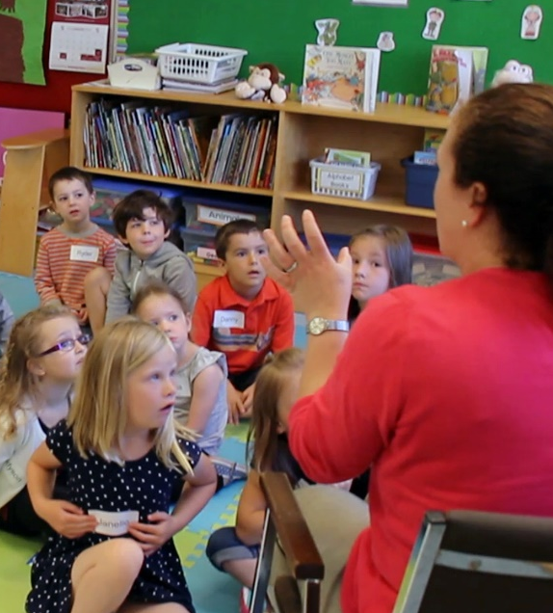
Responding to the results
Now that you’ve observed your children, recorded their scores, reviewed their results, and shared the reports, it’s time to work on strengthening the children’s skills. This will help them be ready to enter Grade 1.
Notes:
Now that you’ve observed your children, recorded their scores, reviewed their results, and shared the reports, it’s time to work on strengthening the children’s skills. This will help them be ready to enter Grade 1.
Let’s look at how you can use the EYE data to enrich and personalize your children’s learning experiences.

Slide 4
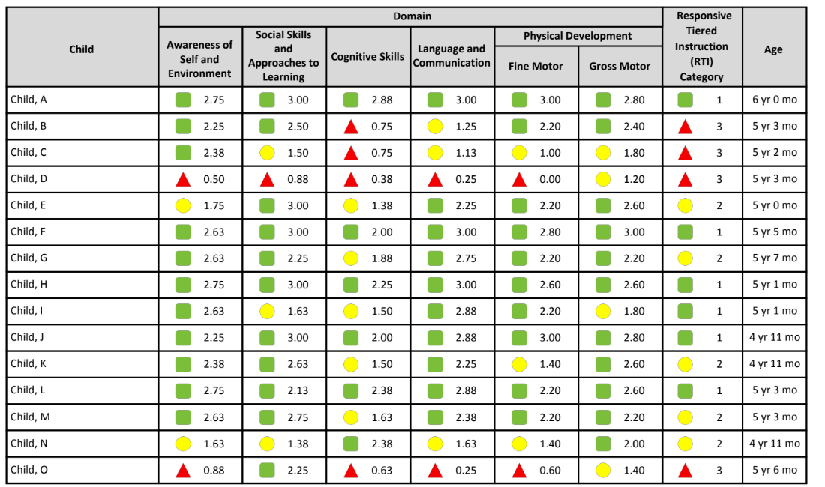
Responding to the results
The EYE Class Report offers insight into the strengths and needs of the children in your class. You can use this information to personalize each child’s learning experience.
Notes:
The EYE Class Report offers insight into the strengths and needs of the children in your class. You can use this information to personalize each child’s learning experience.

Slide 5
Responding to the results
Which domains are the strongest? Which ones need further support?
Notes:
The Class Report can be used to help guide instruction when planning classroom activities.
Which domains are the strongest? Which ones need further support?

Slide 6
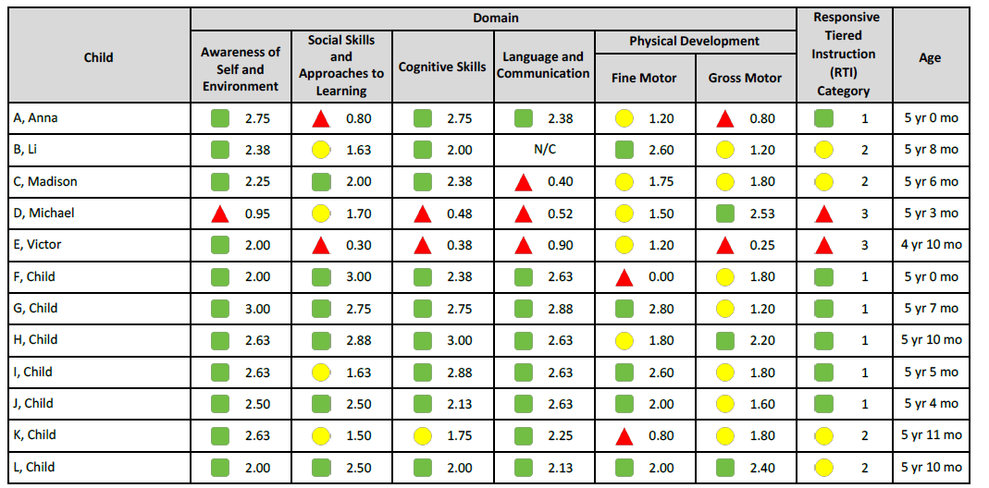
Responding to the results
Use the children’s strengths to support their areas of need.
Notes:
Use the children’s strengths to support their areas of need. For this class, we see that the Awareness of Self and Environment domain is strong, and the children need more experience developing their Gross Motor skills.
Consider creating an activity that uses the skills in the first domain to strengthen the last one- perhaps a variation on Hokey Pokey?

Slide 7
Grouping for differentiated learning
When planning small group activities, the EYE Class Report results can also help you determine how to group children.
If you are doing an activity about numbers, you could look at the Cognitive Skills scores and group them according to the results in that domain. This allows for differentiated instruction within the classroom. Children with green domain results can be presented with a more challenging version of the activity while children with red domain results can be presented with a modified version.
Notes:
When planning small group activities, the EYE Class Report results can also help you determine how to group children.
You can group according to skill level, where children of similar ability work with one another. For instance, if you are doing an activity about numbers, you could look at the Cognitive Skills scores and group children according to the results in that domain. This allows for differentiated instruction within the classroom. Children with green domain results can be presented with a more challenging version of the activity while children with red domain results can be presented with a modified version.

Slide 8

Grouping for differentiated learning
Another option would be to create groups with a range of abilities.
Notes:
Another option would be to create groups with a range of abilities. You may have a few students who are great at explaining things and working with their peers. Use these great social skills to boost the skills of children who are struggling. Remember to keep it challenging for all children though.

Slide 9
Grouping for differentiated learning
It is valuable to distinguish between and within coloured EYE results when preparing for small group activities.
Skill Level | Red | Yellow | Green
Low | 0.00 - 0.49 | 1.00 – 1.49 | 2.00 – 2.49
High | 0.50 - 0.99 | 1.50 – 1.99 | 2.50 – 3.00
Notes:
It is valuable to distinguish between and within coloured EYE results when preparing for small group activities. For example, you may wish to have children who have low-green scores grouped with children with high-yellow scores.

Slide 10
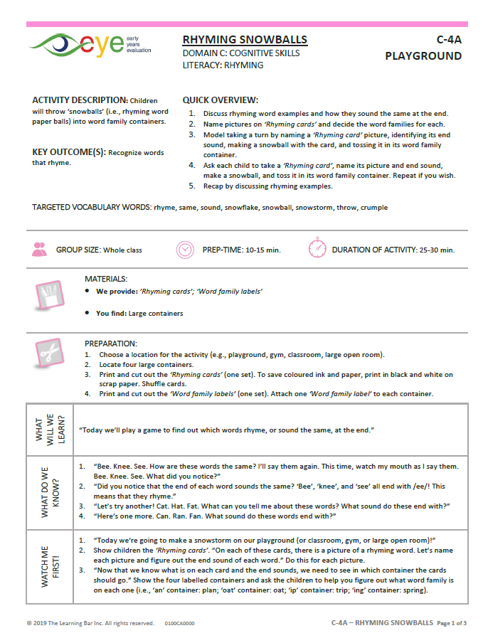
EYE-100 Domain-Strengthening Activities
This is an amazing resource we’ve developed to help strengthen the children’s skills.
Notes:
This is an amazing resource we’ve developed to help strengthen the children’s skills.
These activities were developed by an educator with over 20 years of experience, along with a speech and language pathologist. The activities were then vetted by an occupational therapist and a physical therapist.
Many of the activities were tested by over 350 teachers like you; they provided feedback so we could make them even better!

Slide 11
EYE-100 Domain-Strengthening Activities
Feelings
Sports
The activities are fun, engaging and easy to use.
Each set of five activities has a theme.
Seasons
Community
Food
Daily Routines
Clothing
Nature
Drama
Notes:
The activities are fun, engaging and easy to use.
Each set of five activities has a theme.
Although the activities are meant to strengthen skills across all domains, they primarily focus on:
Cognitive Skills (one literacy and one numeracy)
Language and Communication (one receptive and one expressive)
Inquiry Skills / STEAM (science, technology, engineering, arts, and math)

Slide 12
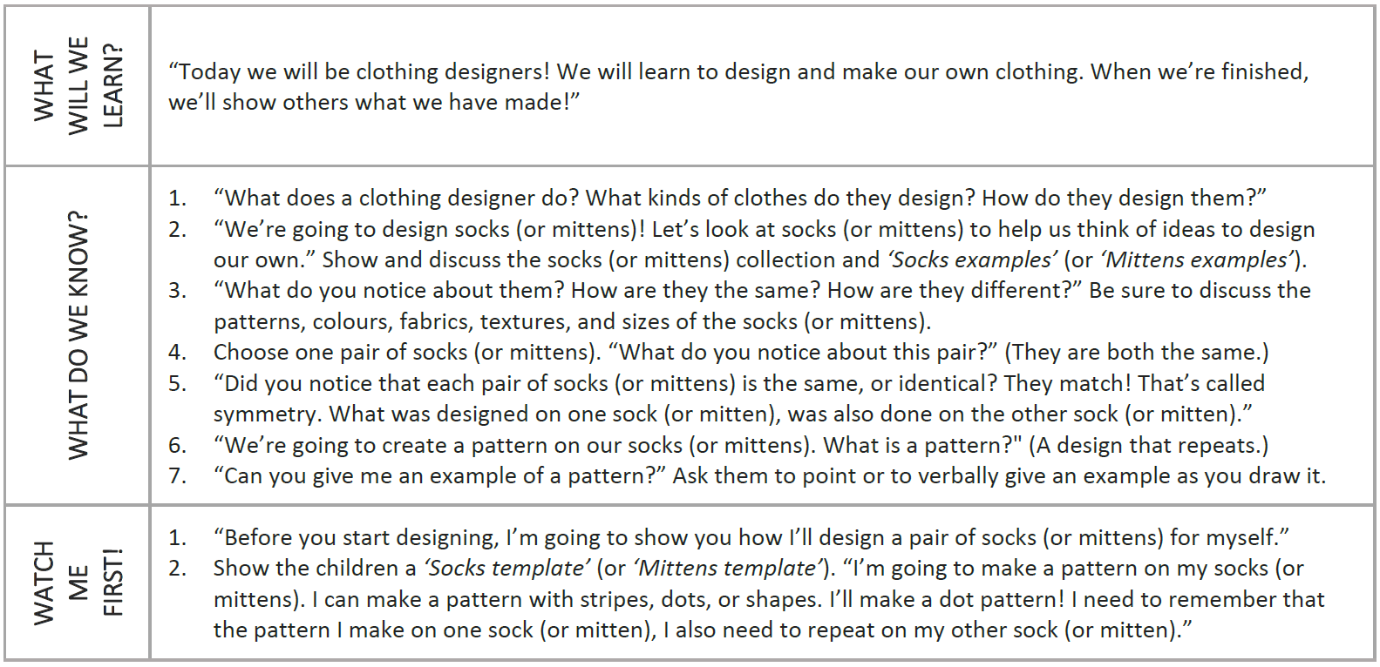

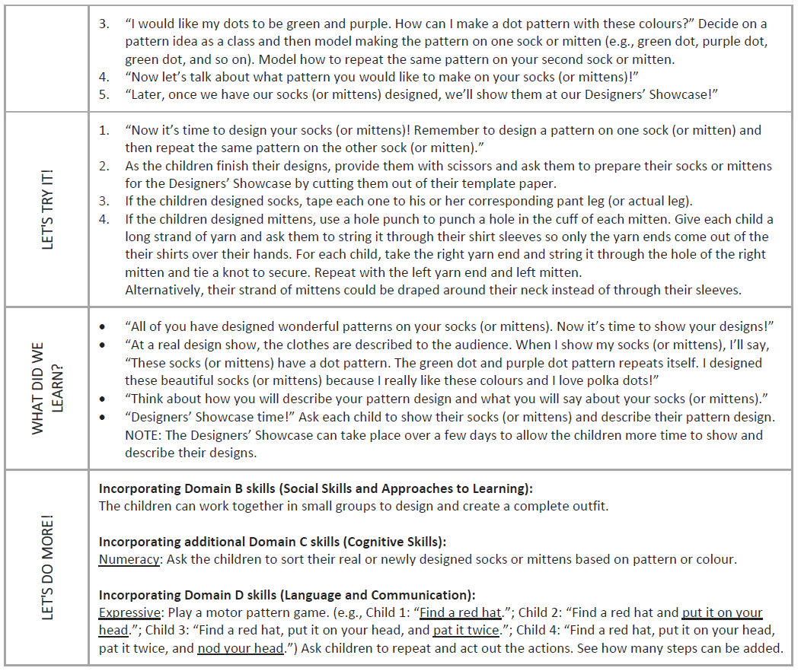
Active teaching approach
  The activities use an active teaching approach that combines high-yield teaching strategies such as cooperative learning and questioning.
  Every activity goes through a series of steps.
Notes:
The activities use an active teaching approach that combines high-yield teaching strategies such as cooperative learning and questioning.
Every activity goes through each of these steps:
1 – What will we learn?
2 – What do we know?
3 – Watch me first!
4 – Let’s try it!
5 – What did we learn?
6 – Let’s do more!

Slide 13
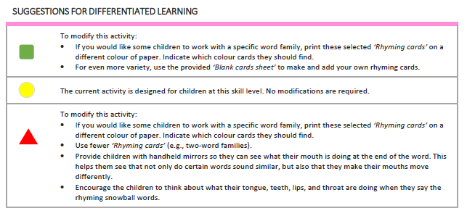
Differentiated learning
One of the great features of the EYE-100 activities is the differentiated learning section.
Notes:
One of the great features of the EYE 100 activities is the differentiated learning section. Each activity was created for children with Tier 2 learning needs. To allow for all children to partake in the same activity though, we’ve provided some modifications you can make to the activity to make it a bit more challenging for children with Tier 1 learning needs and other modifications for children with Tier 3 learning needs.

Slide 14
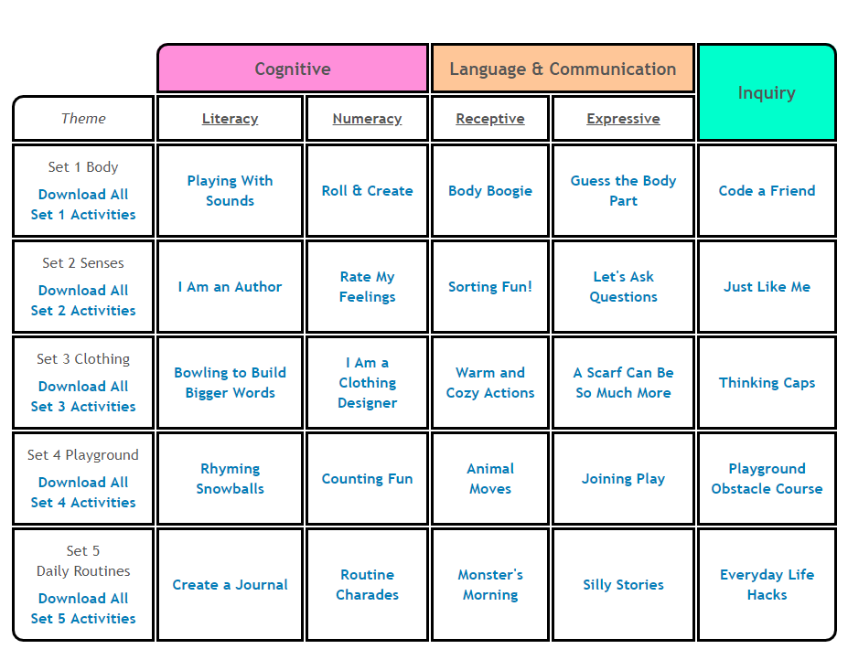
How to access the EYE-100 Activities
The EYE-100 activities are posted in the ‘Resources & Help’ section of our website.
Notes:
The EYE 100 activities are posted in the ‘Resources & Help’ section of our website.
They’re organized by theme, as well as by focus (for example, Cognitive Skills) and sub-focus ( numeracy for example).

Slide 15
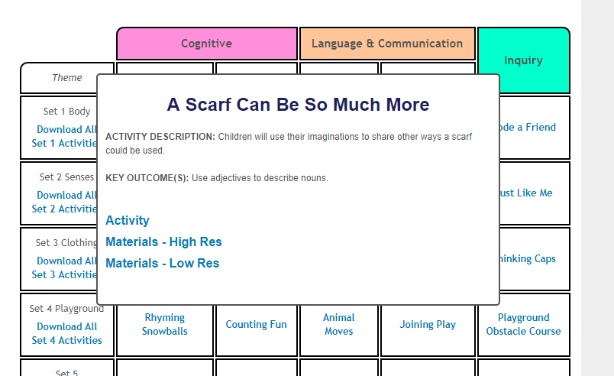
How to download the EYE-100 Activities
Once you click on an activity, you get a short description of it, as well as its key outcomes.
How to access the EYE-100 Activities
Notes:
Once you click on an activity, you get a short description of it, as well as its key outcomes. Just below, you can download the activity and the materials either in high or low resolution. We’ve included all the printable materials, so you don’t have to create them yourself!

Slide 16
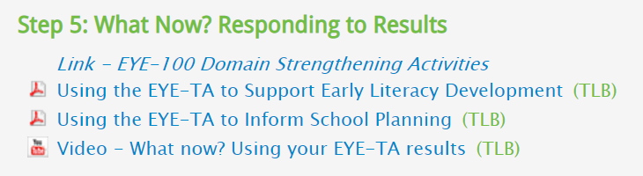
Resources
We have other resources available online in our ‘Resource & Help’ section to help you respond to the results, including a link to the EYE-100 activities.
Notes:
We have other resources available online in our ‘Resource & Help’ section to help you respond to the results, including a link to the EYE 100 activities.

Slide 17


Thank You!
Any questions?
eye-support@thelearningbar.com
1 877 840 2424

