Slide 1

Sharing reports with multiple stakeholders
Notes:
Welcome!

Slide 2
What will you learn?
Steps for developing a plan for sharing results with your school’s multidisciplinary team
Determining strategies for sharing results with families
Identifying available resources for teachers and families
Notes:
Our intent today is for you to easily navigate the process of sharing results within your multidisciplinary team and with families.
Our goals for today’s session include:
-Developing a plan for sharing results with your school’s multidisciplinary team
-Determining strategies for sharing results with families
-As well as identifying our available resources to facilitate the process.

Slide 3
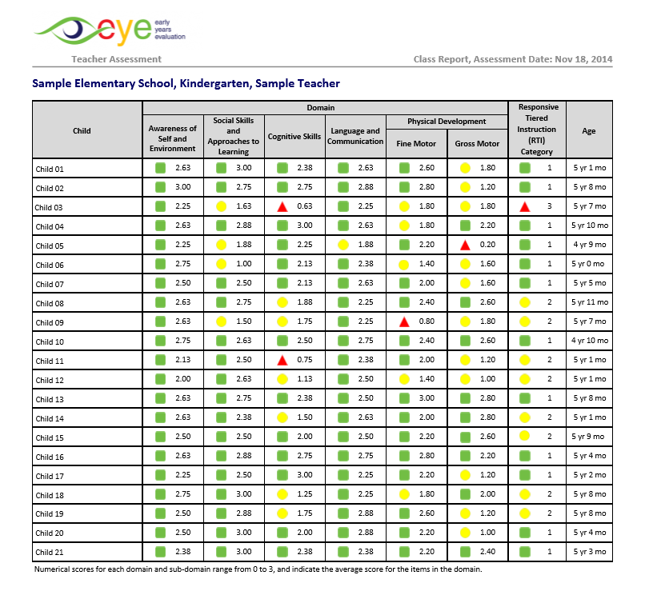
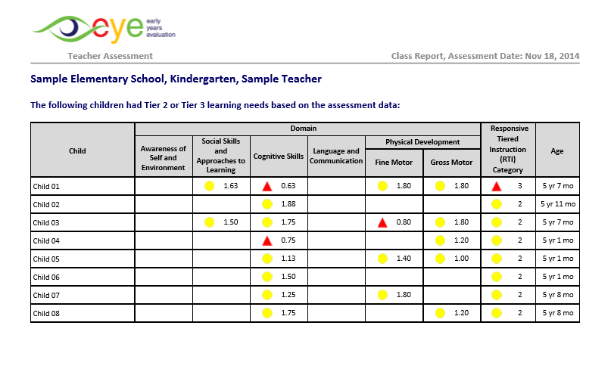
Sharing the reports with your multidisciplinary team
The EYE-TA Class Reports provide an overview of the composition of your classroom.
You and your multidisciplinary team can see the strengths as well as the domains where the children would benefit from additional experiences.
The information helps create individualized support plans for children.
Notes:
The EYE-TA Class Reports provide an overview of the composition of your classroom.
You and your multidisciplinary team can see the strengths as well as the domains where the children would benefit from additional experiences.
The information helps create individualized support plans for children.

Slide 4
Sharing results with multidisciplinary teams
When sharing EYE-TA results with your multidisciplinary team and developing a collaborative action plan, there are several areas to consider.
Developing a collaborative action plan
Strengthening areas of concern
Setting goals and tracking progress
Accessing specialists
Reviewing the data
Notes:
When sharing EYE-TA results with your multidisciplinary team and developing a collaborative action plan, there are several areas to consider.

Slide 5
Sharing results with multidisciplinary teams
Strengthening areas of concern
Setting goals and tracking progress
Accessing specialists
Reviewing the data
Use the data to identify the child’s areas of strengths and need; this will be helpful as you are planning interventions. Prepare talking points based on the child’s EYE results and gather examples of their learning and development to share with the team.
Developing a collaborative action plan
Notes:
Reviewing the data
Use the data from the EYE reports to identify the child’s areas of strengths and need; this will be helpful as you are planning interventions. Prepare talking points based on the child’s EYE results and gather examples of their learning and development to share with the team.

Slide 6
Sharing results with multidisciplinary teams
Developing a collaborative action plan
Strengthening areas of concern
Based on your interpretation of results found within the EYE-TA Class Reports and Individual Child Reports, plan responses to the data. This can be done at the individual and class levels.
Setting goals and tracking progress
Accessing specialists
Reviewing the
data
Notes:
Strengthening areas of concern
Based on your interpretation of results found within the EYE-TA Class Reports and Individual Child Reports, plan responses to the data. This can be done at the individual and class level.

Slide 7
Sharing results with multidisciplinary teams
Developing a collaborative action plan
Strengthening areas of concern
Setting goals and tracking progress
To consider:
What goals are realistic for the class or for specific children in the class?
How will you track progress?
What resources are available in your school?
Accessing specialists
Reviewing the
data
Notes:
Setting goals and tracking progress
To consider:
What goals are realistic for the class or for specific children in the class?
How will you track progress?
What resources are available in your school?

Slide 8
Sharing results with multidisciplinary teams
Developing a collaborative action plan
Strengthening areas of concern
Setting goals and tracking progress
Accessing specialists
Consider the availability and access to specialists such as OTs, PTs, SLPs, or school psychologists and how they can support.
Reviewing the
data
Notes:
Accessing specialists
Consider the availability and access to specialists such as OTs, PTs, SLPs, or school psychologists and how they can support.

Slide 9
Collaborative Action Plan
The Action Plan should be reviewed regularly by you and your multidisciplinary team in order to track progress and set future learning goals.
Some questions to consider include:
What strategies have been working or not working?
Do adjustments need to be made to the Action Plan?
Should some areas of the Action Plan be prioritized?
Notes:
The Action Plan should be reviewed regularly by you and your multidisciplinary team in order to track progress and set future learning goals.
Some questions to consider include:
What strategies have been working or not working?
Do adjustments need to be made to the Action Plan?
Should some areas of the Action Plan be prioritized?

Slide 10
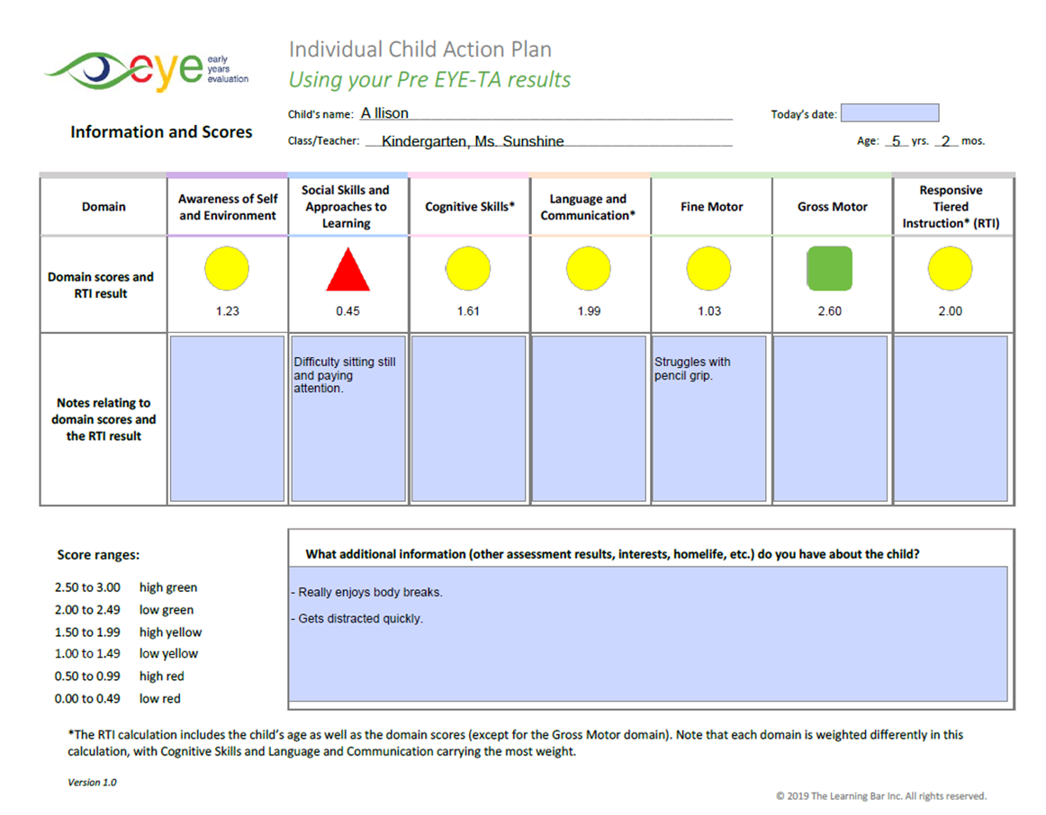
EYE Child Action Plan
We have developed EYE Child Action Plans that are available for every child in your class. This resource is available in the online data entry site after results have been generated.
The plans are pre-populated with the child’s demographic information and EYE results and give you the opportunity to record your domain-specific observations.
Notes:
We have developed EYE Child Action Plans that are available for every child in your class. This resource is available in the online data entry site after results have been generated.
The plans are pre-populated with the child’s demographic information and EYE results and give you the opportunity to record your domain-specific observations.

Slide 11
EYE Child Action Plan
They were developed to help you analyze the report results as well as to support you as you sit down with your school’s multidisciplinary team and create a plan for the most at-risk children.
.
Notes:
They were developed to help you analyze the report results as well as to support you as you sit down with your school’s multidisciplinary team and create a plan for the most at-risk children.

Slide 12
Child Action Plan (pre) – page 1
Demographic information about the child
Pre-populated domain and RTI scores
Space to record your domain and RTI comments
General comments about the child
Notes:
At the top of the action plan on page one, there is a section for the child’s demographic information. Next, we have the pre-populated domain and RTI scores, along with a space to record your domain and RTI comments. At the bottom of the page, we have a large section to record your general comments.

Slide 13
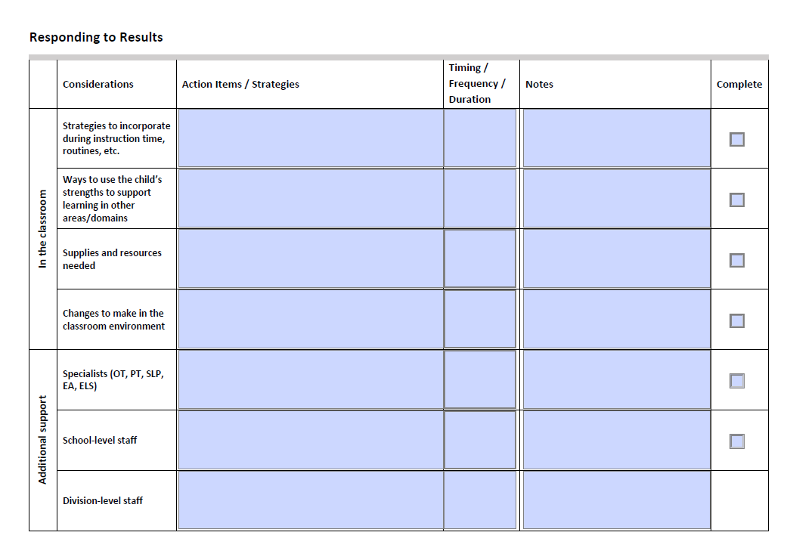
Child Action Plan (pre) – page 2
Topics to consider
What is the plan?
How often?
Who else can provide support?
What else is there to share?
Notes:
Page two is where you outline your plan for the child. What kind of support will you put in place? How often? Who else can provide support?

Slide 14
Sharing reports with families
Notes:
Let’s review how you can share reports with families.

Slide 15

Prepping for meetings with families
Prepare material for the meeting:
    EYE-TA Child Report
    Child’s learning portfolio and other material
    Strategies and activities for home
Prepare notes on the EYE-TA results
Prepare a plan to help the child throughout the year
Make sure to draw out strengths and needs, anticipate questions, and prepare possible responses
Arrange for language interpreters, as needed
Notes:
Prior to meeting with families to discuss the EYE report, there are preparations you can make. These include gathering materials and
Printing off a copy of the child’s EYE-TA Report
Gathering the child’s learning portfolio and other material
Printing off strategies and activities for home
Preparing notes on the EYE-TA results
Preparing a plan to help the child throughout the year
Reviewing reports to identify strengths and needs, anticipate questions, and prepare possible responses
Arranging for language interpreters, as needed

Slide 16
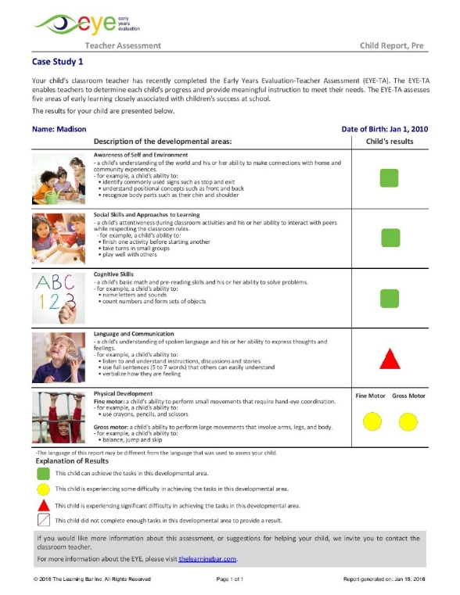
Five steps to sharing results with families
Step 1: Engage families by explaining the objective of the EYE-TA and the purpose of the meeting.
Step 2: Discuss the importance of each domain and the child’s current skill level for each.
Step 3: Celebrate areas of success for the child.
Step 4: Discuss opportunities for family involvement when it comes to domains to be strengthened.
Step 5: Discuss an Action Plan with the input from the family: ask about the child’s interests and offer ideas to support learning and development at home.
1 – Engage
3 – Celebrate
2 – Discuss
4 – Opportunities
5 – Action Plan
Notes:
Five steps to sharing results with families
Step 1: Engage families by explaining the objective of the EYE-TA and the purpose of the meeting.
Step 2: Discuss the importance of each domain and the child’s current skill level for each.
Step 3: Celebrate areas of success for the child.
Step 4: Discuss opportunities for family involvement when it comes to domains to be strengthened.
Step 5: Discuss an Action Plan with the input from the family. Ask about the child’s interests and offer ideas to support learning and development at home.

Slide 17
Resources
Notes:
Let’s review some of our resources.

Slide 18
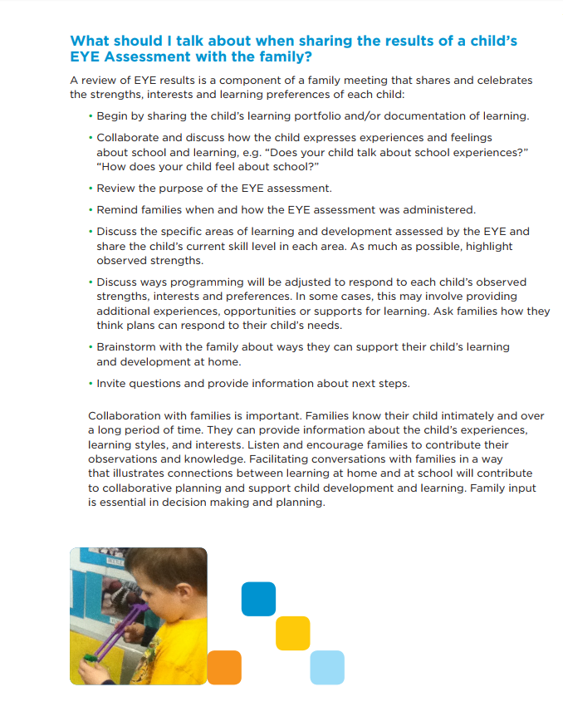
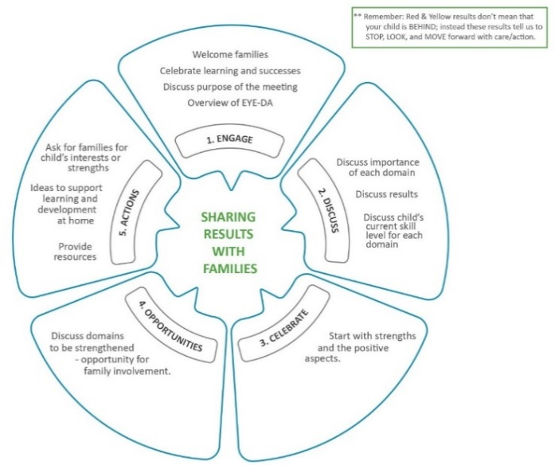
Resources available for teachers
In the ‘Resource & Help’ section of our website, various documents are available to guide team planning and prepping for meeting with families, including:
Tips for Sharing the EYE-Teacher Assessment Child Report Results with Families
A Guide for Teachers to Engage Families
Notes:
In the ‘Resource & Help’ section of our website, various documents are available to guide team planning and prepping for meeting with families, including:
Tips for Sharing the EYE-Teacher Assessment Child Report Results with Families and also A Guide for Teachers to Engage Families.

Slide 19
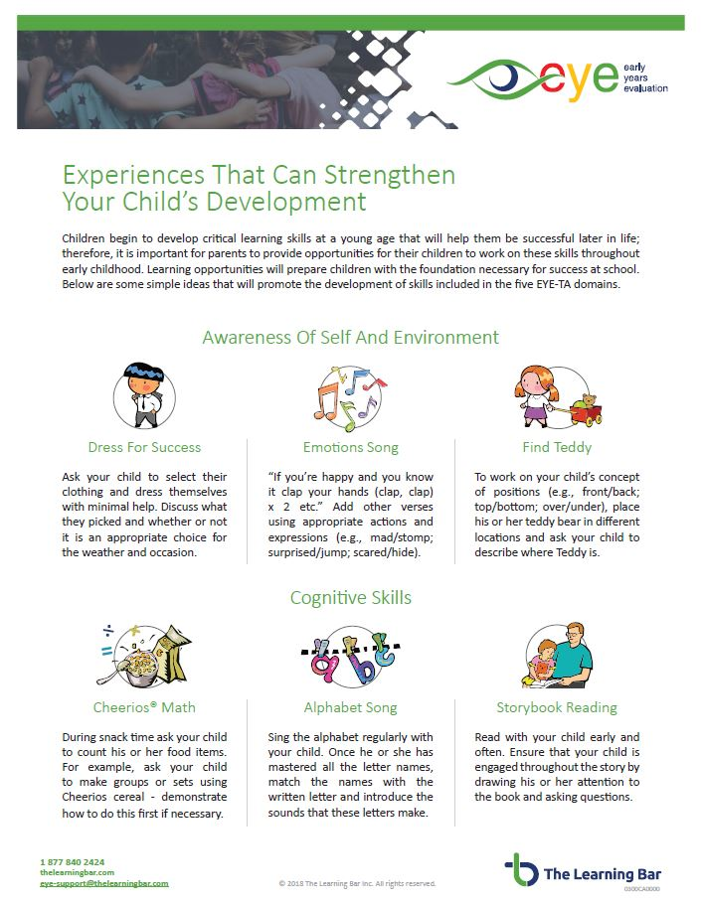
Resources available for families
There are also resources that teachers can share with families with activities to strengthen each domain.
Notes:
We also have resources that teachers can share with families with activities to strengthen each domain.

Slide 20

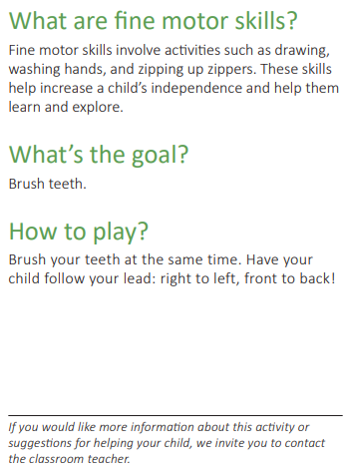
Resources available for families
Front
Back
Family Activity Cards
24 activity cards – 4 per domain.
4 per page – can be cut out and put on a ring.
Simple explanations of the skill, the goal, and the activity.
Notes:
The Family Activity Cards are another great resource that can be shared with families to help strengthen domains at home.
It includes 24 activity cards – 4 per domain. There are 4 per page and can be cut out and put on a ring.
There is a simple explanation of the skill, the goal, and the activity.

Slide 21

Thank You!
Any questions?
eye-support@thelearningbar.com
1 877 840 2424

