Slide 1


Family Information Session
Early Years Evaluation – Teacher Assessment (EYE-TA)
Notes:
Welcome to the Early Years Evaluation Family Information Session

Slide 2
Introduction

Slide 3
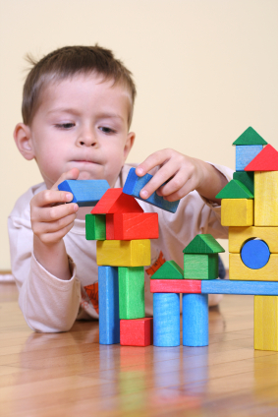
Children develop skills as they grow and learn.
These skills and abilities are the building blocks for their future.
For example….
Entering kindergarten with strong language skills can help children to become successful readers.
Notes:
Children develop skills as they grow and learn
These skills and abilities are the building blocks for their future
For example….
Entering kindergarten with strong language skills can help children to become successful readers

Slide 4
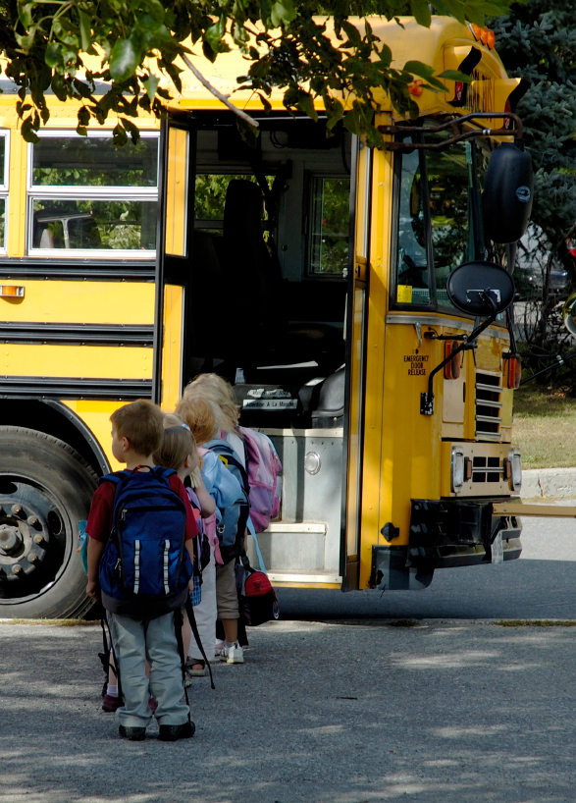
Most reading difficulties can be prevented with early identification, excellent classroom instruction, and appropriate support.
This is the premise on which the Early Years Evaluation – Teacher Assessment (EYE-TA) was created.
Notes:
Most reading difficulties can be prevented with early identification, excellent classroom instruction, and appropriate intervention.
This is the premise on which the Early Years Evaluation Teacher Assessment (EYE-TA) was created

Slide 5
What is the Early Years Evaluation – Teacher Assessment (EYE-TA)?

Slide 6

What is the EYE-TA?
The Early Years Evaluation – Teacher Assessment (EYE-TA) is a teacher observation assessment of kindergarten children’s skills.
Notes:
What is the EYE-TA? Well,
The Early Years Evaluation-Teacher Assessment (EYE-TA)
is a teacher observation assessment of children’s skills and abilities in early kindergarten

Slide 7
What does the EYE-TA assess?
The EYE-TA assesses the developmental strengths and areas requiring support for kindergarten children.
The EYE-TA assesses five key areas of early childhood development: Awareness of Self and Environment, Cognitive Skills, Language and Communication, Physical Development, Social Skills and Approaches to Learning.
The key areas are linked to children's readiness to learn at school.
1
2
3
4
5
Notes:
The EYE-TA assesses the developmental strengths and weaknesses of children at the start of school.
The EYE-TA assesses five key areas of early childhood development: Awareness of Self and Environment, Cognitive Skills, Language and Communication, Physical Development, and Social Skills and Approaches to Learning.
The domains are linked to children's readiness to learn at school.

Slide 8
1. Awareness of Self and Environment
A child's understanding of the world and his or her ability to make connections with home and community experiences.
This area refers to children’s ability to:
Think and talk about their world (e.g., identify opposites, concepts of time, functions of familiar objects);
Make connections with home and community experiences (e.g., a police officer keeps you safe).
1
2
3
4
5
Notes:
1. Awareness of Self and Environment
a child's understanding of the world and his or her ability to make connections with home and community experiences.
This area refers to children’s ability to:
Think and talk about their world (e.g., identify opposites, common animals, colours, and positions of objects)
Make connections with home and community experiences (e.g., a police officer keeps you safe)

Slide 9
2. Cognitive Skills
A child's basic math and pre-reading skills and his or her ability to solve problems.
This area refers to children’s ability to:
Recognize letters and their sounds;
Name numbers and count sets of objects;
Understand how books are manipulated.
1
2
3
4
5
Notes:
2. Cognitive Skills
a child's basic math and pre-reading skills and his or her ability to solve problems.
This area refers to children’s ability to:
Recognize words that rhyme
Name some letters and sounds
Name numbers and count sets of objects
Recognize same and different

Slide 10
3. Language and Communication
A child's understanding of spoken language and his or her ability to express thoughts and feelings.
This area refers to children’s ability to:
Listen to and understand instructions, discussions, and stories;
Use full sentences (i.e., five to seven words) to explain ideas and their feelings;
Predict what will happen next in a story.
1
2
3
4
5
Notes:
3. Language and Communication
a child's understanding of spoken language and his or her ability to express thoughts and feelings.
This area refers to children’s ability to:
Listen to and understand instructions, discussions,
and stories
Use full sentences (i.e., five to seven words) to explain ideas
Talk so people can easily understand

Slide 11
4. Physical Development
Fine motor
Small movements that require hand-eye coordination.
This area refers to children’s ability to:
Hold a pencil and draw a recognizable person;
Copying and colouring simple shapes
Gross motor
Large movements that involve arms, legs, and body.
This area refers to children’s ability to:
Balance, jump and hop on one foot;
Run, kick and catch a soccer ball.
1
2
3
4
5
Notes:
4. Physical Development
Fine motor
Small movements that require hand-eye coordination.
This area refers to children’s ability to:
Using crayons, pencils, and scissors
Copying shapes, letters, and numbers
Gross motor
Large movements that involve arms, legs, and body
This area refers to children’s ability to:
Balance, jump and hop on one foot
Catch and throw, run, and skip

Slide 12
5. Social Skills and Approaches to Learning
Attentiveness, persistence and signs of social and emotional connectedness towards others.
This area refers to children’s ability to:
Shift from one learning activity to another;
Take turns, share, and show respect for others;
Stay focused on learning activities.
1
2
3
4
5
Notes:
5. Social Skills and Approaches to Learning
Attentiveness, persistence and signs of social and emotional connectedness towards others.
This area refers to children’s ability to:
Shift from one learning activity to another
Take turns, share, and show respect for others
Stay focused on learning activities

Slide 13
Early Years Evaluation – Teacher Assessment (EYE-TA)

Slide 14

EYE-TA
The EYE-TA provides teachers with a checklist they can use to keep track of their observations and informal assessments of children during regular classroom activities.
The EYE-TA is very non-intrusive as teachers observe daily tasks and play activities to complete the assessment.
Notes:
The EYE-TA provides teachers with a checklist they can use to keep track of their observations and informal assessments of children during regular classroom activities.
The EYE-TA is very non-intrusive as teachers can observe daily tasks, and play activities to complete the assessment

Slide 15
What is the EYE-TA used for?
The EYE is used to:
Assess areas of strength, and areas of difficulty;
Identify children who may need extra help;
Monitor learning gains during first years of school;
Provide a positive transition to school.
Notes:
What is the EYE-TA used for?
The EYE is used to:
Assess areas of strength, and areas of difficulty;
Identify children who may need extra help;
Monitor learning gains during first years of school;
Provide a positive transition to school;

Slide 16
What is the EYE-TA not used for?
The EYE identifies a child’s strengths and areas which could benefit from further instruction.
The EYE-TA it is not:
a test to be passed or failed;
used to label children;
a diagnostic tool to identify specific learning disabilities.
Notes:
The EYE is not:
a test to be passed or failed;
used to label children;
a diagnostic tool to identify specific learning disabilities.

Slide 17
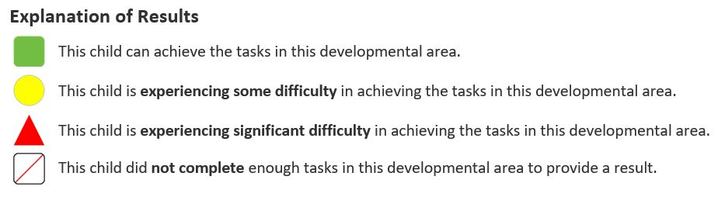
Child Results
After the EYE-TA is complete, families will be informed of the results for their child.
Results are presented using three colour-coded shapes as described below:
Notes:
After the EYE is complete, families will receive a copy of the results for their child.
Results are presented using three colour-coded shapes as described below:
Green for Appropriate development
Yellow for Experiencing some difficulty
Red for Experiencing significant difficulty
And Not complete indicates that the child did not complete enough items in the domain to generate a result.

Slide 18
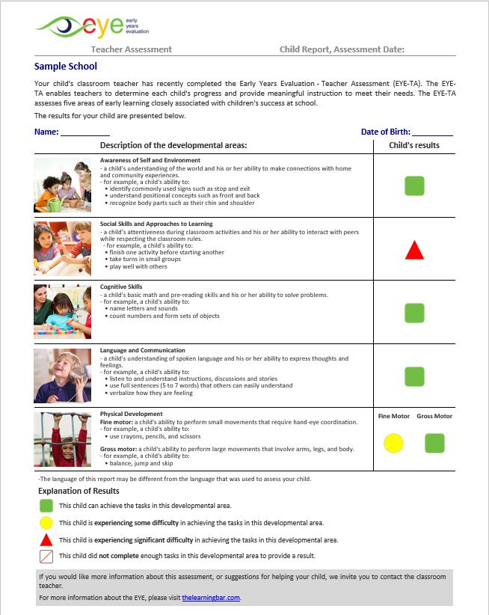
EYE-TA Child Report
This report lists each of the developmental areas, along with examples describing each area, and a colour-coded shape showing the child’s results.
Notes:
Reporting from the EYE-TA includes a child report that outlines the developmental areas and uses colour-coded shapes to illustrate the child’s results. This report lists each of the developmental areas described above, along with examples describing each area, and a color coded shape illustrating the child’s results Results are reported for each of the five domains. Results for physical development are split into Fine and Gross Motor squares.

Slide 19



Results can be used to:
Identify students who need extra support.
Provide guidance and assistance to students.
Inform & involve families in meaningful ways.
Notes:
After the EYE is complete, Results can be used to identify children who need extra support, provide guidance and assistance to children, involve families in meaningful ways.

Slide 20
Examples of Extra Support
Children work in small groups with more attention and focus for a part of the school day;
Referral to specialist (i.e., SLP, OT, PT, etc.) for further assessment and targeted interventions.
Notes:
If a child needs extra instructional support, there are many approaches that can be taken. Some examples of Instructional Support include:
Children work in small groups with more attention and focus for a part of the school day;
Referral to specialist (i.e., SLP, OT, PT, etc.) for further assessment and targeted interventions

Slide 21

Thank You!
Any questions?
Name First Last
NAME@thelearningbar.com
506 458 9311 ext 0000
1 877 840 2424
Notes:
Thank you so much for your time and attention today – we hope you enjoyed this presentation about the Early Years Evaluation. If you have any further questions, please email the appropriate contact on this final slide.

