Slide 1

Understanding your Early Years Evaluation – Teacher Assessment (EYE-TA) reports
Notes:
Welcome!

Slide 2
What will you learn?
Understand what the EYE-TA results mean
Review the EYE-TA Child Report
Understand the domain-level results as well as the RTI scores
Identify available resources
Answer Frequently Asked Questions
Notes:
Our intent today is for you to walk away with a thorough understanding of the EYE-TA reports.
Our goals for today’s session include:
-Understanding what the EYE-TA results mean
-Reviewing the EYE-TA Child Report
-Understanding the domain-level results as well as the RTI scores
-Identifying available resources
-Answer Frequently Asked Questions

Slide 3

What do the results really mean?
The EYE-TA items represent the developmental skills children will need when they begin Grade 1.
Notes:
The EYE-TA items represent the developmental skills children will need when they begin Grade 1.

Slide 4

What do the results really mean?
The results tell us:
The child’s current skill level today and where you can take the child in the future.
Notes:
Remember that the EYE-TA is a snapshot in time. The EYE identifies a child’s strengths and areas in which he or she could benefit from further instruction.
The results indicate where a child is today and where we need to take the child in the future.

Slide 5
EYE-TA Child Report
Notes:
Now let’s take a look at the child report—

Slide 6
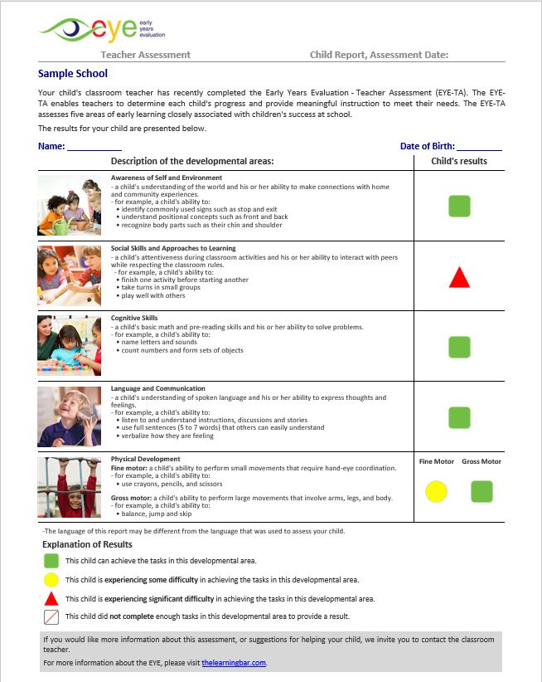
EYE-TA Child Report
Sometimes, teachers will review a child’s results and infer that -
green results are “good”
red results are “bad”
This is simply not the case.
Notes:
This is an example of the individual child report. This report is provided for every single child that is assessed – immediately. You will see here that there is a one-sentence explanation of each domain, along with a few examples from each domain (the green arrow). The explanation of the results is just down at the bottom here (the blue arrow) – and the child’s results are just to the right (the orange arrow). While many assessments provide lengthily, in-depth - and at times complicated results– the EYE is remarkable in its simplicity.
The individual report is presented in such a way that family members– across multiple literacy levels- will have an understanding of their child’s strengths and areas where their child would benefit from additional experiences.

Slide 7
EYE-TA Child Report
Results on the individual child report = domain results
Provides educators and families with leading indicators
Helps guide support, improve teacher practices, and identify issues
Notes:
The results you see on the individual child report are the same as the child’s domain scores found on the class report.
EYE-TA individual child report results provide leading indicators of children’s developmental strengths and areas for growth at the start of the school year.
Individual reports provide a current, real-time analysis of each child’s development to help guide support, improve teacher practices, and identify issues that are relevant to an individual child’s success at school.

Slide 8
EYE-TA Class Report- domain level results
Notes:
Now let’s take a look at the class report in a little more detail—

Slide 9
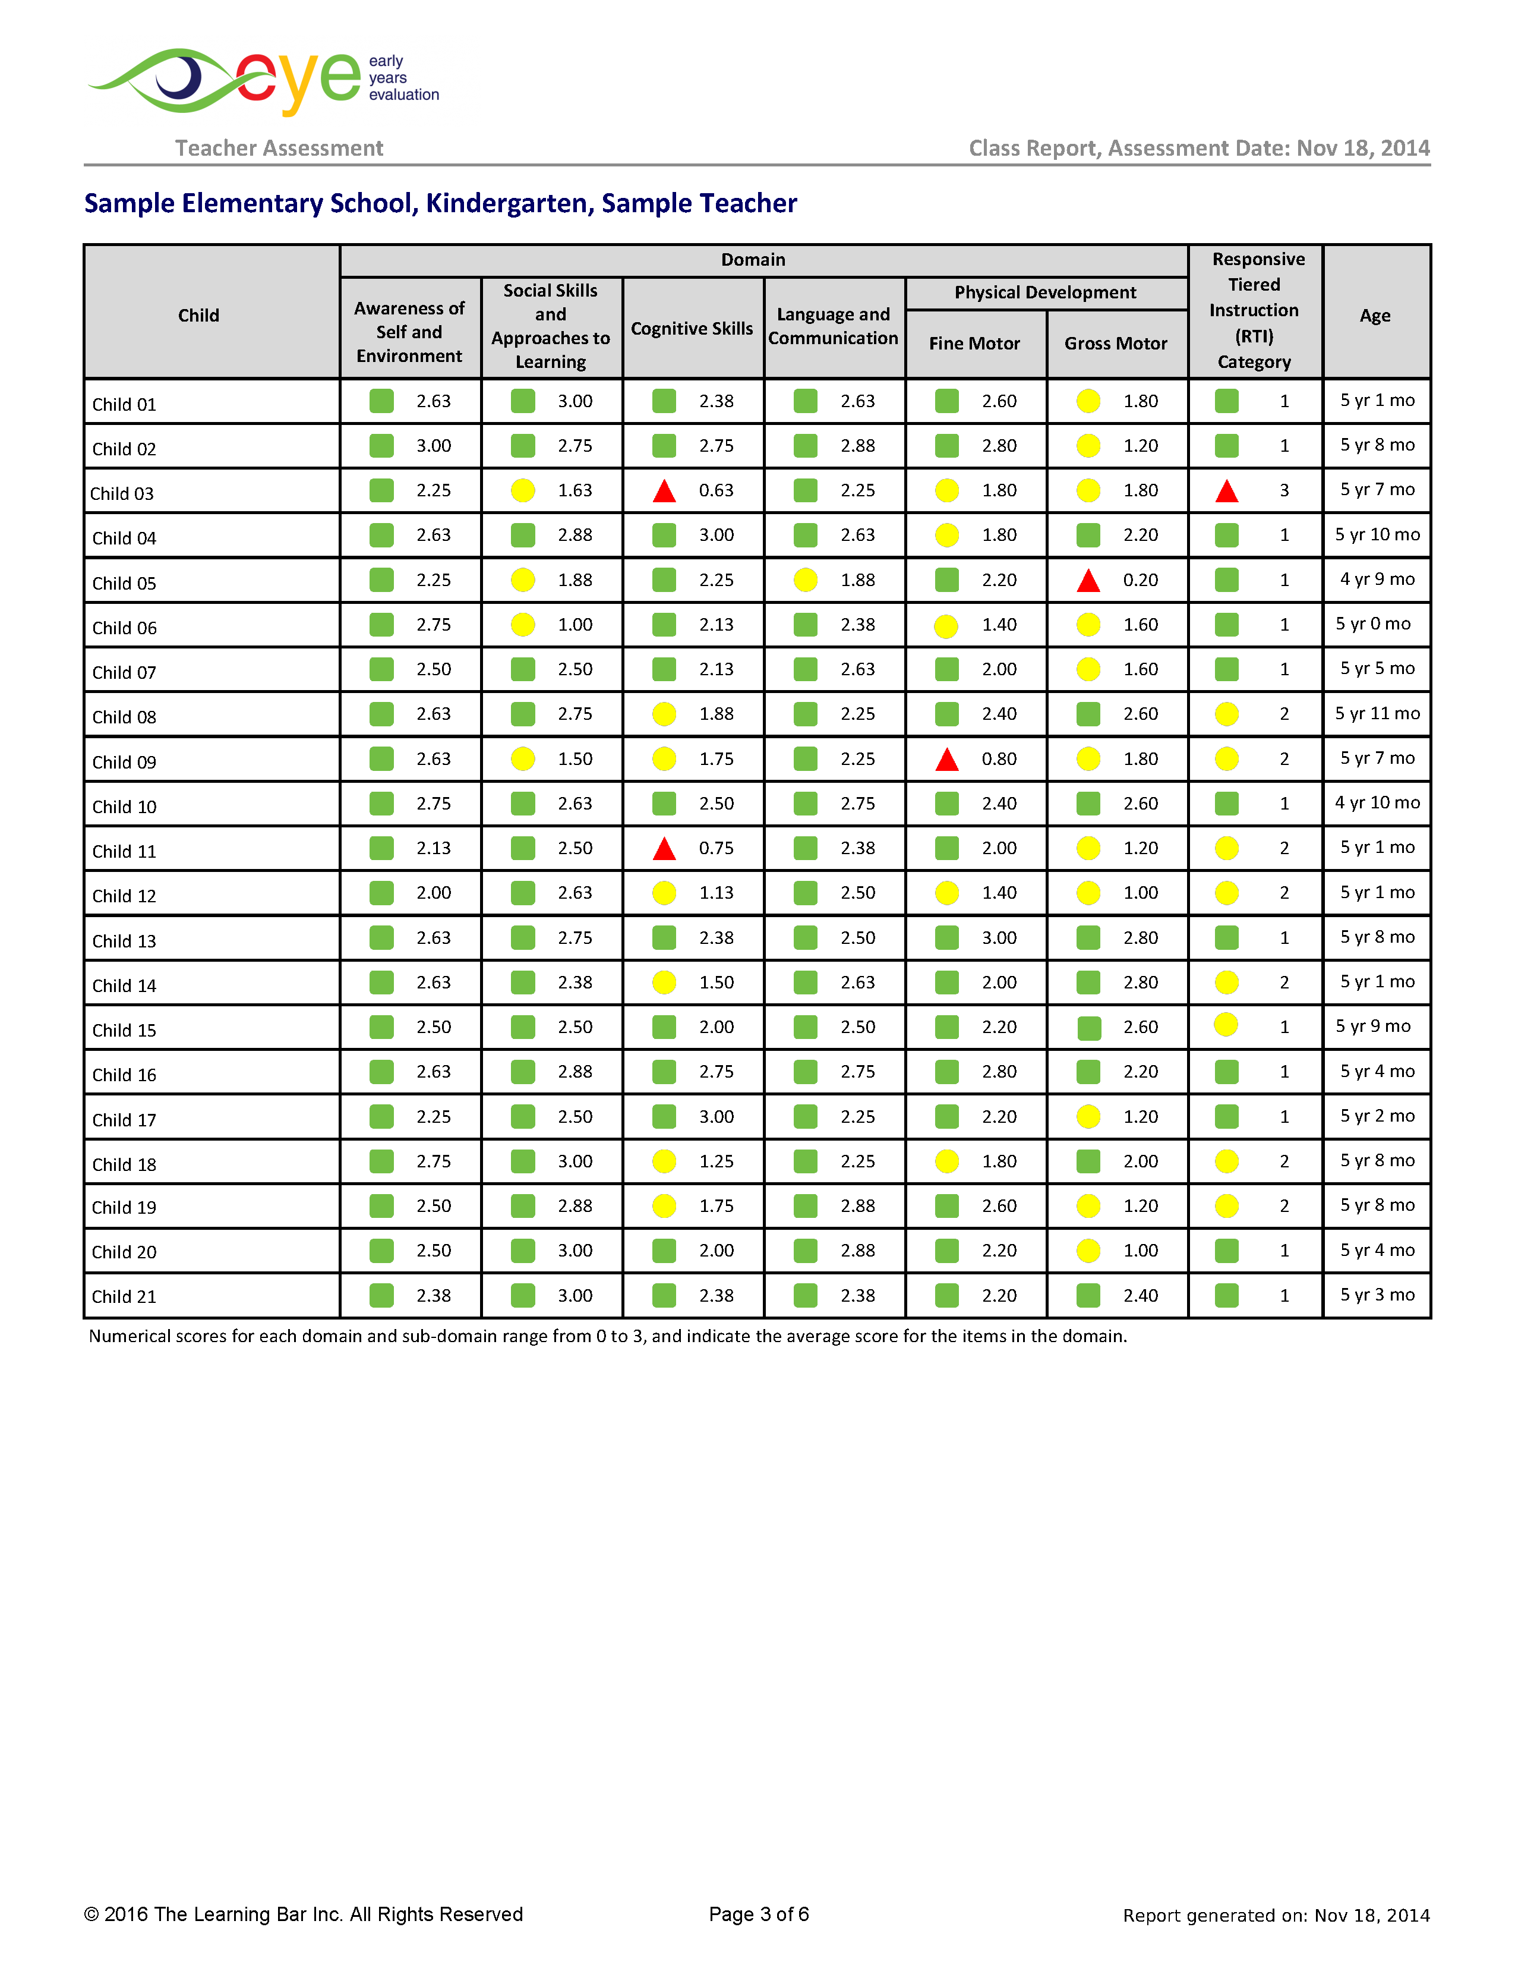
Notes:
Individual scores are provided for each child in your class- results are depicted in two ways: [CLICK]
Numbers: scores ranging between 0-3 [CLICK]
Colour (green, yellow or red)

Slide 10
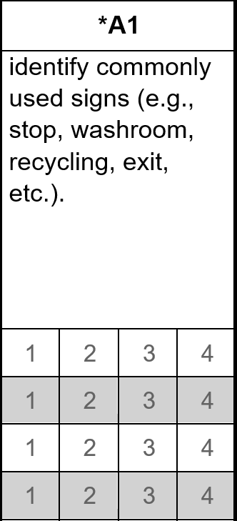
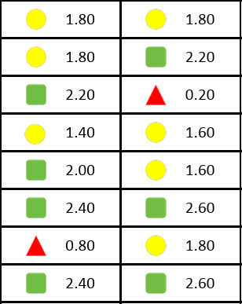

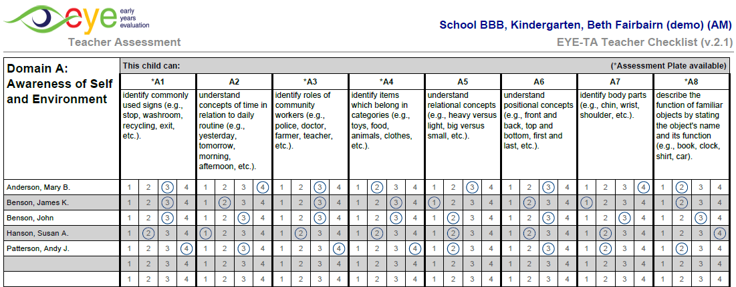
Domain average scores
Add scores, divide by 8 = average score
THEN: Rescale 0-3
Notes:
So, what do these numbers actually mean? [CLICK]
As children are assessed on each domain, items are scored on a scale of 1-4 [CLICK]
We take all the scores for the items for each domain and divide them by 8 to get an average score, and then that score is rescaled from 1-4 to 0-3 [CLICK]
On the class report, you’ll see that all scores range from 0-3

Slide 11
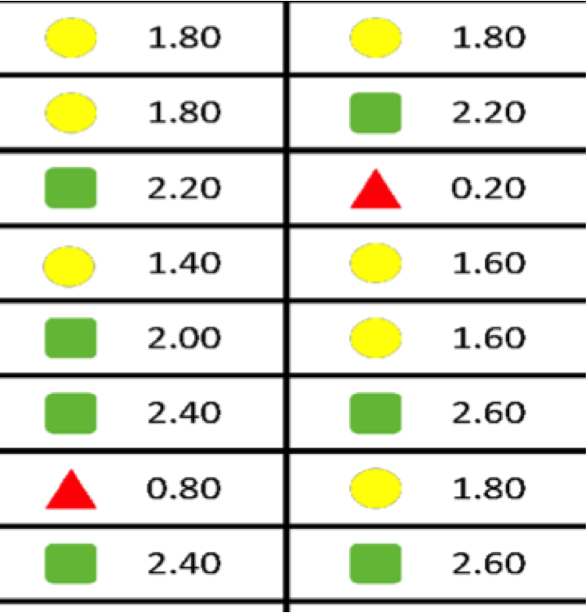
Domain results and age of the child
A child’s age does not have an impact on their Domain Results.
Notes:
It’s important to note that a child’s age does not have an impact on their Domain Results- as I mentioned, the domain results are simply an average of a child’s item-level scores.

Slide 12
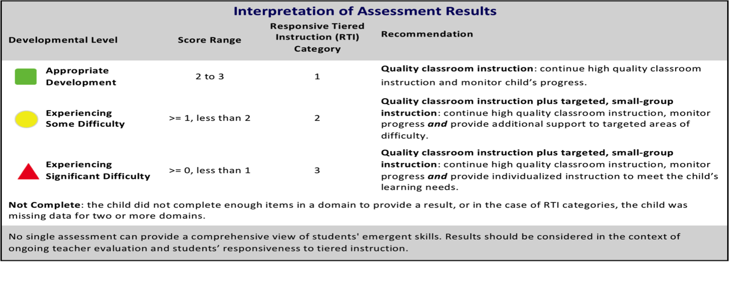
Domain results
Notes:
This table is taken from page 2 of the class report; it shows what each score range means in relation to a child’s current skill level in that particular domain [CLICK]
So, we see that a score between 2 and 3 is a green [CLICK]
A score that is greater than 1 but less than 2 is a yellow [CLICK]
And a score greater than 0 but less than 1 is a red

Slide 13
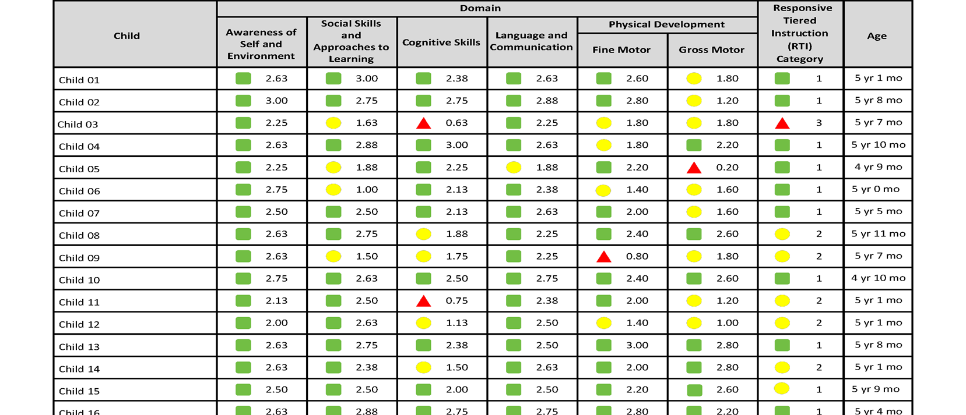

Using the Class Report
Notes:
How can viewing EYE-TA results from a ‘whole-class’ perspective help drive instruction and support children’s learning?
You can see if your class has a particular area of strength or area of need. For example, on this class report we see that ‘Awareness of Self and the Environment’ is a strong domain.
For this areas of strength, you can plan enriching experiences for your children.
For areas of need, such as the ‘Gross Motor’ and ‘Cognitive’ domains, you can incorporate activities into your everyday lessons to help bolster these weaker domains.

Slide 14
Distinguishing between and within colour coded EYE-TA results

Slide 15

Distinguishing between and within colour results
When viewing children’s domain-level scores, take note of the differences between colours as well as the difference within colours.
Notes:
Knowing how scores are calculated allows us to not only distinguish between colours, but now we can also distinguish within colours.

Slide 16
EYE-TA domain level results provide teachers with information about which children are in need of support, and also how much intervention is needed.
Notes:
Looking once again at the class report, let’s break down these children's scores:
Child 1 has a ‘high yellow’ score- 1.8 (almost a green 2) in the Gross Motor domain
Whereas child 2 has a ‘low yellow’ score- 1.2
This could mean that with maturation and good teaching, Child 1 will likely progress to a green result over time.
However, Child 2 with a low yellow score is on the cusp of receiving a ‘red’ result, therefore, this child may need further support and experiences to strengthen their skills in this particular domain. [Click]
For this reason, it is important to examine the scores of each domain, as these results provide more detailed information concerning which children are in need of support, and potentially HOW MUCH support or intervention is needed.

Slide 17
Calculating and understanding the RTI

Slide 18
Understanding Responsive Tiered Instruction (RTI)
A leading indication of children’s skills as they begin kindergarten and progress to later grades.
Identifies vulnerable children at the beginning of the school year- children who are at risk for later literacy difficulties.
The probability of a child becoming a successful reader by the end of Grade 2.
RTI
Notes:
What is RTI?
A formula that estimates the probability of a child becoming a successful reader by the end of Grade 2.
The RTI is used as a leading indicator of children’s skills as they begin Kindergarten and progress to later grades.
Identifies vulnerable children at the beginning of the school year- children who are at risk for later literacy difficulties. It calls for a tiered approach comprised of continuous assessment of children’s progress in the regular classroom setting and providing support to children who have learning difficulties or behavioural challenges.

Slide 19
Calculating the RTI
Notes:
When thinking of HOW we calculate the RTI, think of it like a recipe:
1 cup of cognitive skills
¾ a cup of language and communication
¼ a cup of fine motor skills
0.2 of awareness of self and environment
0.15 of social skills
Gross motor skills are not included in calculating RTI, not because this domain isn’t important, but because our research shows that it isn’t predictive of later literacy levels. It is important to note that the age of the child is factored into the RTI calculation. This is a key difference between RTI scores and domain level scores- age does impact the result of the RTI score, while it has no impact on the domain score.

Slide 20
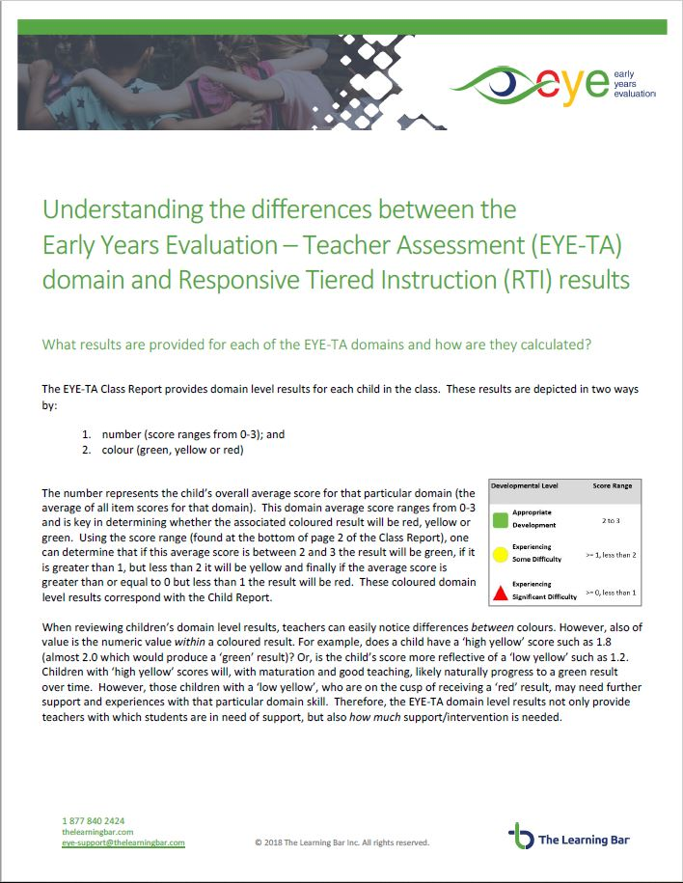
Resources
Understanding the differences between the EYE-TA domain and RTI results
Notes:
We have a great resource available ‘Understanding the differences between the EYE-TA domain and RTI results’ that provides some detailed information about the domain and RTI results.

Slide 21
Frequently asked questions
Notes:
Let’s review some frequently asked questions.

Slide 22

Is it possible for a child to receive green results across all domains and still end up with an RTI result of Tier 2?
Notes:
Is it possible for a child to receive green results across all domains and still end up with an RTI result of Tier 2?

Slide 23
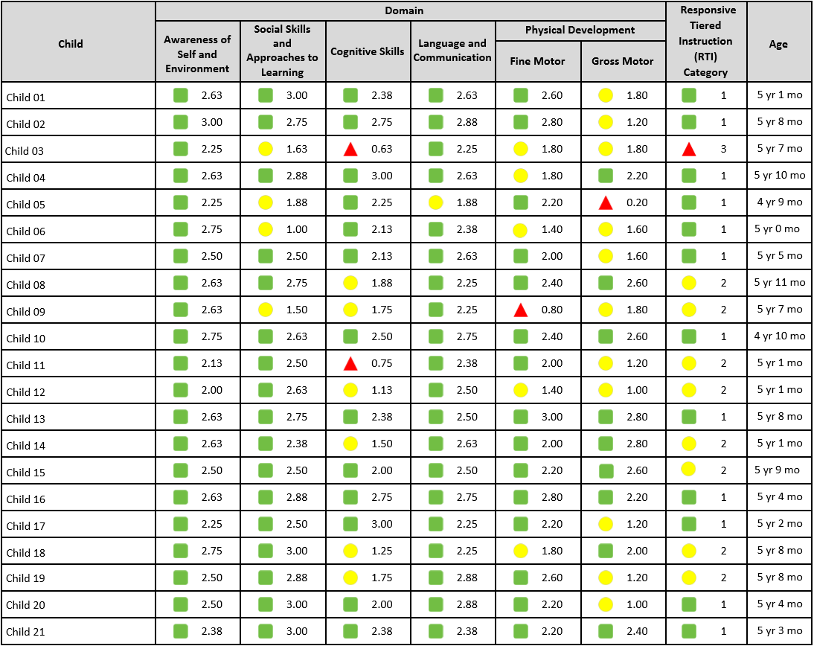
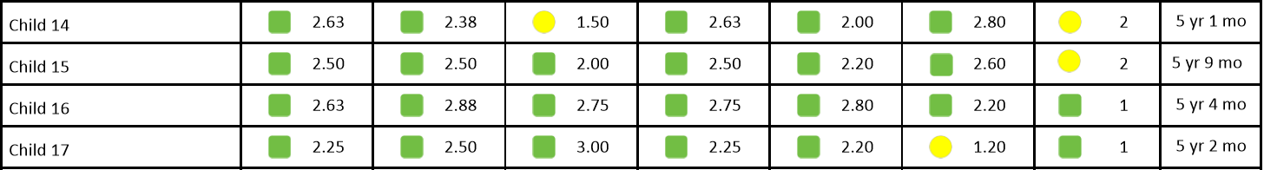
Notes:
Unlike the domain scores, the RTI does take the child’s age into account [CLICK]
Let’s look at Child 14 and 15 in a little more detail [CLICK]
Child 14 scored relatively well also, with one domain in the ‘yellow’ range and other domains sitting within the ‘high green’ range, but their RTI is tier 2 (yellow). Why could this be?
Thinking about the ‘RTI recipe’- the reason for this child scoring a yellow RTI is because their domain score for the cognitive skills domain is a ‘low yellow’ and cognition is the main ingredient when calculating the RTI.
[CLICK]
Child 15 has ‘green’ scores in all of the domains, however, their overall RTI was classed as tier 2 (yellow)— now why could this be?
The child has scored relatively well in each domain, but because they are 5 years 9 months (nearly 6), their RTI is calculated as tier 2.
This would indicate to a teacher that perhaps this child is progressing relatively well, none the less they will likely require some focused time/resources to ensure they continue developing the appropriate skills for grade 1.

Slide 24
Notes:
Is it possible for a child to receive domain results that are red and yellow and still end up with an EYE-RTI result of Tier 1 (green)?
[CLICK]
Occasionally cases arise where children have domain results that are yellow and may even have a red domain result but are indicated as having EYE-RTI Tier 1 results. One must again take into account the child’s age and the results for heavily weighted domains. Therefore, a younger child who receives yellow or red results in domains that are not heavily weighted (such as Socials Skills and Approaches to Learning), and whose results in heavily weighted domains (such as Cognitive Skills) are green, may end up being indicated as having Tier 1 learning needs.

Slide 25

Thank You!
Any questions?
eye-support@thelearningbar.com
506 458 9311
1 877 840 2424

