Slide 1
Entering EYE-TA results into the online system
Notes:
Welcome to the Early Years Evaluation – Teacher Assessment or EYE-TA.
Let’s look at entering EYE-TA results into the online system

Slide 2
What will you learn?
How to access and navigate the online data entry site​
Features of the online data entry site​
How to enter your scores​
Insight into the additional available features
Notes:
What will you learn in today’s session?
How to access and navigate the online data entry site​
Features of the online data entry site​
How to enter your scores​
Insight into the additional available features

Slide 3
Getting started
Once you’ve started your observations and recording the children’s scores, you can begin entering results into our online system if your session has started.
You will receive an email from our EYE support team once your EYE-TA session is active.
Notes:
Once you’ve started your observations and recording the children’s scores, you can begin entering results into our online system if your session has started.
You will receive an email from our EYE support team once your EYE-TA session is active.

Slide 4
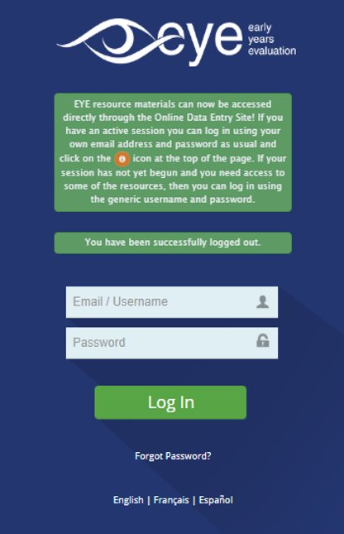
Getting started
Enter your username (typically your work email address) and the unique password provided by our support team. Once in the system, you will be prompted to change your password for security reasons, if it’s your first time logging in.
Notes:
Enter your username (typically your work email address) and the unique password provided by our support team. Once in the system, you will be prompted to change your password for security reasons, if it’s your first time logging in.

Slide 5
Getting started
Forgot your password?
Simply click on the ‘Forgot Password?’ link to request a password reset.
Notes:
Forgot your password?
Simply click on the ‘Forgot Password?’ link to request a password reset.

Slide 6
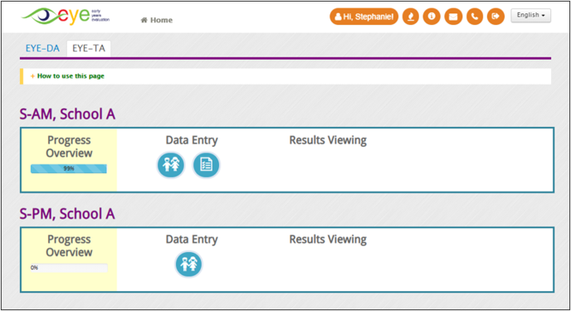
Getting started
After logging in, you can access the wide variety of features that our online data entry site has to offer. These features allow you to enter scores, edit children’s demographic information, view reports, and access our resources.
Notes:
After logging in, you can access the wide variety of features that our online data entry site has to offer. These features allow you to enter scores, edit children’s demographic information, view reports, and access our resources.

Slide 7
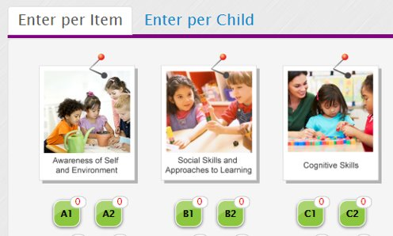
Additional features
Entering scores per child ​
It is possible to enter your EYE-TA scores on a per-child basis instead of a per-item basis. This method should help save time if you only need to enter data for a small number of children (for example, if a new child moves into the class after you've entered data for all the other children).
Notes:
Entering scores per child ​
It is possible to enter your EYE-TA scores on a per-child basis instead of a per-item basis. This method should help save time if you only need to enter data for a small number of children (for example, if a new child moves into the class after you've entered data for all the other children).

Slide 8
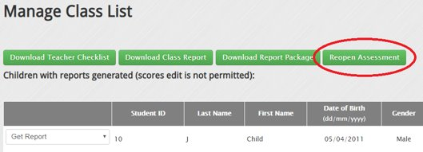
Additional features
Reopening the session to add additional children ​
As long as the data entry window is still open for your jurisdiction, you can ‘reopen’ a closed classroom where reports have already been generated and add new children to the assessment. Please note that this feature does not include the ability to reopen specific child records to change finalized scores.
Notes:
Reopening the session to add additional children ​
As long as the data entry window is still open for your jurisdiction, you can ‘reopen’ a closed classroom where reports have already been generated and add new children to the assessment. Please note that this feature does not include the ability to reopen specific child records to change finalized scores.

Slide 9
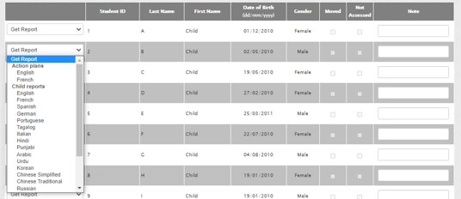
Additional features
Downloading EYE Child Reports in other languages​
Individual EYE Child Reports are available in over 20 languages. To download an EYE Child Report in another language, click the ‘Get Report’ drop-down menu and select the required language. EYE Action Plans containing pre-populated results are also available in this menu.
Notes:
Downloading EYE Child Reports in other languages​
Individual EYE Child Reports are available in over 20 languages. To download an EYE Child Report in another language, click the ‘Get Report’ drop-down menu and select the required language. EYE Action Plans containing pre-populated results are also available in this menu.

Slide 10
Data entry best practices
Once you’ve received an email from the EYE support team with your temporary password, log into the system to make sure everything is in order.​
Create a new password you’ll remember.​
Start by verifying and confirming your class list. However, up until you generate your reports, you can still edit the children’s information. You can also add additional children right up until the closing of your jurisdiction’s data assessment window, even if you’ve generated your reports already.​
Notes:
Once you’ve received an email from the EYE support team with your temporary password, log into the system to make sure everything is in order.​
Create a new password you’ll remember.​
Start by verifying and confirming your class list. However, up until you generate your reports, you can still edit the children’s information. You can also add additional children right up until the closing of your jurisdiction’s data assessment window, even if you’ve generated your reports already.​

Slide 11
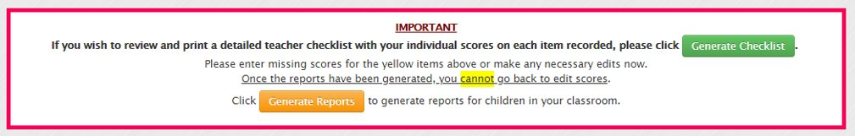
Data entry best practices
Print your Teacher Checklist so you can jot down scores. ​
Stay on top of your data entry. ​
Double-check your scores once everything is entered. ​
Make sure you click on ‘Generate Reports’ once you confirm that all the scores are correct.
Notes:
Print your Teacher Checklist so you can jot down scores. ​
Stay on top of your data entry. ​
Double-check your scores once everything is entered. ​
Make sure you click on ‘Generate Reports’ once you confirm that all the scores are correct.

Slide 12

Online data entry resources
Online Data Entry Guide
A step-by-step guide to assist you with entering your results online.​
There is also a section about data entry in the Teacher Implementation Guide (TIG).
Notes:
Online Data Entry Guide
A step-by-step guide to assist you with entering your results online.​
There is also a section about data entry in the Teacher Implementation Guide (TIG).

Slide 13


Thank You!
Any questions?
eye-support@thelearningbar.com
506 458 9311
1 877 840 2424

