Slide 1

Observing and recording Early Years Evaluation – Teacher Assessment (EYE-TA) skills
Notes:
Welcome to the Early Years Evaluation – Teacher Assessment or EYE-TA.
Let’s look at the first step of the EYE-TA: observing and recording the skills of the children in your class.

Slide 2
What will you learn?
Understand what the EYE-TA is and how it works
Determine simple strategies for observing and recording data during your regular classroom routine
Identify available resources
Answer Frequently Asked Questions
Notes:
Today, our intent is for you to walk away with the ability to easily evaluate the EYE-TA within the context of your existing classroom activities and routines.
Our goals for today’s session include CLICK
-Understanding what the EYE-TA is and how it works. CLICK
-Determining the strategies that work best for you when observing your children. CLICK
-Review our available resources to easily integrate the TA into your regular classroom routine. CLICK
-Answering the most Frequently Asked Questions about the TA.

Slide 3
What is the EYE-TA?
  A tool to see where children are today and to help them build their skills for tomorrow.
  It is not:
  a test to be passed or failed
  a means to label children
  a diagnostic tool to identify learning problems
  about what you have taught the children
Notes:
What is the purpose of the EYE-TA?
CLICK The EYE provides a way for us to determine where a child is today and what supports can be put in place to best help them achieve their fullest potential. CLICK
It is important to note that the EYE-TA is not a test to be passed or failed, CLICK. It is not to be used to label children CLICK or to identify specific learning problems CLICK and it is not about what you as a teacher have taught the children. CLICK, CLICK

Slide 4

How does the EYE-TA
benefit you?
It identifies a child’s strengths and areas which could benefit from further instruction.
It informs individual planning and can be used to guide practice.
It provides results that can be easily shared with parents and multidisciplinary teams.
Notes:
How does the EYE-TA benefit you?
The TA allows you to easily identify a child’s strengths and areas which could benefit from further instruction.
TA results will help you create lessons tailored to children’s specific needs and can be used to guide teaching practice in the classroom.
Results can be used to engage parents and multidisciplinary teams, as well as help schools, allocate resources.

Slide 5
Simple observational strategies
Notes:
Let’s review some simple observational strategies that you can use to help collect your TA data.

Slide 6

The power of observation
Observation is an effective strategy for recording and documenting evidence of children's skills.
Notes:
The purpose of observation is to gain insight into how children think, learn, and make sense of their world.
It is an effective strategy for recording and documenting evidence of children's skills.
The EYE-TA was not created to directly align with any specific curriculum or curriculum outcomes. Rather, it provides an overall account of children’s development in kindergarten.

Slide 7
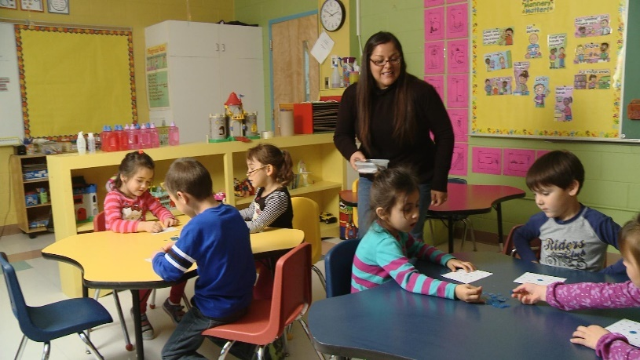

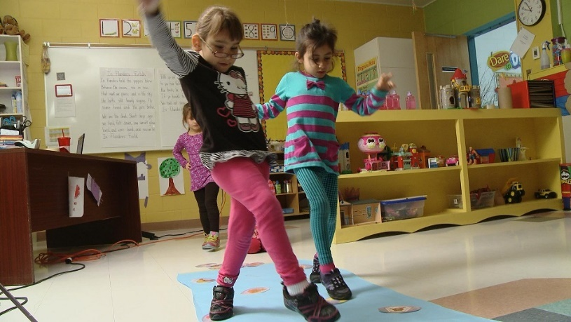
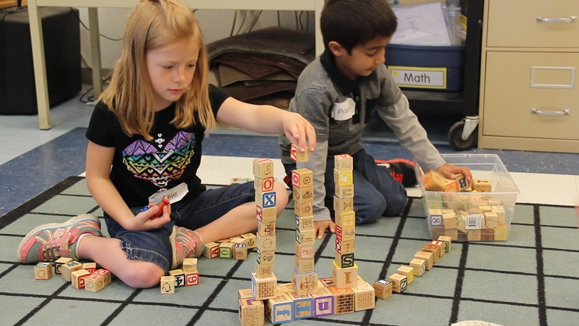
Does this look familiar?
Notes:
Chances are there are elements from these classroom photos that are familiar to you, like a calendar, centres, and an area for free play. All of these can be used as part of your EYE-TA observations and evaluations. It’s important to remember that the EYE-TA is not a pull-out or direct assessment. Instead, you are encouraged to observe the EYE-TA skills during regular play-based classroom activities.
The EYE-TA provides a systematic framework you can use to structure your frequent observations. Since it is observation-based, it can be incorporated into your everyday practice.

Slide 8
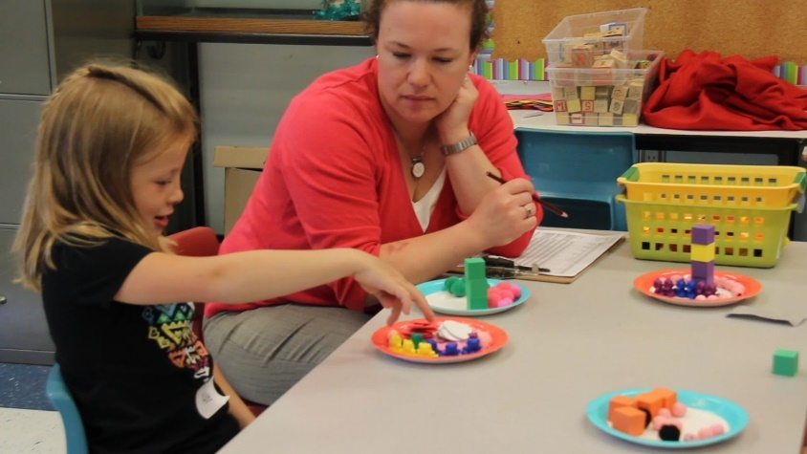
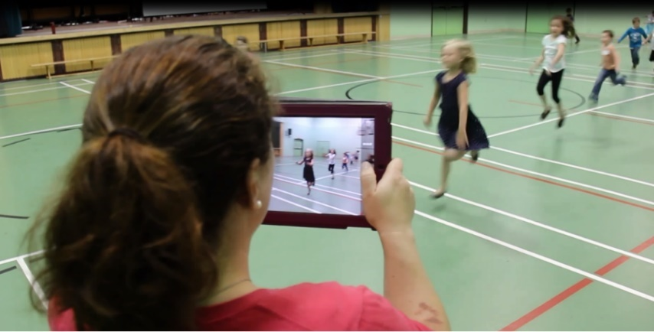
Integrate the EYE-TA into your existing classroom activities
Item C5: Sorts articles by size, shape, colour
Do not directly assess every item - integrate them into daily activities:
  Routines and transitions
  Classroom activities and centre time
  Story time
  Physical education class
  Recess and other unstructured playtimes
Item E8: Skip forward with alternating feet
Trust your knowledge of your children and your professional judgement.
Notes:
Keep in mind that you are not expected to directly assess each child on every item; EYE-TA items are intended to be assessed in the context of other school activities, such as during classroom work and play, or even during physical education and recess.
You can incorporate the EYE-TA observations into your existing classroom activities, such as:
Routines and transitions like morning circle time and lining up at the door
Story/circle time
Play-based centre activity
Story time
Physical education class
Recess or other unstructured playtimes
CLICK
Trust your knowledge of your children and your professional judgement.

Slide 9


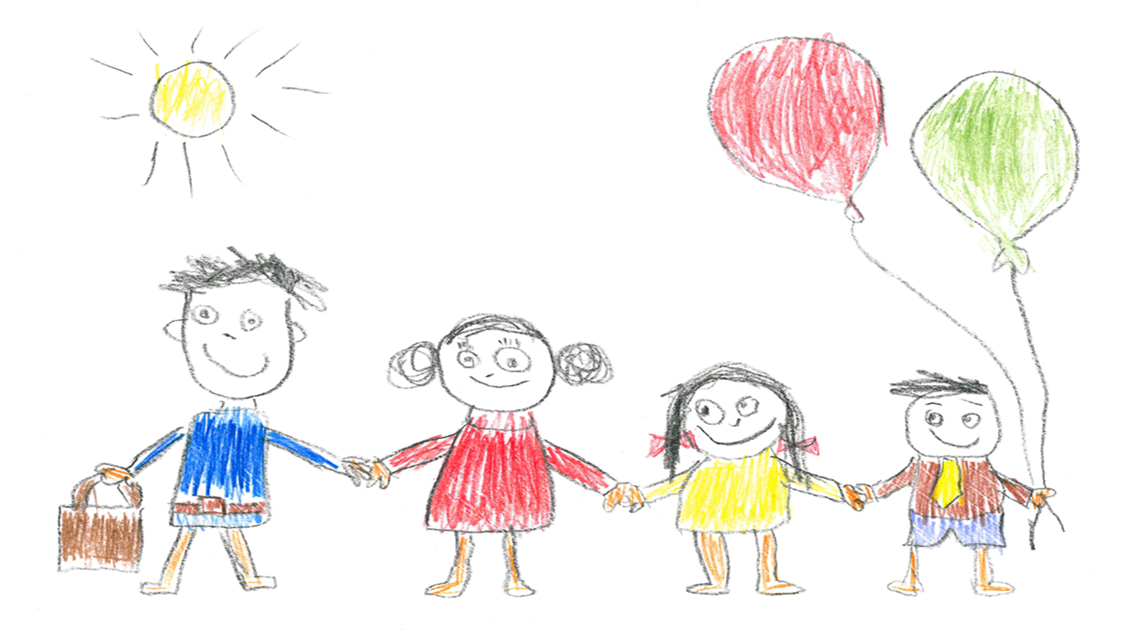

Use time-saving documentation strategies
Accessibility:
Print out and place checklists around the classroom.
Video:
Document children’s gross motor skills.
Sticky notes: Capture spontaneous learning anywhere, anytime!
Drawings:
Assess tangible evidence of a child’s fine motor skills.
Notes:
Documentation strategies can include:
written observations (anecdotal evidence)
language samples
children's constructions
drawings
attempts at writing
photos
audio/video recordings
learning stories
Accessibility:
Copies of the teacher checklist can be printed off and placed in specific areas of your classroom. For example, a copy of the Domain B items (Social Skills and Approaches to Learning) can be placed close to the door enabling you to assess items such as “respects classroom rules” as the children are lining up to go outside for recess.
Video:
Video or audio recordings of learning experiences are great forms of documentation and are very useful when assessing children's learning. A parent volunteer or educational assistant could film you during story time, your morning routine or during a Physical Education class. When you go back to watch the recordings, you may be surprised at the items that can be assessed.
Sticky notes:
Observations can occur spontaneously, for example when children arrive in the morning, during indoor recess on a rainy day, at snack time, and so on. Having sticky notes accessible throughout your classroom is a fast, easy way to jot down a couple of notes when incidental observations occur.
Drawings:
Children's artistic expressions such as pictures and drawings can be used to assess items such as E3 (draw a recognizable person) and E4 (stay inside the lines when colouring simple shapes).
Children's portfolios can be a great source of information for scoring EYE-TA items and is also a way to document progress, provide tangible evidence of a child’s skill and provide teachers with examples for families and other members of the multidisciplinary team.

Slide 10
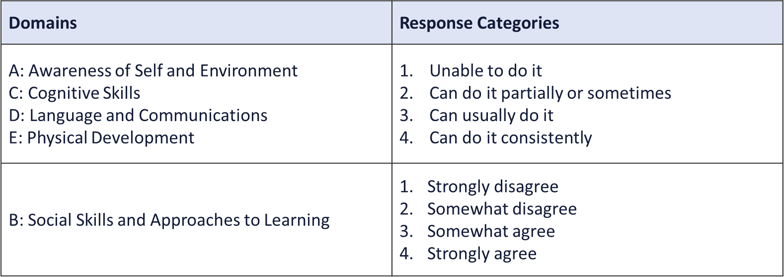
Scoring
A child’s performance is rated on a 4-point scale ranging from a low of 1 to a high of 4. Response categories by domain are outlined below:
Notes:
In terms of scoring, a child’s ability is rated on a 4-point scale ranging from a low of 1 to a high of 4.
Note the slightly different response category used for Domain B: Social Skills and Approaches to Learning.

Slide 11
Scoring
Use the rubric below in conjunction with the response categories, when trying to differentiate between numerical ratings (e.g., recording a score of 2 vs. 3):
Response Category | Score 1: Unable to do it yet | Score 2: Can do it partially or sometimes | Score 3: Can usually do it | Score 4: Can do it consistently
 | Child is unable to do this task and appears not to have any of the skills required for it. | Child appears to have some of the skills required for this task, but can only do it with prompting or assistance at this time | Child can do this task without assistance but does not do it well, confidently or consistently. It appears that the child will soon master this task. | The skills for this task are well developed. It was done confidently and it appears that the child can do it consistently.
Notes:
You might find it helpful to use a rubric in conjunction with the response categories when trying to differentiate between scores (e.g., recording a score of 2 vs. 3).
We recognize that you want to make sure you are doing it right and conducting an accurate assessment. Keep in mind that you have plenty of time to observe the skills of your children and that as you become more familiar with the scoring for each item, it will become clearer and easier. One important thing to keep in mind is that you are a trained teacher and know the children in your class the best, so trust your instincts!

Slide 12
Supporting a successful implementation
Notes:
Let’s review some of the TA resources available that can help you with the observation and recording portion of the assessment.

Slide 13

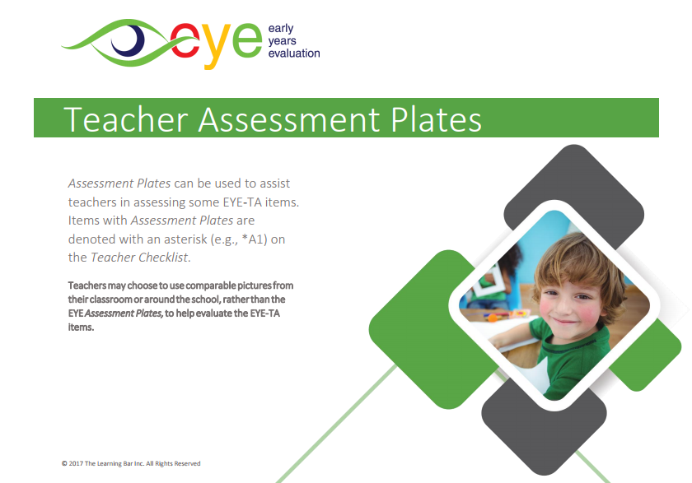
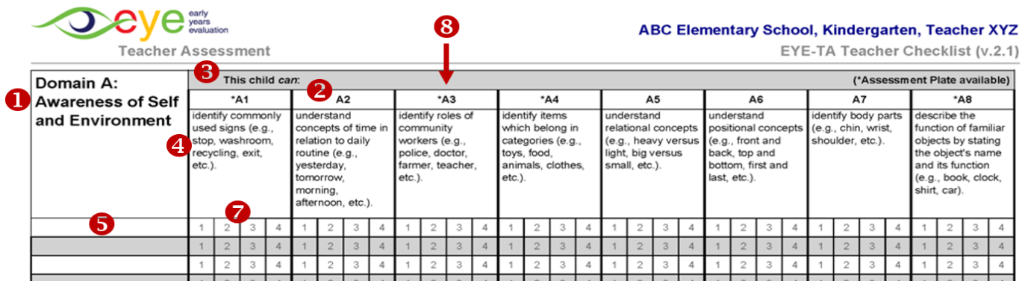
Core assessment materials
Essential resources for implementation:
Teacher Implementation Guide
Assessment Plates
Teacher Checklist
Notes:
Here are the three core assessment materials.
CLICK
The Teacher Implementation Guide contains all the information you need to successfully implement the EYE-TA. If at any point during your implementation you have questions, this will be a wonderful resource to refer back to.
CLICK It also contains the Assessment Plates that can help assess certain TA items as well as the Teacher Checklist, CLICK where you will record your scores.

Slide 14
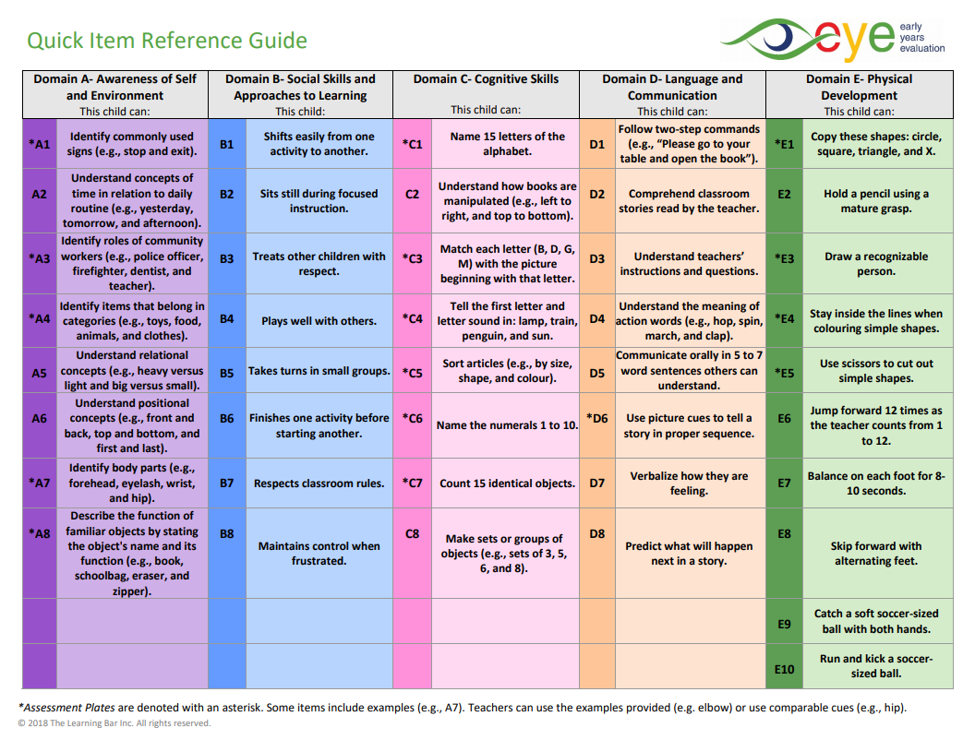
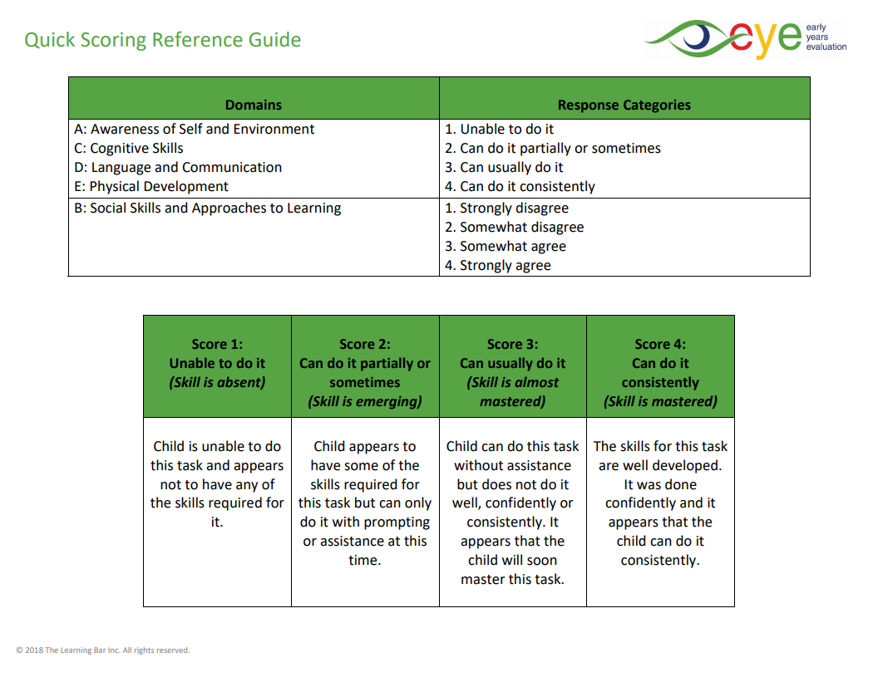
Quick Reference Guide
Notes:
Another great document to have on hand is our Quick Reference Guide.
The front shows all the EYE-TA items. This is extremely useful in those moments where you know you have a child demonstrating a TA skill, but you just can’t remember specifically which skill it is. This is also helpful when you are reviewing the TA items that will fit into your daily lessons.
On the reverse side, there is a scoring rubric, which is useful when you have questions about which score to assign.

Slide 15
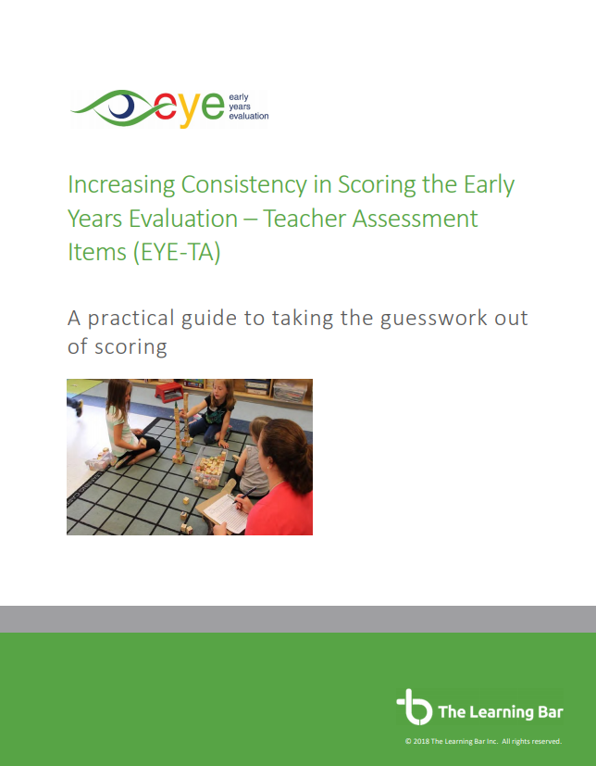
Increase consistency in scoring
The Increasing Consistency in Scoring EYE-TA document provides:
Suggestions for scoring
Hints and tips
Reasons why the skill should be assessed
Ideas on how to easily assess it in your classroom
Notes:
The ‘Increasing Consistency in Scoring EYE-TA Items’ document is one example of the many resources you may find useful when scoring each EYE-TA item.
This companion resource for the EYE-TA was created:
to help build observational capacity ;
to increase the efficiency of your observations; and
to provide you with specific scoring suggestions and insights into the intended purpose of each of the 42 EYE-TA items
With a deeper understanding of the assessment tool, the data is more relevant, and you can use it to help provide each child with opportunities to increase their skills and overall chances of literacy success.

Slide 16


Activity ideas
Activities to help you observe children’s skills:
15 Play-Based Activities to Assess All 42 EYE-TA Items
Observe multiple items per activity
Simple Activities to Assess Targeted EYE-TA Items
Focuses on assessing items in Domains A and C
Notes:
Our TLB team has also created documents to help you as you are observing the skills. The 15 Play-Based Activities to Assess All 42 EYE-TA Items document helps you assess multiple items with each activity. The activities in this document are also referenced in the Increasing Consistency in Scoring Guidelines.
Another document that we have created is called Simple Activities to Assess Targeted EYE-TA Items. Teachers have shared with us which items they find a bit trickier to assess in whole-class or small-group settings and so we have created a resource with activities focusing on the two domains they identified: Domain A – Awareness of Self and Environment and Domain C- Cognitive Skills.

Slide 17
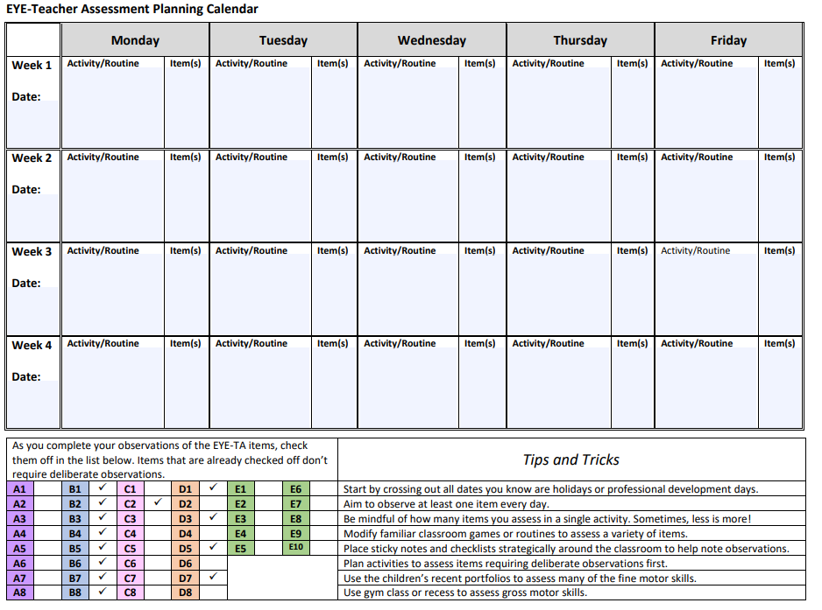
Planning calendar
Helps you plan when you’ll be doing specific activities to cover all the EYE-TA items.
Jot down activity names and items covered per day
Check off completed items as you go
Read the tips and tricks
Notes:
This planning calendar was created to help you organize and plan out your TA observations. It is a great complement to the resource Simple Activities to Assess Targeted EYE-TA Items.

Slide 18
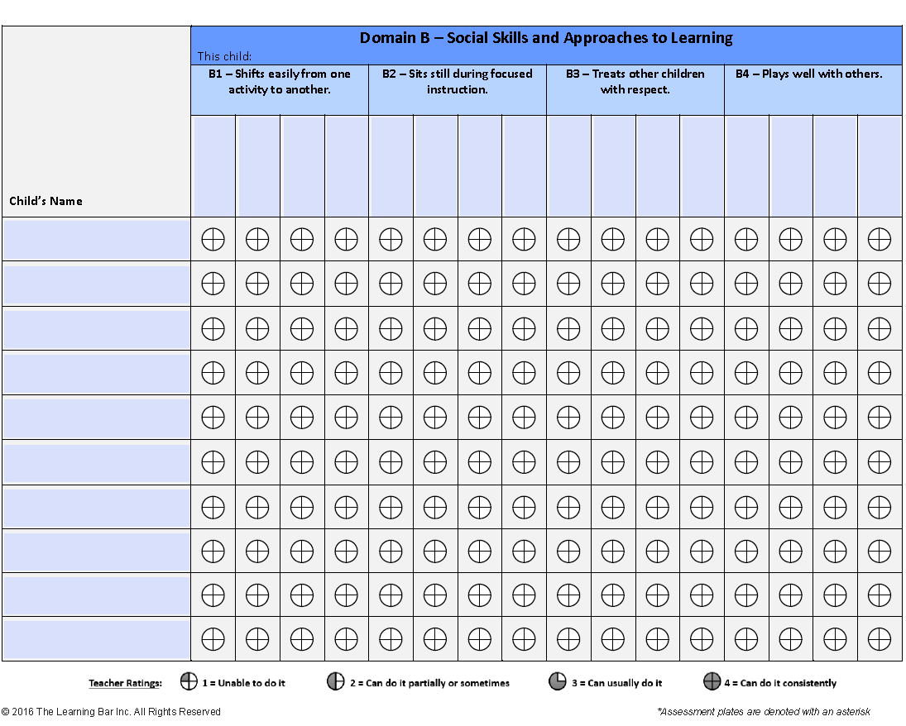
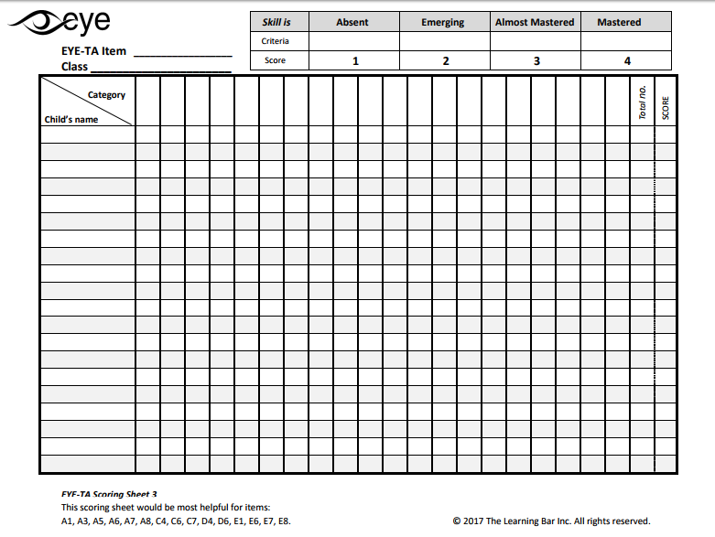
Resources to track observations
Teacher Observation Charts Great for multiple observations
Scoring Sheets Customizable form-fillable templates
Notes:
We also have these resources that can help you document your observations.
The first one is the Teacher Observation Charts which are great when assessing children over the course of multiple observations. There is a section for each item where you simply fill in the circle’s quadrants to represent a score of 1 to 4.
The second one is the Scoring Sheets. They are customizable form-fillable templates that can be used in many different ways. We have listed suggested items at the bottom of each sheet.

Slide 19
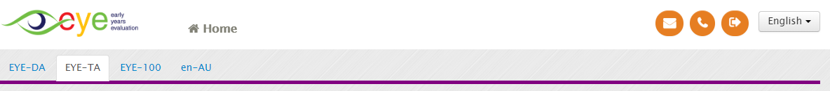
Website access to resources
Your EYE-TA coordinator will distribute materials to support your implementation however, you can also find them on the EYE website:
app.earlyyearsevaluation.com
Prior to your session opening, use the generic log-in information:
Once your session is open, use your unique log-in information:
Notes:
To access these resources on our website, you will need a username and password. CLICK
Prior to your session opening, use the generic log-in information. CLICK Once logged in, simply click on the EYE-TA tab. CLICK
Once your session is open, you will receive personal log-in information, which you can use to enter data AND access the materials. CLICK Simply click on the “i” icon.

Slide 20
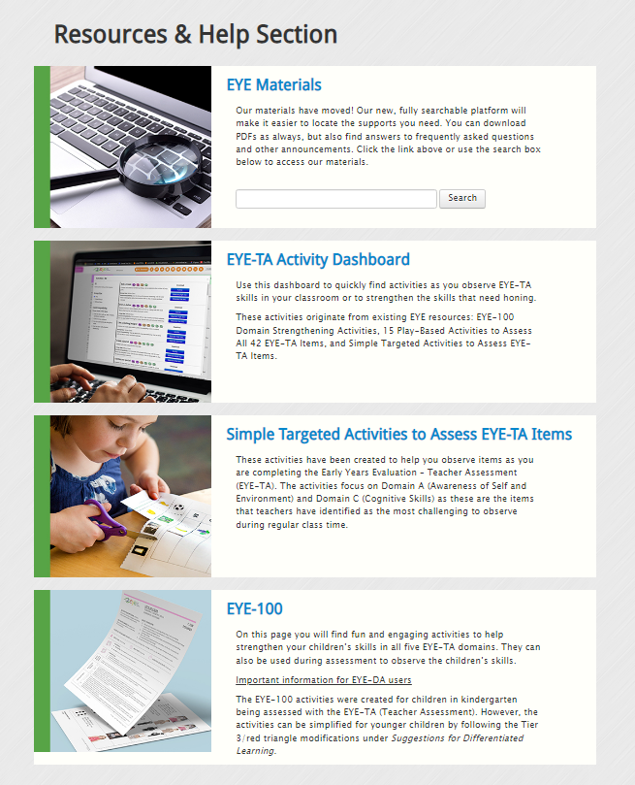
Resources on website
EYE Materials
This fully searchable platform makes it easy to locate the supports you need. You’ll find numerous documents and videos, answers to frequently asked questions, and other announcements.
Notes:
Once you log in to our website, you’ll find a number of great resources. At the top, you’ll see the EYE Materials section.
This fully searchable platform makes it easy to locate the supports you need. You’ll find numerous documents and videos, answers to frequently asked questions, and other announcements.

Slide 21
Resources on website
EYE-TA Activity Dashboard
This dashboard contains over 180 activities. Use it to quickly find ideas to help you observe EYE-TA skills in your classroom.
Notes:
The next section features our EYE-TA Activity Dashboard. This dashboard contains over 180 activities. Use it to quickly find ideas to help you observe EYE-TA skills in your classroom or to strengthen the skills that need more support.
Activity suggestions can be filtered based on several factors and include the name and a short description, a full activity description, including possible activity modifications, and any accompanying materials.

Slide 22
Resources on website
Simple Targeted Activities to Assess EYE-TA Items
These activities have been created to help you observe items as you are completing the EYE-TA. The activities focus on Domain A (Awareness of Self and Environment) and Domain C (Cognitive Skills).
Notes:
Simple Targeted Activities to Assess EYE-TA Items
A bank of activities that focuses on Domain A (Awareness of Self and Environment) and Domain C (Cognitive Skills).

Slide 23
Resources on website
EYE 100
On this page, you will find fun and engaging activities to help strengthen your children’s skills in all five EYE-TA domains.
Notes:
The EYE 100 is a large part of the ‘what next’ piece after you get your EYE reports.
On this page, you will find fun and engaging activities to help strengthen your children’s skills in all five EYE-TA domains. All the activities are play-based and are laid out using an active teaching approach. Each set contains five themed activities. Two activities focus on cognitive skills (one literacy and one numeracy), two activities focus on language and communication (one receptive and one expressive) and an inquiry-based activity with roots in STEAM.

Slide 24
Frequently asked questions
Notes:
Let’s review some frequently asked questions next.

Slide 25
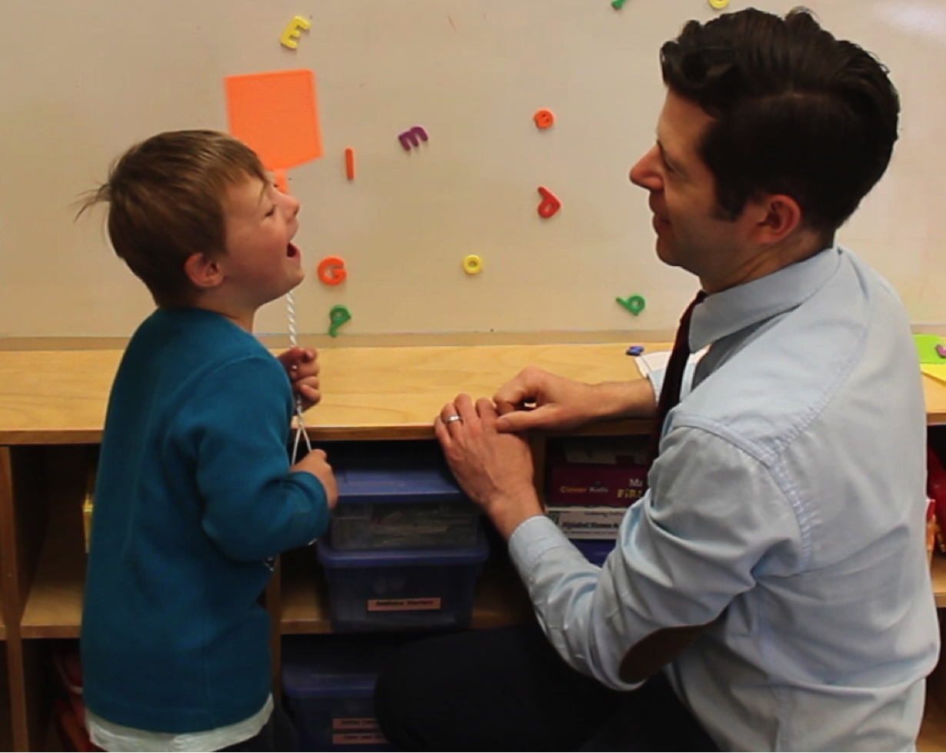
How do I administer EYE-TA to children with exceptional needs?
We advocate that all children complete as much of the EYE-TA as possible.
Enter in scores for all observed items. Check off ‘Exempt’ for non-assessed items.
Option to forego the entire assessment.
Notes:
How do I administer EYE-TA to children with exceptional needs? We advocate for all children to complete as much of the EYE-TA as they are able.
Enter scores for all the items you have been able to assess the child on. Check off “Exempt” for the others you weren’t able to assess. If you are unable to complete any or a minimal number of items for a child in one of the domains, the result for that domain will appear on the report as Not Complete.
In the case of a child with a severe disability – who has already been diagnosed – we rely on your professional judgment, the wishes of the families, and your school’s policies and procedures when deciding if it would be appropriate to assess the child using the TA. You may choose to not assess the child at all. In this case, just click on “Not Assessed” in the class list.

Slide 26

What about assessing children with English as an additional language?
The majority of EYE domains can be assessed regardless of the child’s home language – except Domain D: Language and Communication.
Remember you are assessing the child’s skills rather than their language acquisition.
Translators can be used.
Try to assess as many items as you can.
Notes:
Some points to think about when assessing children whose first language is not English.
The majority of EYE domains can be assessed regardless of the child’s home language. You should be able to assess children regardless of language on the majority of items (except Language and Communication) through observational means.
When you are doing the evaluation, you want to make sure you are assessing the child’s skills and not language acquisition.
Because this is a skill-based assessment, it is fine to use a translator to explain the task to the child and translate their response back to you.
All in all, try to assess as many items as you can to get an accurate snapshot of the child’s skills.

Slide 27

How should I assess a child who has a high absentee rate?
Assess as many items as possible while the child is at school.
For items that were not assessed, you should indicate ‘Exempt’.
Notes:
Assessing a child who is frequently absent poses a challenge. CLICK You should attempt to assess as many items as possible while the child is at school. CLICK
However, for items that cannot be assessed, you should indicate ‘Exempt’ when entering data.

Slide 28
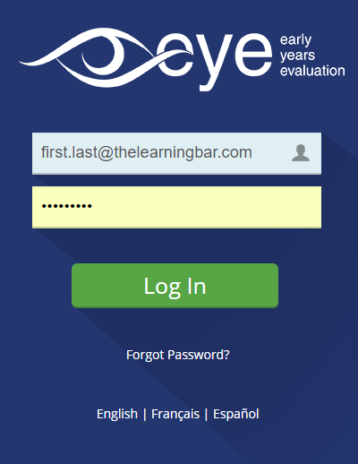
When will I have access to the online data entry site to enter my results?
The start date is determined by your jurisdiction.
On that date, you will receive an email from our EYE support team indicating that your new session is active.
Notes:
The start date is determined by your jurisdiction.
On that date you will receive an email from our EYE support team indicating that your new session is active.

Slide 29

Remember
The TA identifies a child’s strengths and areas which could benefit from further instruction.
Integrate observations into what you are already doing.
There are several resources available to help with this first phase of the TA implementation.
Notes:
Remember
1. The goal of the EYE-TA is to identify a child’s strengths and areas which could benefit from further instruction.
2. Integrate observations into what you are already doing.
3. There are a number of great resources available to help you with this first phase of the TA implementation.

Slide 30

Thank You!
Any questions?
eye-support@thelearningbar.com
506 458 9311
1 877 840 2424

