Slide 1
Responding to EYE-DA results
Notes:
Welcome to this Early Years Evaluation- Direct Assessment Learning Series.
This session will focus on using your EYE-DA results.

Slide 2
What will you learn?
Review your EYE-DA results.
Identifying which children require additional support and how much support is needed.
Discuss strategies that will help you respond to your data.
Notes:
This session will focus on:
Reviewing your EYE-DA results
Identifying which children require additional support and how much support is needed
Discussing strategies that will help you respond to your data

Slide 3
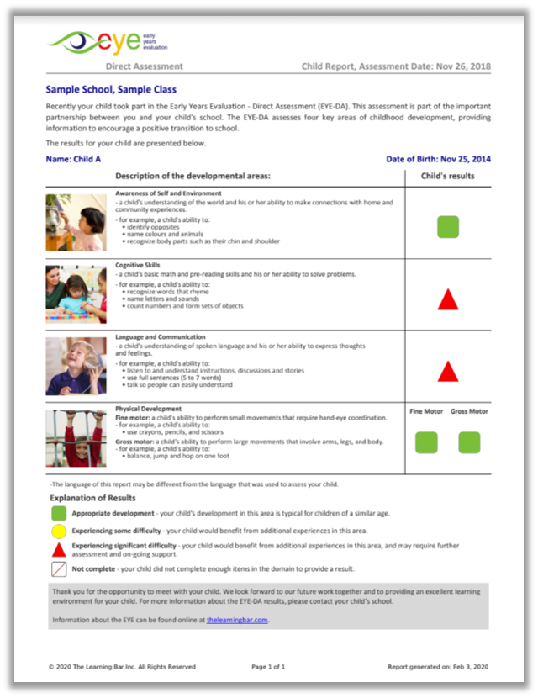
Determining scores
If you remember, item scores within a domain are averaged, and then assigned to the green, yellow or red developmental category based on a child’s age at the time of assessment.
Notes:
If you remember, item scores within a domain are averaged, and then assigned to the green, yellow or red developmental category based on a child’s age at the time of assessment.

Slide 4
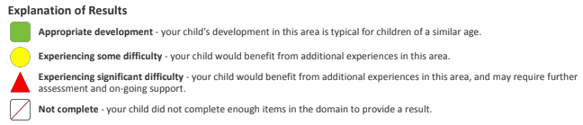
Supports based on child-level results
The EYE-DA results can be used to determine the amount of support and/or type of intervention for a child.
Notes:
Children with yellow and red domain results would ideally receive additional, targeted support. The EYE-DA results can be used to determine the amount of support and/or type of intervention for a child. Follow-up can take place within a class by educators and support staff, or referrals can be made to other departments or organizations.

Slide 5
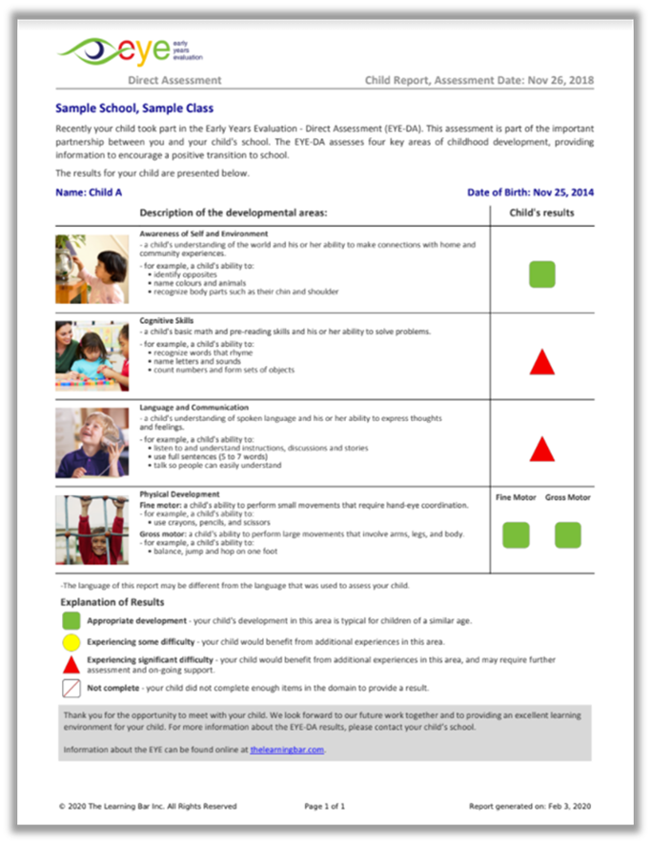
Supports based on child-level results
Looking at this Child Report, the two domains we would want to focus on with this child would be their Cognitive Skills and Language and Communication Skills.
Notes:
Looking at this Child Report, the two domains we would want to focus on with this child would be their Cognitive Skills and Language and Communication Skills. Offering activities to help strengthen these two domains both in class and at home would be beneficial for this child.

Slide 6
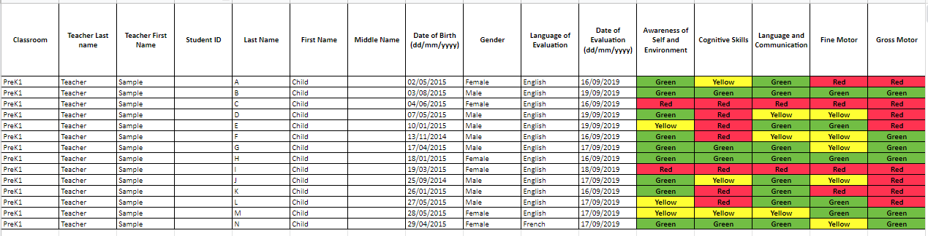
Grouping for differentiated instruction
EYE-DA results can also be used at a whole-class level. When planning small group activities in a classroom setting, EYE reports such as the Excel sheet can help you determine how to group children based on their domain results.
Notes:
EYE-DA results can also be used at a whole-class level. When planning small group activities in a classroom setting, EYE reports such as the Excel sheet can help you determine how to group children based on their domain results. You can group according to skill level, where children of similar abilities work with one another, or you can create a group with a range of abilities.

Slide 7
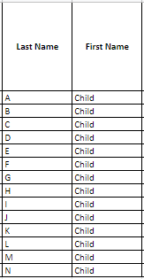
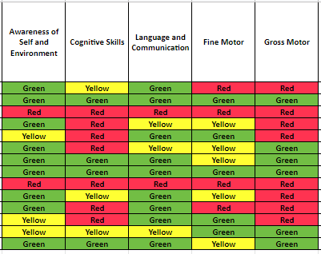
Grouping for differentiated instruction
For instance, if you are doing an activity about numbers, you could look at the Cognitive Skills domain and create groups according to the results. This allows for differentiated instruction within the classroom.
Notes:
For instance, if you are doing an activity about numbers, you could look at the Cognitive Skills domain and create groups according to the results. This allows for differentiated instruction within the classroom. Children with ‘green’ domain results can be presented with a more challenging version of the activity while children with ‘red’ domain results can be presented with a modified version.

Slide 8

Planning responses
As you plan your response to the results, consider these factors:
1) Results, information, and strategies
2) Additional support staff
3) Supplies and environment
Notes:
As you plan your response to the results, consider these factors:
1) Results, information, and strategies
2) Additional support staff
3) Supplies and environment

Slide 9
Results, information, and strategies
Questions to consider:
What additional information do you have about the cohort?
What level of support do these children require?
Which domain(s) will require intentional strategies and focus?
How could the children’s strengths support learning in other areas?
Notes:
Questions to consider when planning a response:
What additional information do you have about the cohort? How does that impact your response? For instance, you may have a half-day class or many children with special needs.
What level of support do these children require (universal, targeted, or specialized)?
Which domain(s) will require intentional strategies and focus?
How could the children’s strengths support learning in other areas?

Slide 10
Additional support staff
Questions to consider:
Has an educational assistant been assigned to your class/children?
Will you have access to specialists (e.g., OTs, PTs, SLPs)?
Will volunteers be available to work with children to provide support?
Notes:
Questions to consider:
Has an educational assistant been assigned to your class/children?
Will you have access to specialists (e.g., OTs, PTs, SLPs)?
Will volunteers be available to work with children to provide support?
Consider how you will allocate your time, as the main educator, in the classroom. Having additional staff in your classroom can provide you with the opportunity to work with and focus on those children who need additional support.

Slide 11

Supplies and environment
Questions to consider:
Are there additional supplies and resources needed for the learning environment?
Is there anything that should be modified in the environment?
Notes:
Questions to consider:
Are there additional supplies and resources needed for the learning environment? Perhaps some children could benefit from noise-cancelling headphones, modified pencil grips, more pictures for EAL learners, etc.
Is there anything that should be modified in the environment? Think about what could be useful: more space, a different seating configuration, etc.

Slide 12
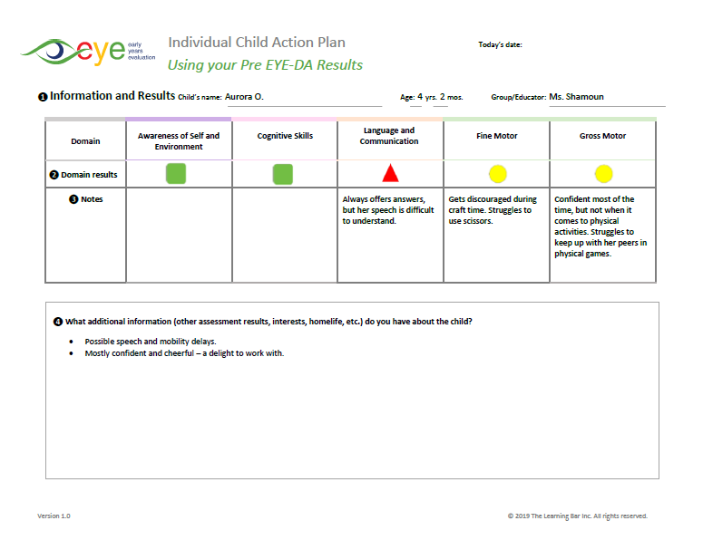
Child Action Plan
You can use our Child Action Plans to help amalgamate your information. The action plan is available in the system where you download your Child Reports.
Notes:
You can use our Child Action Plans to help amalgamate your information. The action plan is available in the system where you download your Child Reports. It comes pre-populated with the child's demographic information along with their domain scores. After you download the Child Action Plan, you can add any details you know about the child that could be helpful as you interpret the results.

Slide 13
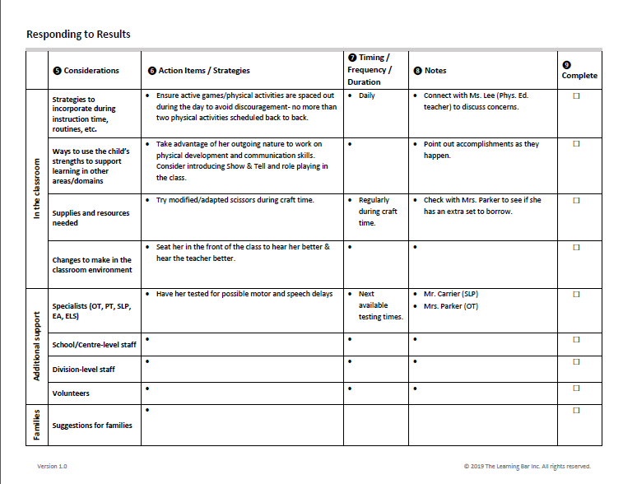
Child Action Plan
Include information about what supports you intend to provide this child in the classroom, which additional personnel can help, and the resources and suggestions shared with the family.
Notes:
Include information about what supports you intend to provide this child in the classroom, which additional personnel can help, and the resources and suggestions shared with the family.
Sharing this child action plan and EYE-DA results with your school administration ensures everyone is working with the same information.

Slide 14
Teaching strategies
Looking for teaching strategies to try in your classroom as you respond to your EYE results?
Check out these two:
1) Show-and-Tell (modelling)
Try a fishbowl activity:
As the teacher, you can model your thought process by thinking aloud when:
  - reading a text (predicting, trying to understand the text, etc.)
  - solving a problem
  - walking through everyday classroom routines
A small group of children/a child who are strong in that particular domain can model an activity for the rest of the class.
Tap into prior knowledge, guide children, and offer hints and suggestions.
Notes:
Looking for teaching strategies to try in your classroom as you respond to your EYE results?
Check out these two:
1) Show-and-Tell (modelling)
Try a fishbowl activity:
As the teacher, you can model your thought process by thinking aloud when:
- reading a text (predicting, trying to understand the text, etc.)
- solving a problem
- walking through everyday classroom routines
A small group of children or a child who is strong in that particular domain can model an activity for the rest of the class.
Tap into prior knowledge, guide children, and offer hints and suggestions.
This activity is a wonderful way to build language skills in particular.

Slide 15
Teaching strategies
2) Think-Pair-Share
This approach is a collaborative learning strategy where children work together to solve problems:
Think: Give children the opportunity to tap into prior knowledge.
Pair: Children share ideas which helps with building language and communication skills.
Share: Confirm the learning objective and celebrate success.
Notes:
2) Think-Pair-Share
This approach is a collaborative learning strategy where children work together to solve problems:
Think: Give children the opportunity to tap into prior knowledge.
Pair: Children share ideas which helps with building language and communication skills.
Share: Confirm the learning objective and celebrate success.

Slide 16

Key points
Use the results to:
  identify domains where your children/class require additional support
  inform classroom instruction
  create the Child Action Plans
  ensure that all educators and administrators are speaking the same ‘language’ and working with the same information
Notes:
Use the results to:
identify domains where your children/class require additional support
inform classroom instruction
create the Child Action Plans
ensure that all educators and administrators are speaking the same ‘language’ and working with the same information

Slide 17


Thank You!
eye-support@thelearningbar.com
506-458-9311
1 877 840 2424

