Slide 1
Post EYE-DA
Notes:
Welcome to this Early Years Evaluation- Direct Assessment Learning Series.
This session will focus on the post EYE-DA.

Slide 2
What will you learn?
Benefits of the Post EYE-DA
Overview of the Post EYE-DA
Sharing the results to facilitate the transition to kindergarten
Notes:
In this session, we will discuss the benefits of the Post EYE-DA, we’ll review the Post EYE-DA and we’ll discuss sharing the results to facilitate the transition to kindergarten.

Slide 3

What are some benefits of the Post EYE-DA?
A post-session can help gauge the effectiveness and appropriateness of supports provided throughout the year.
The results from the Post EYE-DA can also be shared with families to help highlight areas of improvement or to identify areas that still need additional support.
Notes:
A post-session can help gauge the effectiveness and appropriateness of supports provided throughout the year.
The results from the Post EYE-DA can also be shared with families to help highlight areas of improvement or to identify areas that still need additional support.
At the administrative level, it can also help with resource allocation and classroom composition in the new grade.

Slide 4
What are some benefits of the Post EYE-DA ?
A post-session can also support a successful transition to kindergarten. Results can be shared with kindergarten teachers, with a focus on the learning needs of the children who will soon be in their class. This can also ensure that supports are consistent as the children enter their new classroom.
Notes:
A post-session can also support a successful transition to kindergarten. Results can be shared with kindergarten teachers, with a focus on the learning needs of the children who will soon be in their class. This can also ensure that supports are consistent as the children enter their new classroom. For example, if the child is responding well to the use of visual prompts and cues, these strategies should continue being used. While some children may show results that indicate steady progress, others may not be progressing as expected. This is valuable information for the new teacher as there may be other factors to consider that may be impacting a child’s progress.

Slide 5

What does the Post EYE-DA look like?
The Pre and Post EYE-DA are essentially the same, with one important exception:
In most post-sessions, not all the children will be reassessed.
Notes:
The Pre and Post EYE-DA are essentially the same, with one important exception:
In most post-sessions, not all the children will be reassessed.

Slide 6
Which children should be reassessed?
There are two situations where we recommend that a child is reassessed:
Situation 1- The child’s results indicate they are experiencing significant difficulty (red result) in any domain.
Situation 2- If the child does not have a red result in any domain but is experiencing some difficulty (yellow result) in at least one of the following two domains:
Cognitive Skills
Language and Communication
Notes:
There are two situations where we recommend that a child is reassessed:
Situation 1- The child’s results indicate they are experiencing significant difficulty (red result) in any domain.
Situation 2- If the child does not have a red result in any domain but is experiencing some difficulty (yellow result) in at least one of the following two domains:
Cognitive Skills
Language and Communication

Slide 7
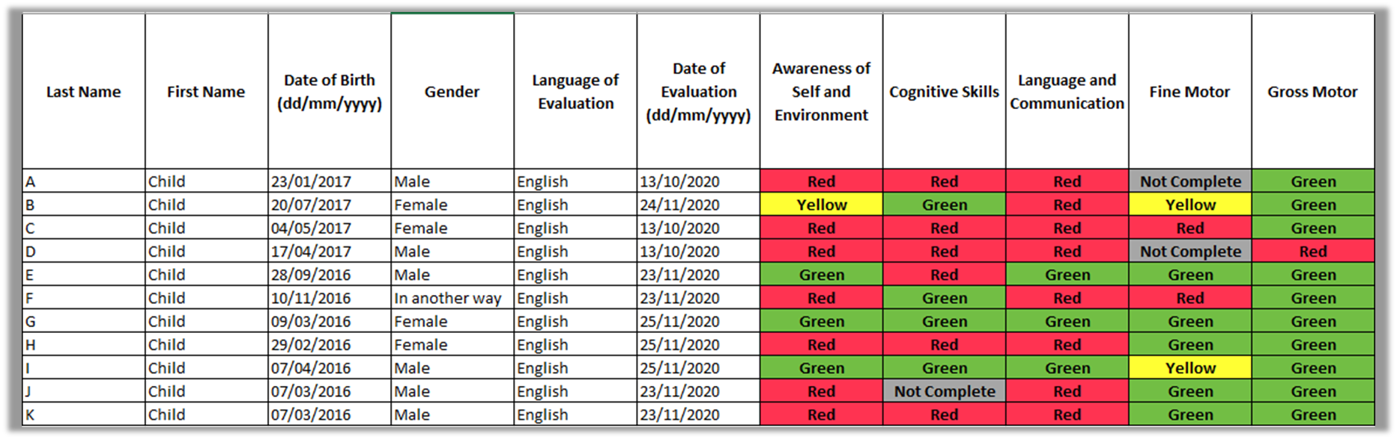
Where can I find the list of children who should be reassessed?
The Excel sheet from your pre-DA session includes the domain results for the children in your class. You can use this report to identify which children you will reassess.
Notes:
The Excel sheet from your pre-DA session includes the domain results for the children in your class. You can use this report to identify which children you will reassess. For example, based on the guidelines from the previous slide, we would recommend that all the children except Child G and I be reassessed in this sample class.

Slide 8
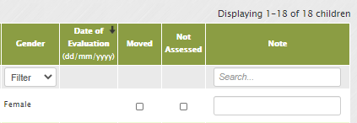
Children not being reassessed
Once your post-session opens, you will see a full list of children. If you do not intend to reassess a child, simply check the ‘Not Assessed’ option.
Notes:
Once your post-session opens, you will see a full list of children. If you do not intend to reassess a child, simply check the ‘Not Assessed’ option. You will be prompted to add a note explaining the reason why, for example, ‘post-assessment not required’.

Slide 9
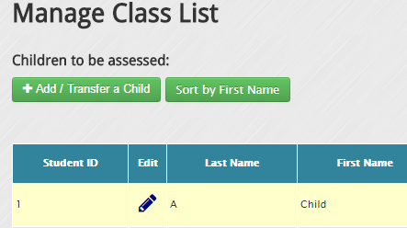
Can I add a new child to the Post EYE-DA?
Yes, simply click on ‘Add / Transfer a Child’ to add the child to your class list on the ‘Manage Class List’ page.
Notes:
Yes, simply click on ‘Add / Transfer a Child’ to add the child to your class list on the ‘Manage Class List’ page.

Slide 10
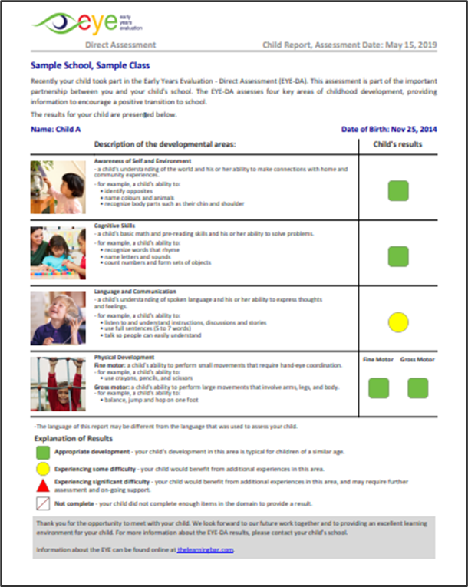
Do I have to reassess the children on all domains, even if they received some green domain results?
Yes, this ensures that you receive a complete Child Report. This is helpful for teachers when sharing results with families and multidisciplinary teams.
Notes:
Yes, this ensures that you receive a complete Child Report. This is helpful for teachers when sharing results with families and multidisciplinary teams.

Slide 11
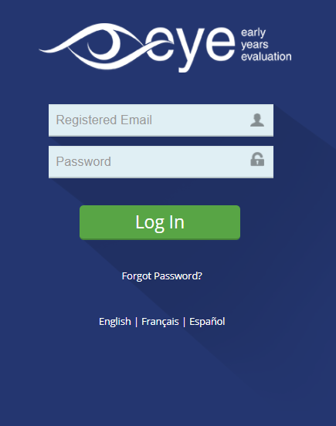
Should I use the same password I used for the Pre EYE-DA?
Yes!
If you forgot your password, simply click on ‘Forgot Password?’ on the login page.
Notes:
Yes!
If you forgot your password, simply click on ‘Forgot Password?’ on the login page.

Slide 12
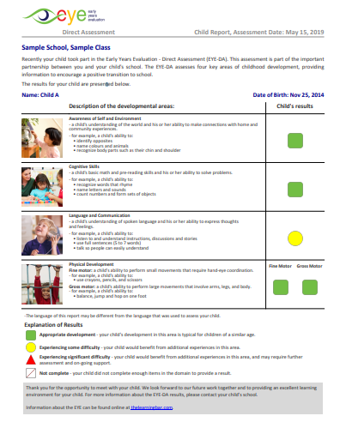
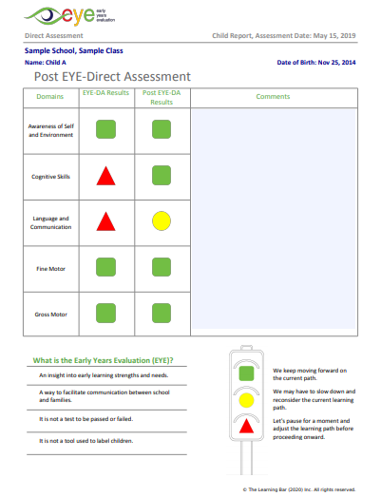
Post EYE-DA Child Report
Page 1 of the Post EYE-DA Child Report has the same format as the one from your pre-session.
Page 2 has side-by-side pre-post results, allowing you and others using this report to quickly see the growth made during the year.
Notes:
Page 1 of the Post EYE-DA Child Report has the same format as the one from your pre session.
Page 2 has side-by-side pre-post results, allowing you and others using this report to quickly see the growth made during the year.

Slide 13
Sharing the results: facilitating the transition to kindergarten

Slide 14

Sharing information with kindergarten teachers
The pre‐post EYE‐DA results provide educators and multidisciplinary teams with information about children’s strengths and areas of need.
Notes:
The pre‐post EYE‐DA results provide educators and multidisciplinary teams with information about children’s strengths and areas of need. As children transition from pre-kindergarten, the information can be shared with kindergarten teachers to establish effective supports and develop a transition plan. This ensures that resources are in place to support the children the moment they begin kindergarten.

Slide 15
Some questions to consider when sharing results with kindergarten teachers:
What supports were implemented in pre-kindergarten?
What worked well to meet the child’s needs?
What supports and responses did not work well and why?
What are the child’s interests?
What interventions will need to be put in place to support the child in the transition to kindergarten?
Are there any environmental accommodations needed? Visual supports?
Notes:
What supports were implemented in pre-kindergarten?
What worked well to meet the child’s needs?
What supports and responses did not work well and why?
What are the child’s interests?
What interventions will need to be put in place to support the child in the transition to kindergarten?
Are there any environmental accommodations needed? Visual supports?
The EYE Child Action Plan helps you capture and share this information with next year’s teacher. As with the pre-session, the Child Action Plans are available in the system where you download your Child Reports on the Class List page.

Slide 16
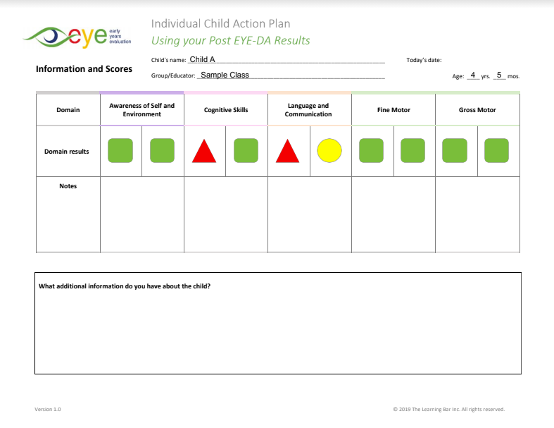
Post EYE-DA Child Action Plan – page 1
Demographic information
Scores
Domain comments
General comments

Slide 17
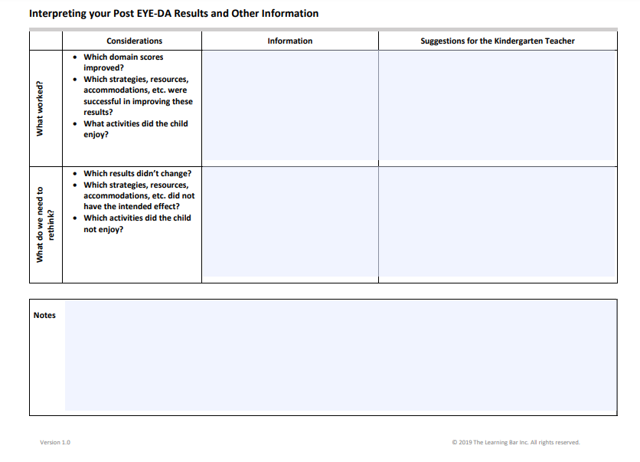
Post EYE-DA Child Action Plan – page 2
What worked?
What should be changed?
What do you recommend to the next year’s teacher?

Slide 18


Thank You!
eye-support@thelearningbar.com
506-458-9311
1 877 840 2424

