Slide 1
Sharing EYE-DA Results with Families
Notes:
Welcome to this Early Years Evaluation- Direct Assessment Learning Series.
This session will focus on sharing your EYE-DA results with families.

Slide 2
What will you learn?
We will review the EYE-DA Child Reports
We will look at sharing the reports
We will provide suggestions for best practice
Notes:
This session will focus on:
reviewing the EYE-DA Child Reports
sharing the reports with families and multidisciplinary teams
And providing suggestions for best practice

Slide 3
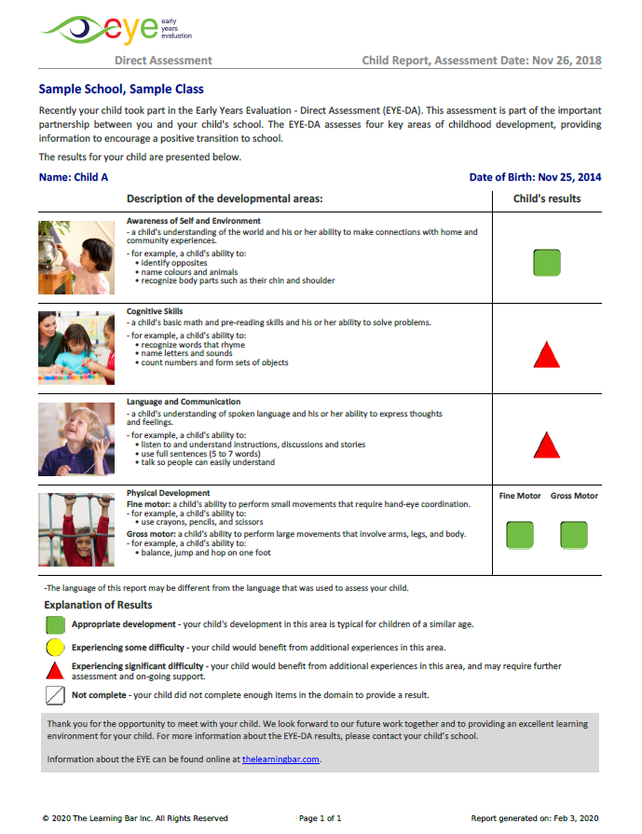
Individual Child Report
The child report is presented in such a way that every family member - across multiple literacy levels - will understand their child’s strengths and areas where their child would benefit from additional experiences.
Notes:
This report is provided for every single child who is assessed – immediately.
The child report is presented in such a way that every family member - across multiple literacy levels - will understand their child’s strengths and areas where their child would benefit from additional experiences.

Slide 4
Why is it important to share EYE-DA results with families?
Engagement
  Meeting with families gives you the opportunity to learn about a child’s home life, experiences, learning styles, and interests. Listen and encourage families to share this with you.
Collaboration
  Sharing results fosters that important home/school partnership and encourages families to contribute to their child’s learning and development.
  It's an opportunity to provide families with simple strategies to support their child’s development in each domain at home.
Notes:
Engagement
Meeting with families gives you the opportunity to learn about a child’s home life, experiences, learning styles, and interests. Listen and encourage families to share this with you.
Collaboration
Sharing results fosters that important home/school partnership and encourages families to contribute to their child’s learning and development.
It's an opportunity to provide families with simple strategies to support their child’s development in each domain at home.

Slide 5
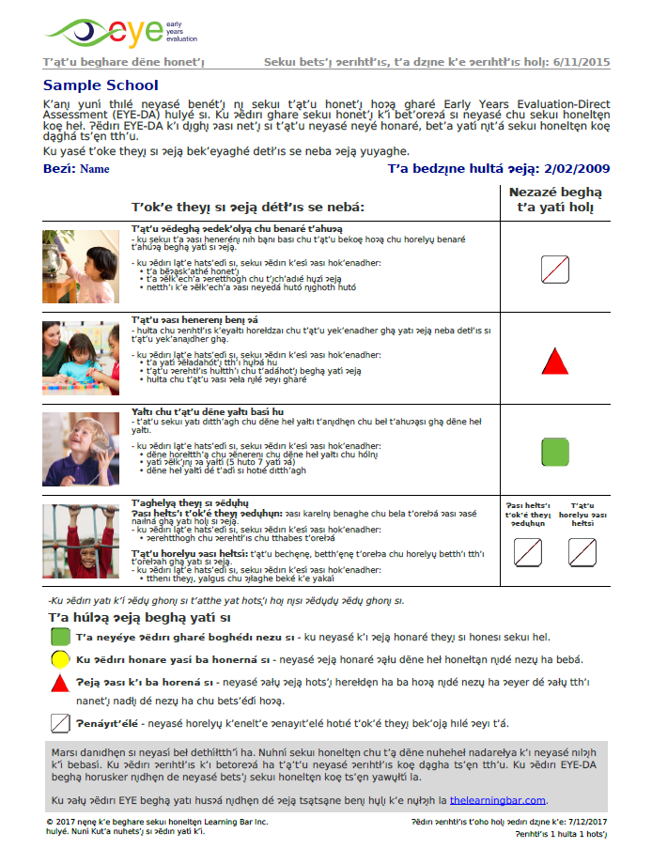
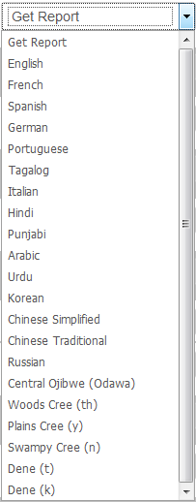
Individual Child Report
Educators have the option of printing the report in various languages.
Notes:
Educators have the option of printing the report in various languages. This may be useful for families who speak a language other than the assessment language at home.

Slide 6
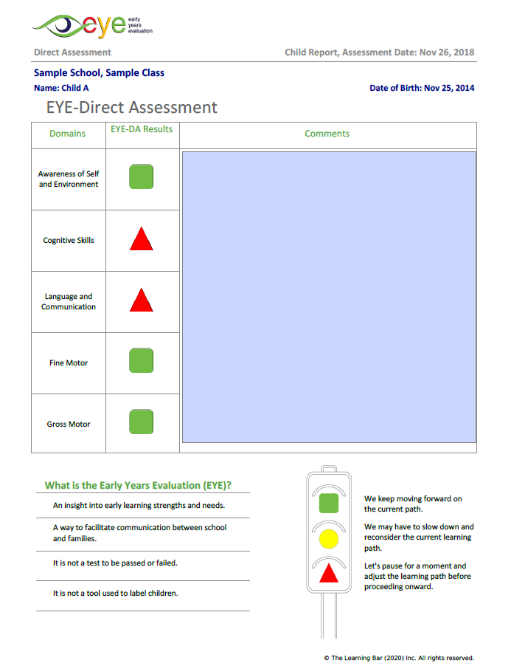
Second page of the EYE Child Report
Features of the second page:
The child’s demographic information and pre-populated coloured scores are included.
A large space for comments – general in nature or linked to a domain.
At the bottom, there is an explanation of the EYE results.
Notes:
Features of the second page:
The child’s demographic information and pre-populated coloured scores are included.
A large space for comments – general in nature or linked to a domain. This is especially useful if you’re using the EYE Child Report as a report card.
At the bottom, there is an explanation of the EYE results to help families understand the information on the report.

Slide 7
Key messages for families
The purpose of the EYE-DA is to:
provide information on school readiness
support a positive transition to school
inform educators & schools as to what they can do to help each child be successful
help guide instruction to best meet the learning needs of the child
Notes:
The purpose of the EYE-DA is to:
provide information on school readiness
support a positive transition to school
inform educators & schools as to what they can do to help each child be successful
help guide instruction to best meet the learning needs of the child

Slide 8
Meeting with a family
Prior to meeting with a family
Meet with the multidisciplinary team to discuss results and a plan for the child.
Prepare material for the meeting.
Review and prepare notes on the EYE-DA results.
Make sure to point out strengths and needs.
Arrange for language interpreters, as needed.
Notes:
Prior to meeting with a family
Meet with the multidisciplinary team to discuss results and a plan for the child. See Step 5 of this series for more information on creating a Child Action Plan.
Prepare material for the meeting: EYE-DA Child Report, the child’s learning portfolio and other material, strategies and activities for home.
Review and prepare notes on the EYE-DA results.
Make sure to point out strengths and needs, anticipate questions, and prepare possible responses.
Arrange for language interpreters, as needed.

Slide 9
Five steps to sharing results with families
One of the most important things for families to understand when sharing results is that the EYE-DA is not a test to be passed or failed. It simply tells us where a child’s strengths are and where there are areas that may need more support.
Notes:
One of the most important things for families to understand when sharing results is that the EYE-DA is not a test to be passed or failed. It simply tells us where a child’s strengths are and where there are areas that may need more support.
There are five basic steps to sharing the reports that we will review in the upcoming slides.

Slide 10

Step 1 – Explain the objective
Start by offering the families a warm welcome!
State the purpose of the meeting.
Explain the EYE-DA in broad terms.
Discuss the child’s feelings about school and learning.
Notes:
Start by offering the families a warm welcome!
State the purpose of the meeting. Explain in broad terms what the EYE-DA is and does. Tell them when it was administered and that all the children were assessed.
Discuss the child’s feelings about school and learning. Ask if the family has noticed any emerging skills or changes at home.

Slide 11


Step 2 – Explain the content
Discuss each domain.
Discuss what each symbol (green, yellow, red) means.
Stay at the domain level results.
Notes:
Discuss each domain – read out the information – point to the picture.
Discuss what each symbol (green, yellow, red) means.
Stay at the domain level results – do not delve into the actual items and raw data.

Slide 12
Step 3 – Focus on the positive
Highlight observed strengths.
Are families doing certain things at home to help develop these skills?
Notes:
Highlight observed strengths and discuss these.
Are families doing certain things at home to help develop these skills?

Slide 13

Step 4 – Point out opportunities
Use domains with yellow and red results as an opportunity to involve the family in strengthening the child’s skills.
Notes:
Use domains with yellow and red results as an opportunity to involve the family in strengthening the child’s skills.
It’s important to point out that you have a plan when discussing the yellow and red domains. Let them know you have some suggestions for things they can do at home too.

Slide 14

Step 5 – Discuss the Action Plan
Talk about the plan you are developing with the multidisciplinary team.
Brainstorm ways they can support learning and development at home.
Notes:
Talk about the plan you are developing with the multidisciplinary team: how programming will be adjusted to respond to the child’s observed strengths, interests, and preferences. Ask the family how they feel about the plan if they have input.
Brainstorm ways they can support learning and development at home:
Have hand-outs ready to give out. Go through the strategies and activities with them so they are understood. Discussing them will help families with low literacy skills or whose first language isn’t English have the information needed to support their child at home.

Slide 15
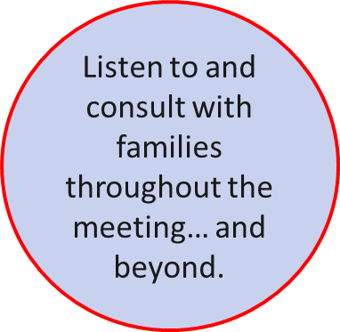
Five steps to sharing results with families
An important element of sharing the results is ensuring you’re having an open dialogue with the families throughout the meeting.
Notes:
An important element of sharing the results is ensuring you’re having an open dialogue with the families throughout the meeting. Make sure families understand the information, that they are comfortable with it, and that they have the opportunity to share with you and ask questions.

Slide 16
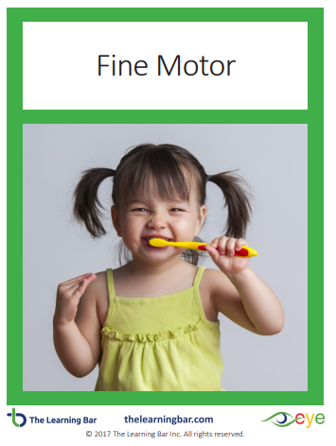
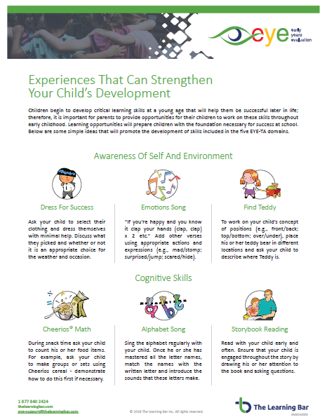
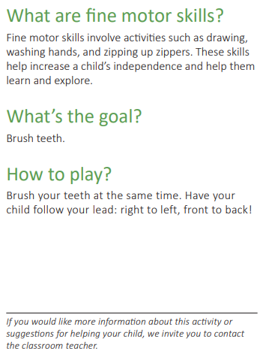
Resources to share with families
Here are two resources from the Resources and Help section of our website you may wish to share with families:
Family Activity Cards
Experience That Can Strengthen your Child’s Development
Notes:
Two great resources from the Resources and Help section of our website you may wish to share with families are the Family Activity Cards and Experience That Can Strengthen your Child’s
Development.

Slide 17


Thank You!
eye-support@thelearningbar.com
506-458-9311
1 877 840 2424

