Slide 1
Entering your EYE-DA data online
Notes:
Welcome to this Early Years Evaluation- Direct Assessment Learning Series.
This session will focus entering your EYE-DA results into our online system.

Slide 2
What will you learn?
How to access and navigate the online data entry site
Features of the online data entry site
How to enter your scores
Insight into the additional available features
Notes:
What will you learn?
How to access and navigate the online data entry site
Features of the online data entry site
How to enter your scores
Insight into the additional available features

Slide 3
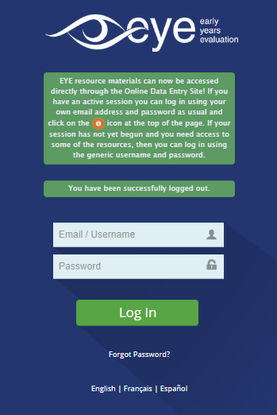
Getting started
You will receive an email from our EYE support team once your EYE-DA session is active.
The start/end date of your session is determined by your EYE coordinator.
Notes:
You will receive an email from our EYE support team once your EYE-DA session is active. The start/end date of your session is determined by your EYE coordinator.

Slide 4
Getting started
Enter your username (typically your work email address) and the unique password provided by our support team.
Notes:
Enter your username (typically your work email address) and the unique password provided by our support team. Once in the system, you will be prompted to change your password for security reasons if it’s your first time logging in.

Slide 5
Getting started
Forgot your password? Simply click on this link to request a password reset.
Notes:
Forgot your password? Simply click on this link to request a password reset.

Slide 6
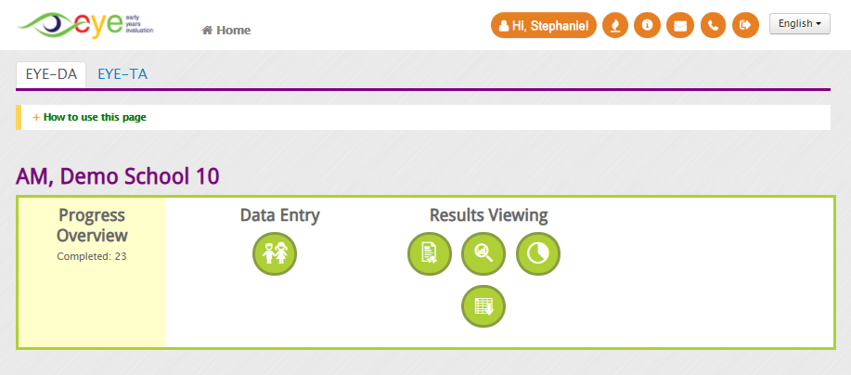
Getting started
After logging in, you can access the wide variety of features that our online data entry site has to offer.
Notes:
After logging in, you can access the wide variety of features that our online data entry site has to offer. These features allow you to enter scores, edit children’s demographic information, view reports, and access our resources.

Slide 7
General navigation
Your profile: update your
name, password, and
preferred system settings
Resources & Help: find all your EYE-DA resources here
Email
us
Log
out
Return to the
landing page
What’s New? Learn more about our latest features and updates
Our phone
numbers
Language
selector
Notes:
Click on the ‘Home’ icon to navigate back to the landing page.
Click on the ‘Profile’ icon to update your name, password and system settings.
‘What’s New’ offers information about our latest features and updates.
Find all our wonderful EYE resources by clicking on the icon for ‘Resources & Help’.
The icons for our email address and telephone are numbers next if you want to contact us.
The next icon is to log out of the system.
Finally, you can change your language setting to French or Spanish by clicking on the language selector.

Slide 8

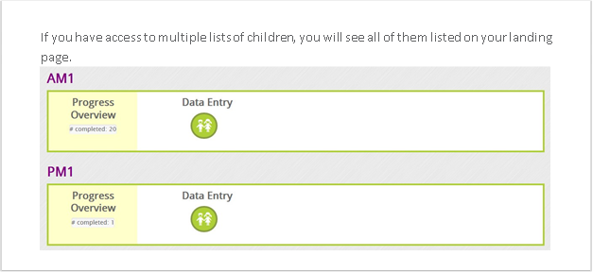
EYE-DA class lists
When you log in to the system, you may see your class listed (depending on your type of EYE-DA session) on the landing page. Click on the Manage Child Data and Enter Scores icon to proceed to data entry.
Notes:
When you log in to the system, you may see your class listed (depending on your type of EYE-DA session) on the landing page. Click on the Manage Child Data and Enter Scores icon to proceed to data entry.
You can also see the data entry progress of each class on the landing page.

Slide 9
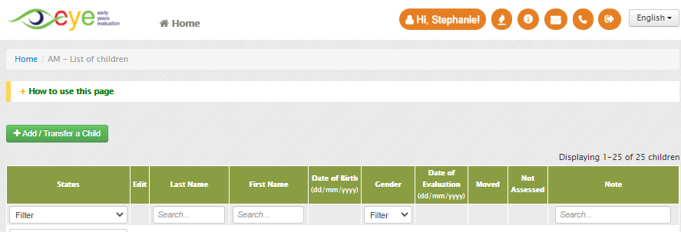
Adding children to your class list
Are you missing a child from your list or adding the children as you complete the evaluations? Simply click on the green Add / Transfer a Child button and you can add them yourself.
Notes:
Are you missing a child from your list or adding the children as you complete the evaluations? Simply click on the green Add / Transfer a Child button and you can add them yourself.

Slide 10
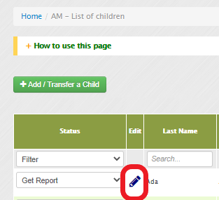
Editing a child’s demographic information
If you notice that a child’s demographic information (e.g., the spelling of the child’s first/last names or date of birth) is incorrect in the system, you can edit it yourself by clicking on the pencil icon.
Important: this is an aged-normed assessment, so please verify that the child’s date of birth is correct.
Notes:
If you notice that a child’s demographic information (e.g., the spelling of the child’s first/last names or date of birth) is incorrect in the system, you can edit it yourself by clicking on the pencil icon.
Important: this is an aged-normed assessment, so please verify that the child’s date of birth is correct.

Slide 11
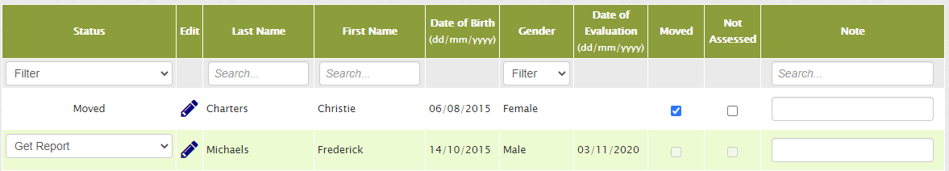
Not assessing a child?
If your class list has already been pre-populated it may contain names of children who have since moved away. In this case, simply check off Moved for the children no longer in your class.
Notes:
If your class list has already been pre-populated it may contain names of children who have since moved away. In this case, simply check off Moved for the children no longer in your class.

Slide 12
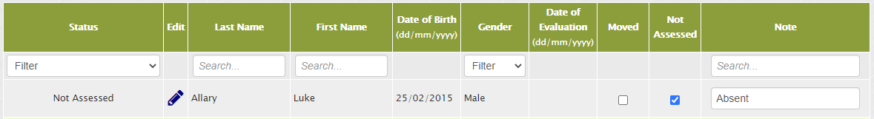
Not assessing a child?
If a child on your list will not be assessed, simply check off Not Assessed. You will be prompted to enter a reason in the Note column.
Notes:
If a child on your list will not be assessed, simply check off Not Assessed. You will be prompted to enter a reason in the Note column.

Slide 13
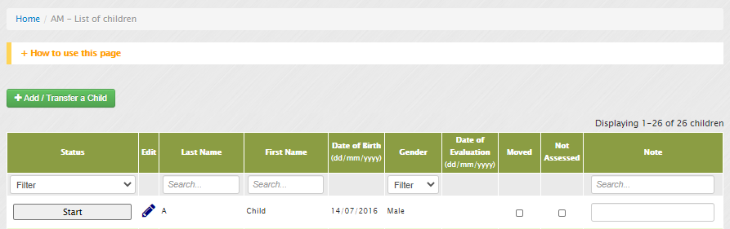
Begin entering results
Locate the child for whom you want to enter scores on your class list and click the Start button in the first column to begin the score entry.
Notes:
Locate the child for whom you want to enter scores on your class list and click the Start button in the first column to begin the score entry.

Slide 14
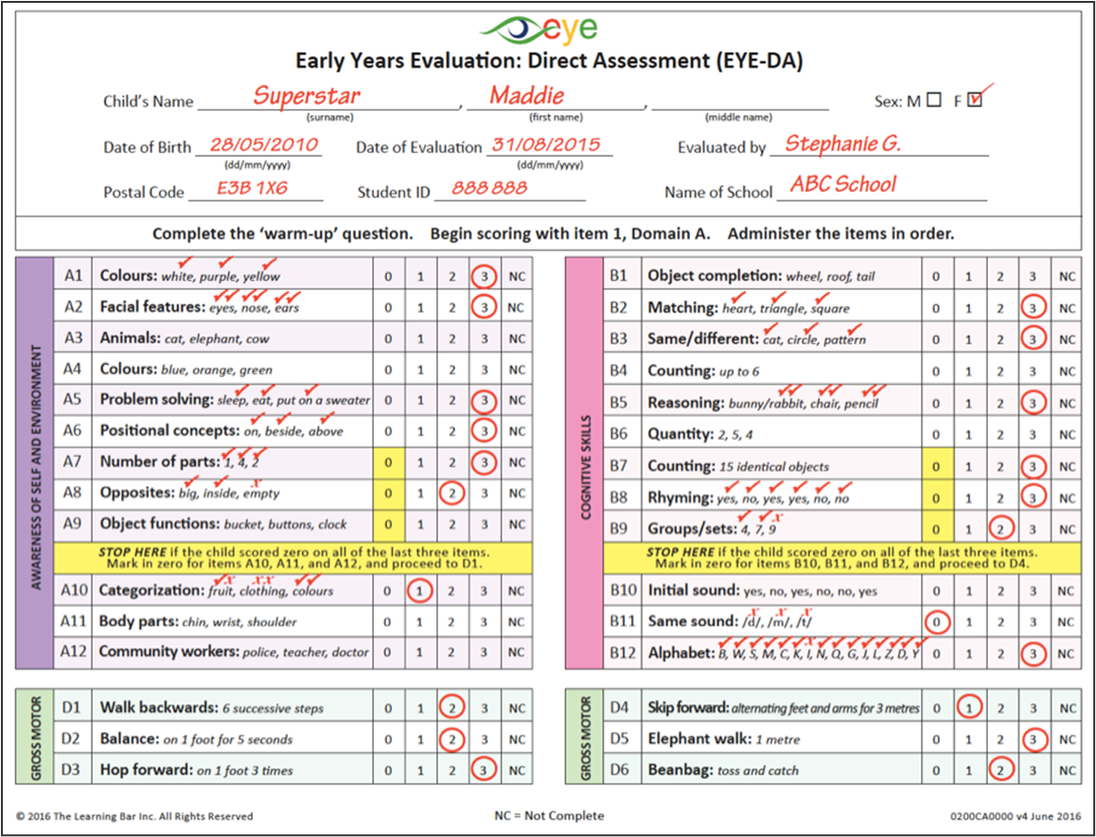
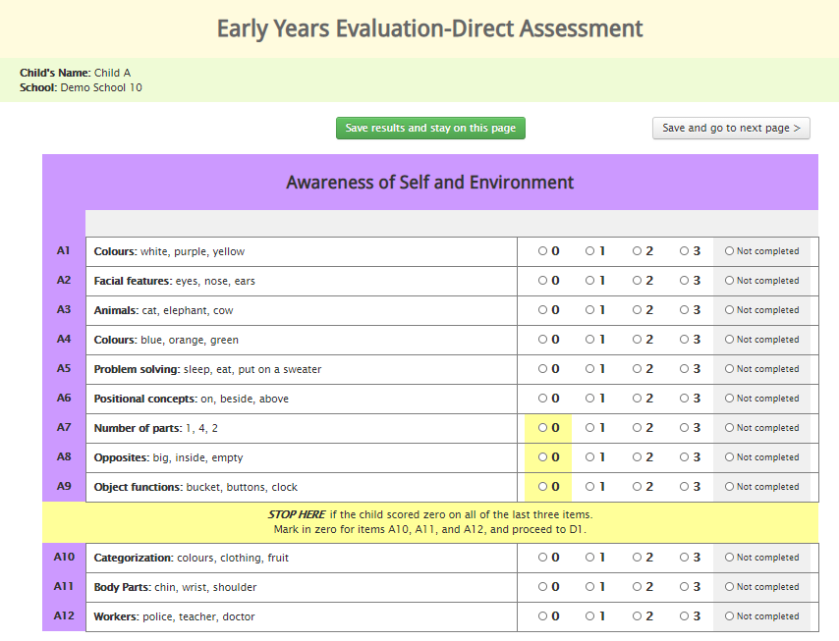
Entering EYE-DA results
Once you have completed the assessment, it's time to enter the EYE-DA results from your Scoring Protocol Sheet into the system.
Notes:
Once you have completed the assessment, it's time to enter the EYE-DA results from your Scoring Protocol Sheet into the system.

Slide 15
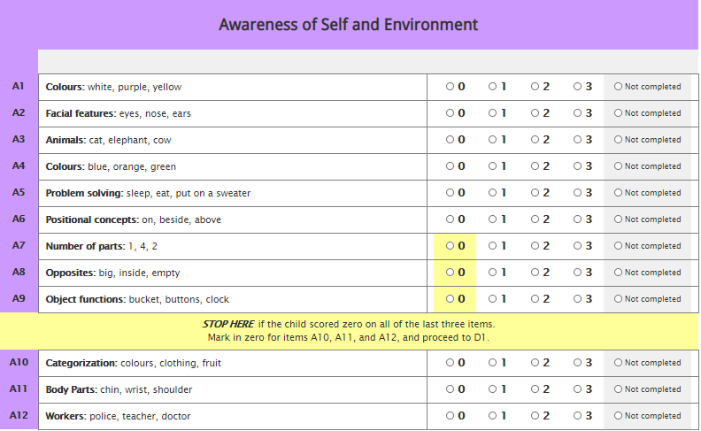
Entering scores
Enter results by clicking on the scores or by using your number keypad.
Notes:
Enter results by clicking on the scores or by using your number keypad.

Slide 16
Entering scores
If a child is unable to complete an item or is
noncompliant and refuses to complete an item, select the Not completed option.
Notes:
If a child is unable to complete an item or is noncompliant and refuses to complete an item, select the Not completed option.

Slide 17
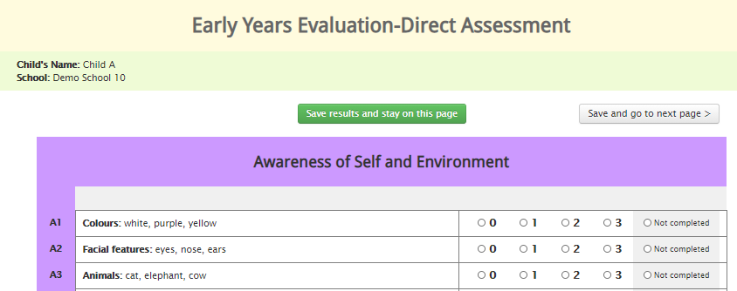
Entering scores
Want to save a partially completed page? Click the Save results and stay on this page button. If you are done entering the scores on the page, click Save scores and go to the next page.
Notes:
Want to save a partially completed page? Click the Save results and stay on this page button. If you are done entering the scores on the page, click Save scores and go to the next page.

Slide 18
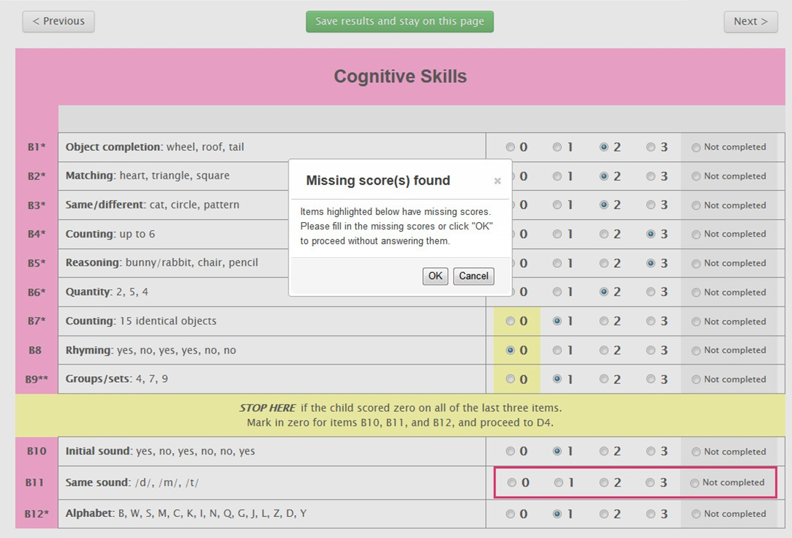
Missing scores message
What should I do when I see the “Missing scores(s) found” message?
Recommended option: click on the Cancel button and fill out the missing score(s). If you really wish to ignore the missing score(s), click on the OK button.
Notes:
What should I do when I see the “Missing scores(s) found” message?
Recommended option: click on the Cancel button and fill out the missing score(s). If you really wish to ignore the missing score(s), click on the OK button.

Slide 19
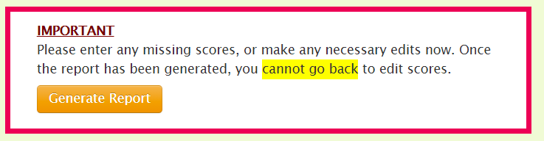

Generating reports
Once you have entered a child’s scores for all EYE‐ DA items, we recommend that you double‐check or edit the scores, as necessary. After you generate the report, you will not be able to go back and edit any of the scores entered. Click on the orange Generate Report button if you are confident in your data entry.
Notes:
Once you have entered a child’s scores for all EYE‐ DA items, we recommend that you double‐check or edit the scores, as necessary. After you generate the report, you will not be able to go back and edit any of the scores entered. Click on the orange Generate Report button if you are confident in your data entry.

Slide 20
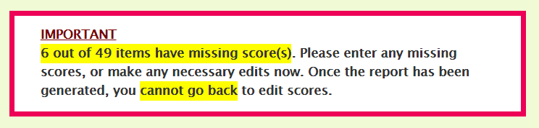
Generating reports
If you have missing scores, the system will prompt you to fill them out before proceeding to report generation.
Notes:
If you have missing scores, the system will prompt you to fill them out before proceeding to report generation.

Slide 21
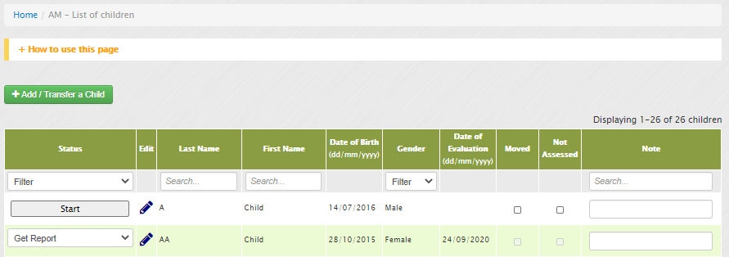
Downloading EYE Child Reports
To download an EYE Child Report, simply click on the Get Report button next to the child’s name on your list of children.
Notes:
To download an EYE Child Report, simply click on the Get Report button next to the child’s name on your list of children.

Slide 22
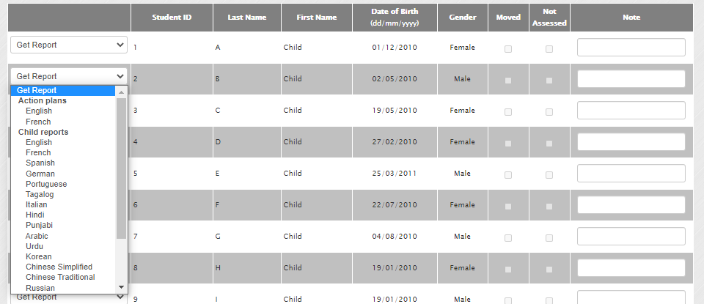
Additional features
Downloading EYE Child Reports in other languages
Individual EYE Child Reports are available in over 20 languages. To download an EYE Child Report in another language, click the Get Report drop-down menu and select your preferred option.
EYE Action Plans containing pre-populated results are also available in this menu.
Notes:
To download an EYE Child Report, simply click on the Get Report button next to the child’s name on your list of children.

Slide 23
Data entry best practices
Once you’ve received an email from the EYE support team with your temporary password, log into the system to make sure everything is in order.
Create a new password you’ll remember.
Start by verifying your list of children and their demographic information; make any necessary edits.
You don’t need to complete all your data entry at once. You can save the results and return to where you left off at a later time.
Double-check the scores you entered into the system before generating the report. Once you generate the report, you will not be able to go back and edit any of the scores.
Notes:
Once you’ve received an email from the EYE support team with your temporary password, log into the system to make sure everything is in order.
Create a new password you’ll remember.
Start by verifying your list of children and their demographic information; make any necessary edits.
You don’t need to complete all your data entry at once. You can save the results and return to where you left off at a later time.
Double-check the scores you entered into the system before generating the report. Once you generate the report, you will not be able to go back and edit any of the scores.

Slide 24

Online data entry resources
Need more help entering your data? Check out the Online Data Entry Guide!
Notes:
Need more help entering your data? Check out the Online Data Entry Guide!

Slide 25


Thank You!
eye-support@thelearningbar.com
506-458-9311
1 877 840 2424

