Slide 1
Interpreting your
EYE-DA Results
Notes:
Welcome to this Early Years Evaluation- Direct Assessment Learning Series.
This session will focus one interpreting your EYE-DA results.

Slide 2
What will you learn?
Understanding your EYE-DA results
How the domain scores are calculated
Features of the Child Reports
Reviewing the pie charts, bar graphs, and Excel sheets
Notes:
This session will focus on:
Understanding your EYE-DA results
How the domain scores are calculated
Features of the Child Reports
Reviewing the pie charts, bar graphs, and Excel sheets

Slide 3

EYE-DA results
The EYE-DA evaluates aspects of early child development in four domains closely related to emerging literacy skills and children’s success at school:
Awareness of Self and Environment
Cognitive Skills
Language and Communication
Physical Development
Notes:
The EYE-DA evaluates aspects of early child development in four domains closely related to emerging literacy skills and children’s success at school:
Awareness of Self and Environment
Cognitive Skills
Language and Communication
Physical Development

Slide 4

EYE-DA results
Learning about a child’s strengths, skills, and areas for development provides a starting point for discussions with the child’s family and multidisciplinary team. This allows for the planning of developmentally appropriate activities to promote further learning.
Notes:
Learning about a child’s strengths, skills, and areas for development provides a starting point for discussions with the child’s family and multidisciplinary team. This allows for the planning of developmentally appropriate activities to promote further learning.

Slide 5
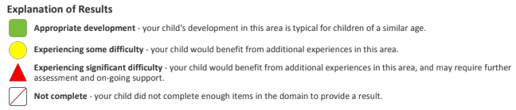
Determining scores
How are the green, yellow, and red EYE-DA scores determined?
Item scores within a domain are averaged and then assigned to the green, yellow or red developmental category based on a child’s age at the time of assessment.
Each domain has a set of thresholds or categories based on the child's age that is used to determine if the child is at appropriate development, experiencing some difficulty, or experiencing significant difficulty.
Notes:
How are the green, yellow, and red EYE-DA scores determined?
Item scores within a domain are averaged and then assigned to the green, yellow or red developmental category based on a child’s age at the time of assessment.
Each domain has a set of thresholds or categories based on the child's age that is used to determine if the child is at appropriate development, experiencing some difficulty, or experiencing significant difficulty.

Slide 6
Age-normed assessment
How does a child’s age affect the results?
Age-based norms (for 3 – 6 years old) are used to determine children’s early readiness skills in the four developmental domains. The norms are based on age-appropriate tasks derived from a number of Canadian and US studies and aligned with results from international assessments. Our norming scale is based on a sample of over 6,000 Canadian children.
Notes:
How does a child’s age affect the results?
Age-based norms (for 3 – 6 years old) are used to determine children’s early readiness skills in the four developmental domains. The norms are based on age-appropriate tasks derived from a number of Canadian and US studies and aligned with results from international assessments. Our norming scale is based on a sample of over 6,000 Canadian children.

Slide 7
Age-normed assessment
How does a child’s age affect the results?
A younger child would have lower score thresholds than an older child in determining whether their domain score outcome is green, yellow, or red. Put simply, we have different skill level expectations for children depending on their age, with lower expectations for younger children and higher expectations for older children.
Notes:
How does a child’s age affect the results?
A younger child would have lower score thresholds than an older child in determining whether their domain score outcome is green, yellow, or red. Put simply, we have different skill level expectations for children depending on their age, with lower expectations for younger children and higher expectations for older children.

Slide 8
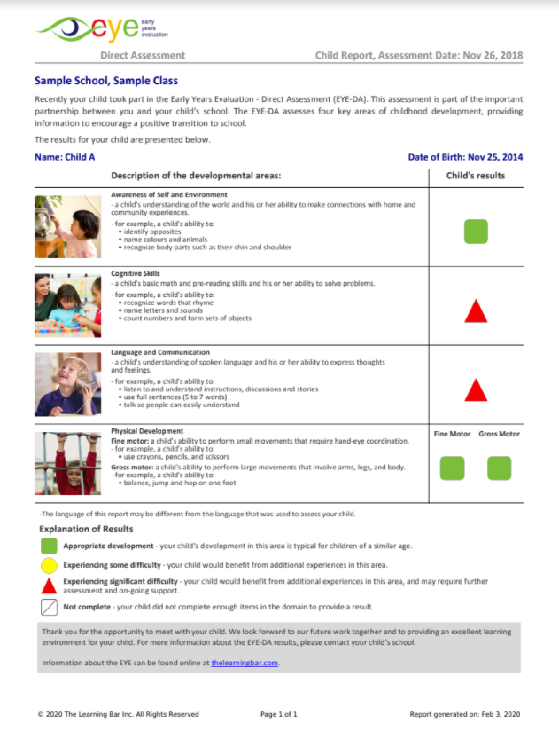
EYE Child Report
The Child Reports are available immediately as soon as you click Generate Report on the online data entry site.
For each domain, we’ve included:
a descriptive photo;
an explanation of the domain and examples of applicable skills; and
a colour-coded result
At the bottom of the Child Report, there is an explanation of the coloured results.
Notes:
The Child Reports are available immediately as soon as you click Generate Report on the online data entry site.
For each domain, we’ve included:
a descriptive photo;
an explanation of the domain and examples of applicable skills; and
a colour-coded result
At the bottom of the Child Report, there is an explanation of the coloured results.

Slide 9
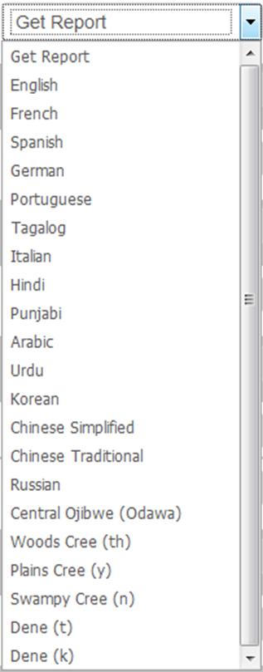
EYE Child Report
The Child Reports are great for sharing with families, other teachers, and members of your resource team.
The Child Reports are available in over 20 languages. This allows most families, regardless of their English literacy level, to easily interpret the child’s results.
Notes:
The Child Reports are great for sharing with families, other teachers, and members of your resource team.
The Child Reports are available in over 20 languages. This allows most families, regardless of their English literacy level, to easily interpret the child’s results.

Slide 10
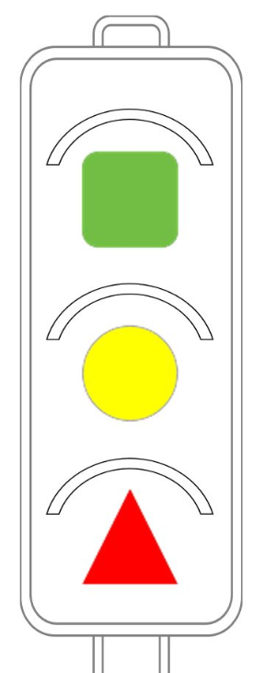
Interpreting the results
We’ve adopted this traffic light metaphor to help teachers and families understand the meaning of the coloured scores.
Incorrect Interpretation:
Green EYE-DA results are “good”
Yellow results are “so-so”
Red EYE-DA results are “bad”
Correct Interpretation:
Green Light – Let’s keep moving on the current learning path.
Yellow Light – We may have to slow down and reconsider the current learning path.
Red Light – Let’s pause for a moment and adjust the learning path before proceeding onward.
Notes:
We’ve adopted this traffic light metaphor to help teachers and families understand the meaning of the coloured scores.
A Green result means let’s keep moving on the current learning path.
A Yellow result means we may have to slow down and reconsider the current learning path.
And a Red result means let’s pause for a moment and adjust the learning path before proceeding onward.

Slide 11
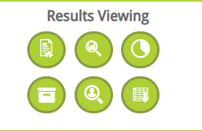
EYE-DA charts and tables
EYE pie charts, bar graphs and Excel sheets are also available for each class within the Results Viewing section in the Online Data Entry site.
These reports are updated in real-time.
Notes:
EYE pie charts, bar graphs and Excel sheets are also available for each class within the Results Viewing section on the Online Data Entry site.
These reports are updated in real-time; as soon as child-level data is entered and reports are generated, these charts are also updated in the system as well. These reports can be saved, downloaded, and printed off.

Slide 12
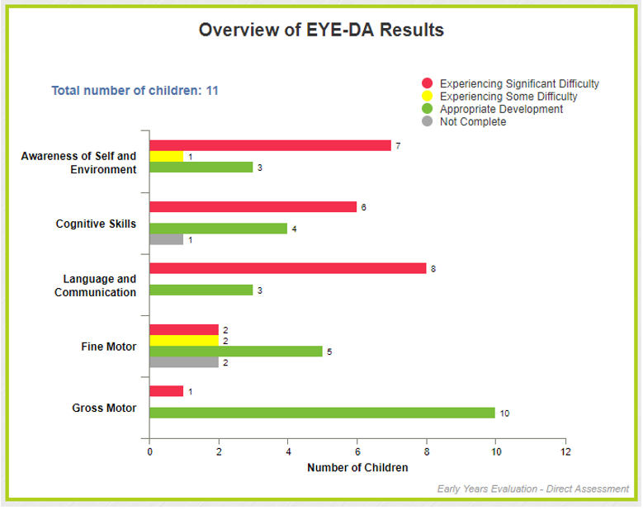
Bar graphs
These reports help you view overall class results and easily identify the strengths and vulnerabilities of your class at a glance.
Notes:
These reports help you view overall class results and easily identify the strengths and vulnerabilities of your class at a glance.
Looking at the results on the sample bar graph here, we see that overall, the Gross Motor domain is a strength for this class, but that generally, the children would benefit from more opportunities to practice their skills in the first three domains, especially Language and Communication.

Slide 13
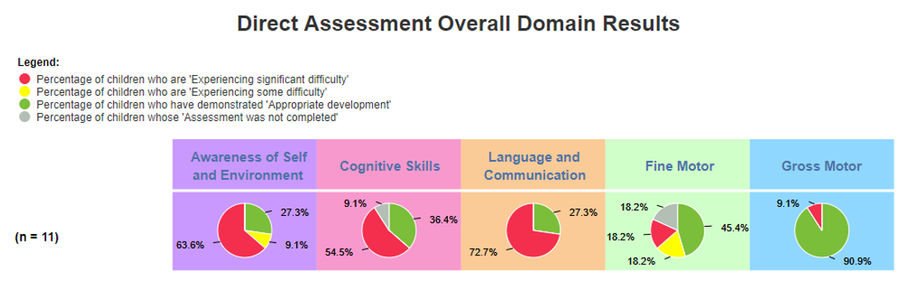
Pie charts
The pie charts present the same information as the bar graphs but in percentages.
Notes:
The pie charts present the same information as the bar graphs but in percentages. Looking at this chart, again we would want to focus on the skills related to the first three domains, especially Language and Communication.

Slide 14
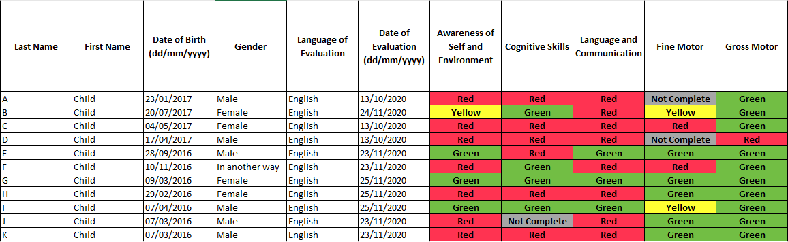
Excel sheet
This Excel sheet is a great way to view results for an entire class and can be used to identify and track which children require additional support and follow-up.
Notes:
This Excel sheet is a great way to view results for an entire class and can be used to identify and track which children require additional support and follow-up.

Slide 15


Thank You!
eye-support@thelearningbar.com
506-458-9311
1 877 840 2424

