Slide 1
Family Information Session
Early Years Evaluation – Direct Assessment (EYE-DA)
Notes:
Welcome to the Early Years Evaluation Family Information Session

Slide 2
Introduction

Slide 3
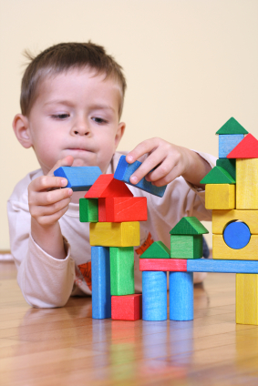
Children develop skills as they grow and learn.
These skills and abilities are the building blocks for their future.
For example….
Entering kindergarten with strong language skills can help children to become successful readers.
Notes:
Children develop skills as they grow and learn
These skills and abilities are the building blocks for their future
For example….
Entering kindergarten with strong language skills can help children to become successful readers

Slide 4
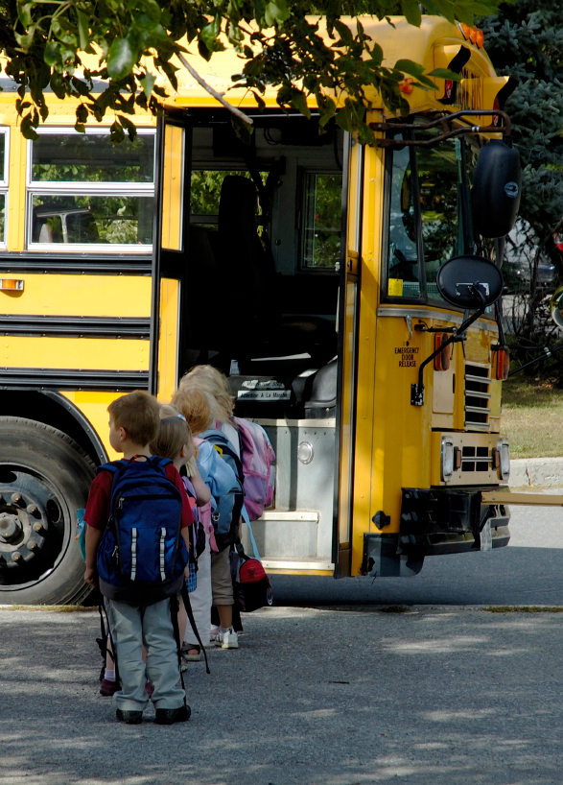
Most reading difficulties can be prevented with early identification, excellent classroom instruction, and appropriate support.
This is the premise on which the Early Years Evaluation – Direct Assessment (EYE-DA) was created.
Notes:
Most reading difficulties can be prevented with early identification, excellent classroom instruction, and appropriate intervention.
This is the premise on which the Early Years Evaluation – Direct Assessment (EYE-DA) was created

Slide 5
What is the Early Years Evaluation – Direction Assessment (EYE-DA)?

Slide 6
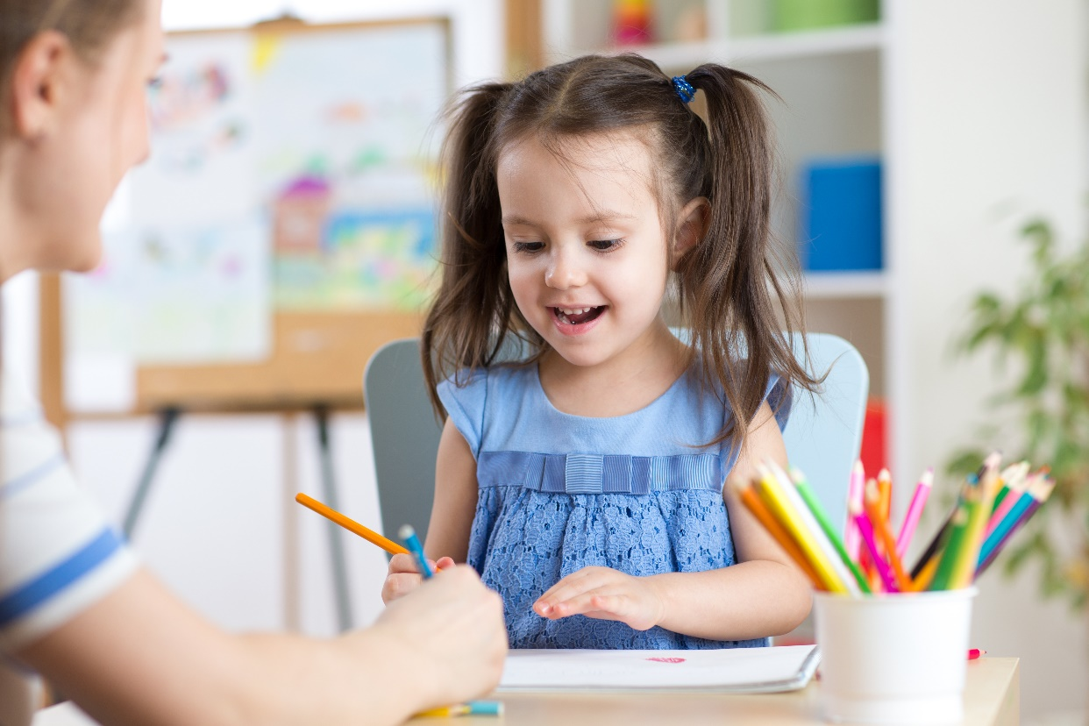
What is the Early Years Evaluation –
Direct Assessment (EYE-DA)?
The EYE-DA is an assessment administered individually with pre-kindergarten children.
Notes:
The Early Years Evaluation-Direct Assessment (EYE-DA)
is an individually administered direct assessment of pre-kindergarten children ages 3 to 5 years.

Slide 7
What does the EYE-DA assess?
The EYE-DA assesses the developmental strengths and areas requiring support for children at the start of school.
The EYE-DA assesses four key areas of early childhood development: Awareness of Self and Environment, Cognitive Skills, Language and Communication, and Physical Development.
The key areas are linked to children's readiness to learn at school.
1
2
3
4
Notes:
The EYE-DA assesses the developmental strengths and weaknesses of children at the start of school.
The EYE-DA assesses four key areas of early childhood development: Awareness of Self and Environment, Cognitive Skills, Language and Communication, and Physical Development.
The key areas are linked to children's readiness to learn at school.

Slide 8
Awareness of Self and Environment
A child's understanding of the world and his or her ability to make connections with home and community experiences.
This area refers to children’s ability to:
Think and talk about their world (e.g., identify opposites, common animals, colours, and positions of objects).
Make connections with home and community experiences (e.g., a police officer keeps you safe).
1
2
3
4
Notes:
1. Awareness of Self and Environment
a child's understanding of the world and his or her ability to make connections with home and community experiences.
This area refers to children’s ability to:
Think and talk about their world (e.g., identify opposites, common animals, colours, and positions of objects)
Make connections with home and community experiences (e.g., a police officer keeps you

Slide 9
Cognitive Skills
A child's basic math and pre-reading skills and his or her ability to solve problems.
This area refers to children’s ability to:
Recognize words that rhyme;
Name some letters and sounds;
Name numbers and count sets of objects;
Recognize same and different.
1
2
3
4
Notes:
2. Cognitive Skills
a child's basic math and pre-reading skills and his or her ability to solve problems.
This area refers to children’s ability to:
Recognize words that rhyme
Name some letters and sounds
Name numbers and count sets of objects
Recognize same and different

Slide 10
Language and Communication
A child's understanding of spoken language and his or her ability to express thoughts and feelings.
This area refers to children’s ability to:
Listen to and understand instructions, discussions,
and stories;
Use full sentences to explain ideas;
Talk so people can easily understand.
1
2
3
4
Notes:
3. Language and Communication
a child's understanding of spoken language and his or her ability to express thoughts and feelings.
This area refers to children’s ability to:
Listen to and understand instructions, discussions,
and stories
Use full sentences to explain ideas
Talk so people can easily understand

Slide 11
Physical Development
Fine motor
Small movements that require hand-eye coordination.
This area refers to children’s ability to:
Using crayons, pencils, and scissors;
Copying shapes, letters, and numbers.
Gross motor
Large movements that involve arms, legs, and body.
This area refers to children’s ability to:
Balance, jump and hop on one foot;
Catch and throw, run, and skip.
1
2
3
4
4
Notes:
4. Physical Development
Fine motor
Small movements that require hand-eye coordination.
This area refers to children’s ability to:
Using crayons, pencils, and scissors
Copying shapes, letters, and numbers
Gross motor
Large movements that involve arms, legs, and body
This area refers to children’s ability to:
Balance, jump and hop on one foot
Catch and throw, run, and skip

Slide 12
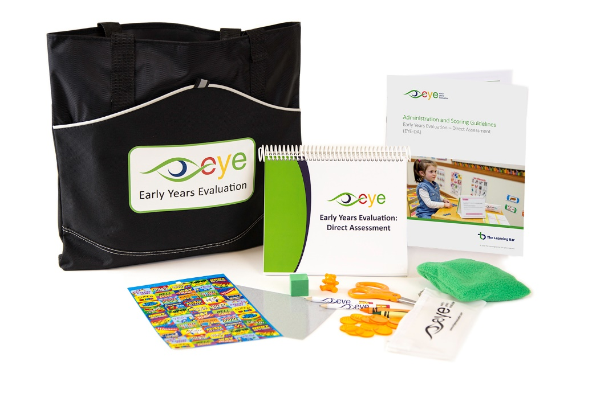
Early Years Evaluation – Direct Assessment (EYE-DA)
The EYE-DA takes approximately 45 minutes per child.
Teachers and support staff administer the EYE-DA.
Colourful pictures and physical activities make the EYE-DA fun for children.
Children love doing the EYE!
Notes:
The EYE-DA takes approximately 45 minutes per child
Teachers and support staff administer the EYE-DA
Colourful pictures and physical activities make the EYE-DA fun for children

Slide 13
What is the EYE-DA used for?
The EYE is used to:
    Assess areas of strength, and areas of difficulty;
    Identify children who may need extra help;
    Monitor learning gains during first years of school;
    Provide a positive transition to school.
Notes:
The EYE is used to:
Assess areas of strength, and areas of difficulty;
Identify children who may need extra help;
Monitor learning gains during first years of school;
Provide a positive transition to school;

Slide 14
What is the not EYE-DA used for?
The EYE is not used to:
a test to be passed or failed;
used to label children;
a diagnostic tool to identify specific learning disabilities.
Notes:
The EYE is not used to:
‘group’ children;
label children;
diagnose specific learning problems;
identify children who are intellectually gifted.

Slide 15
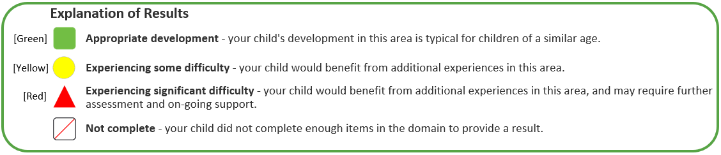
Child Results
After the EYE-DA is complete, families will be informed of the results for their child.
Results are presented using three colour codes as described below:
Notes:
Appropriate development
Experiencing some difficulty
Experiencing significant difficulty
Not complete (Child did not complete enough items in the domain to generate a result).

Slide 16
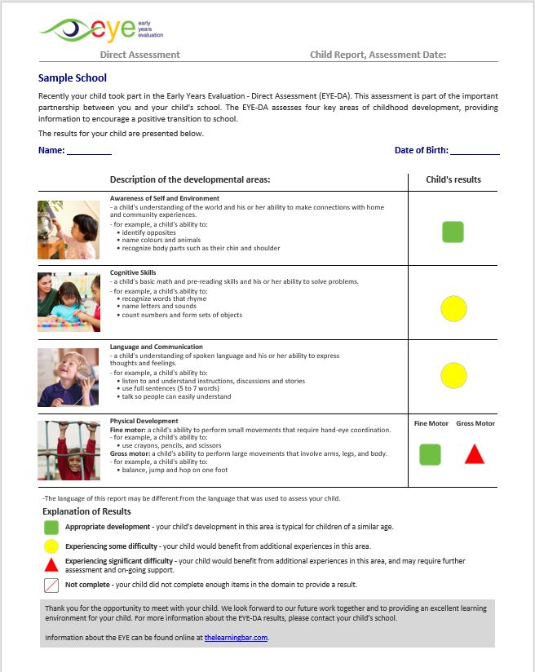
EYE-DA Child Report
This report lists each of the developmental areas, along with examples describing each area, and a colour-coded box showing the child’s results.
Notes:
EYE-DA Child Report
This report lists each of the developmental areas, along with examples describing each area, and a colour coded box illustrating the child’s results. Results are reported for each of the four domains. Results for physical development are split into Fine and Gross Motor squares.

Slide 17
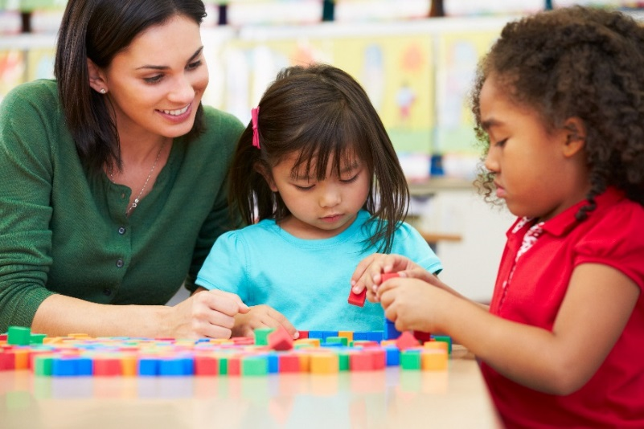


Results can be used to:
Identify students who need extra support.
Provide guidance and assistance to students.
Inform & involve families in meaningful ways.
Notes:
After the EYE is complete, Results can be used to identify students who need extra support, provide guidance and assistance to students, involve families in meaningful ways.

Slide 18
Examples of Extra Support
Scheduled visits to school for children to practice kindergarten routines;
Families and child attend school one half day per week in the summer to work on skills;
Children work in small groups with more attention and focus for a part of the school day;
Referral to specialist (i.e., SLP, OT, PT, etc.) for further assessment and targeted interventions.
Notes:
If a child needs extra instructional support, there are many approaches that can be taken. Some examples of Instructional Support include:
Scheduled visits to school for children to practice kindergarten routines;
Families and child attend school one half day per week in the summer to work on skills;
Children work in small groups with more attention and focus for a part of the school day;
Referral to specialist (i.e., SLP, OT, PT, etc.) for further assessment and targeted interventions

Slide 19


Thank You!
Any questions?
Name First Last
NAME@thelearningbar.com
506 458 9311 ext 0000
1 877 840 2424
Notes:
Thank you so much for your time and attention today – we hope you enjoyed this presentation about the Early Years Evaluation. If you have any further questions, please email the appropriate contact on this final slide.

