Slide 1
Administering and Scoring the EYE-DA
Notes:
Welcome to this Early Years Evaluation- Direct Assessment Learning Series.
This session will focus on preparing for and administering the EYE-DA.

Slide 2

What will you learn?
Overview of the EYE-Direct Assessment (EYE-DA)
Administering the EYE-DA
Suggestions for best practices when using the EYE-DA
Review scoring
Frequently Asked Questions
Notes:
This presentation will:
- Provide an overview of the EYE-DA
- Answer your questions about getting started and administering the EYE-DA
Offer suggestions for best practices
Review scoring
Respond to some Frequently Asked Questions

Slide 3
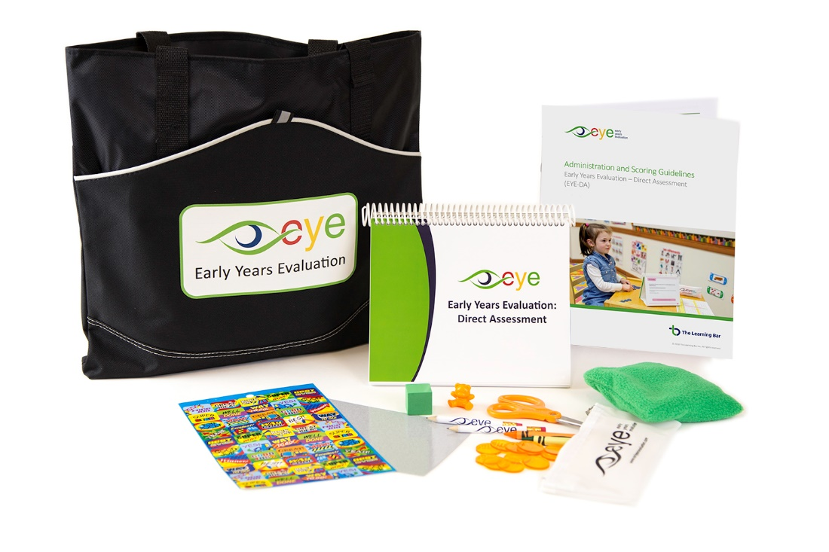

Direct Assessment (EYE-DA)
An age-normed individually administered assessment measuring the developmental skills of children aged 3-6 years.
Notes:
So what is the Direct Assessment?
It’s an age-normed individually administered assessment measuring the developmental skills of children aged 3-6 years.
Using play-based methods, trained assessors gather data in four key domains known to foster learning success. The EYE-DA provides ‘leading indicator’ information on each child’s strengths or areas for further development early, to help schools and families support a positive transition to school.

Slide 4
VERY IMPORTANT:
EYE-DA is NOT to be viewed as a test to be passed or failed. Rather, it identifies strengths and areas which could benefit from further instruction or support.
EYE-DA it is not used to:
label children;
diagnose specific learning problems; or
identify gifted children.
Notes:
It is important to understand that the EYE-DA should not be viewed as a test that can be passed or failed, rather it is an indicator of a child’s strengths and areas which could benefit from further instruction and should be used to guide practice.
EYE-DA is not used to:
label children;
diagnose specific learning problems; or
identify gifted children.

Slide 5

Children are holistic learners
The EYE-DA assesses four domains associated with children’s readiness to learn.
Awareness of Self and the Environment
Cognitive Skills
Language and Communication
Physical Development
Notes:
The EYE-DA is a holistic tool that assesses four domains associated with children’s readiness to learn.
Awareness of Self and the Environment
Cognitive Skills
Language and Communication
Physical Development

Slide 6
General administration procedures
Notes:
Let’s look at some general administration procedures now.

Slide 7

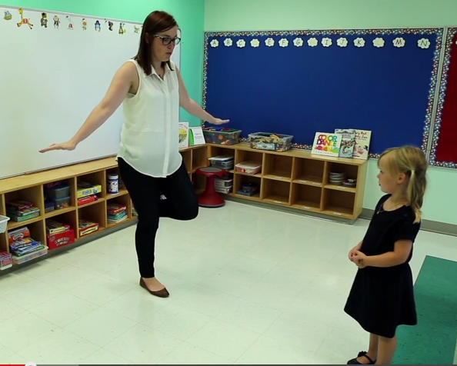
Colourful pictures, hands-on materials, and physical activities make the EYE-DA engaging for children.
Notes:
The EYE-DA assessment uses colourful pictures, manipulatives, and physical activities to make it fun and engaging for children. Items are intentionally placed to ensure the children are fully engaged during the assessment. Evaluators tell us how interactive and fun this assessment is for children. In fact, many children have no idea they are being assessed – they just think they are playing some fun games. The experience is positive for children because they are encouraged and cheered on throughout the assessment. Furthermore, there is never any indication that they ever got a question wrong or right – it’s just strictly positive reinforcement.

Slide 8

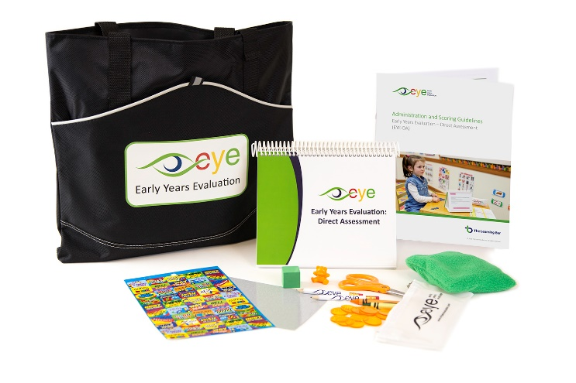
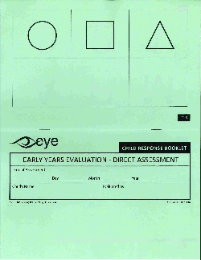

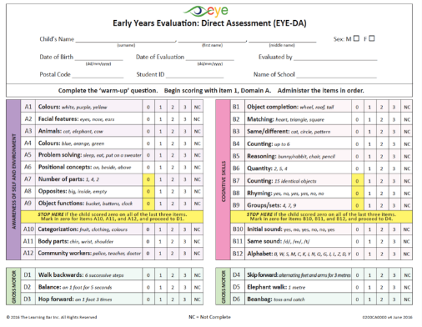
Materials needed for administration:
Administration and Scoring Guidelines (ASG)
Scoring Protocol Sheets and Child Response Booklets
Flipbook
Blank laminated card
Zippered pouch with pencils, crayons, scissors, a block, items for making sets, and a figure
Bean bag
Sheet of stickers
Notes:
It's important to familiarize yourself with the EYE-DA materials before you begin the evaluations.
CLICK The Administration and Scoring Guidelines (ASG) is a valuable source of information- in it, there is an introduction to the EYE-DA, information about the materials used for the evaluation, general administration procedures and it is also a great resource for your scoring questions. Please take the time to read it carefully.
For your evaluation, you will also need:
CLICK Scoring Protocol Sheets and Child Response Booklets (one for each child being evaluated)
CLICK along with the Flipbook, laminated card, the pencil case, the bean bag, and a sheet of stickers.

Slide 9
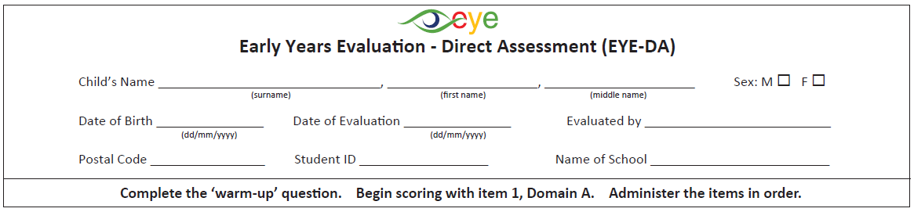
Preparing to administer the EYE-DA
Carefully fill out the requested information (name, sex, age, etc.) at the top of the Scoring Protocol Sheet.
Notes:
When preparing to administer the DA, carefully enter the requested information (name, gender, age, etc.) located at the top of the Scoring Protocol Sheet.
Please note that the date of birth and the date of the assessment are formatted starting with the day, then the month and finally the year. It's very important to correctly enter the child’s date of birth along with the date the evaluation took place. The assessment is age-normed, so we use this information to calculate the child's age at the time of the assessment and this determines his or her results.

Slide 10
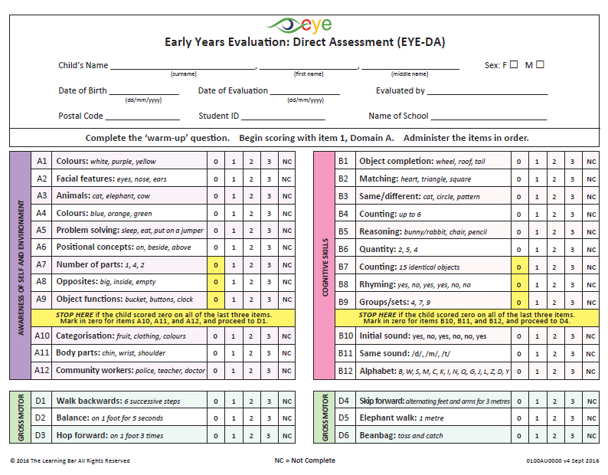
Using the Scoring Protocol Sheet
Notes:
This is where you will be recording the scores as you are administering the items in the flipbook.
Click Fill out the child’s demographic information before you begin the assessment – yellow arrow
Click Colour-coded domains are the same as in the flipbook – purple arrow
Click Item numbers are listed here and match those found in the flipbook – green arrow
Click Here we see the skills assessed, including the correct answers - red arrow
Click The scoring scale is 0-3 points or Not Complete – orange arrow
Click The yellow section describes the stop rule. For Domains A, B, and C – you stop after the 9th item if a score of zero on each of the previous three items (e.g., B7, B8, and B9) is recorded. Enter a score of zero for the remaining three items (e.g., B10, B11, and B12). The ‘Stop Rule’ is not used for Domain D (Gross and Fine Motor Skills).

Slide 11
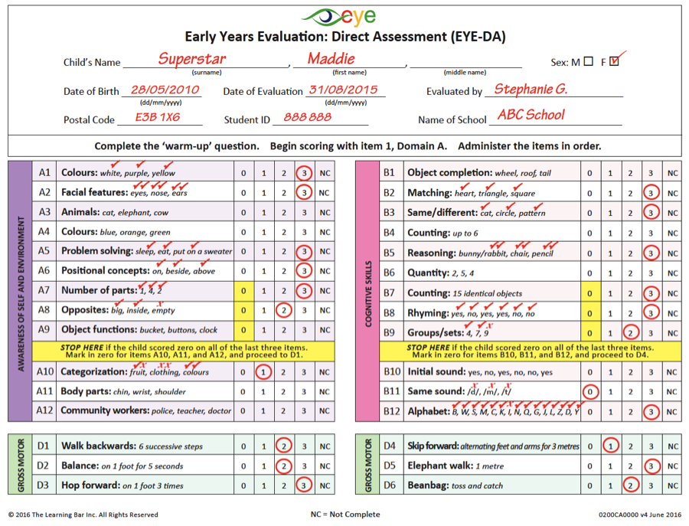
Example: Using the Scoring Protocol Sheet
Notes:
You can see that the evaluator has used the Scoring Protocol Sheet to record additional information as the assessment was done with this child. This is very helpful in case there is uncertainty about the score when it’s time to enter the data into the system. This evaluator put a checkmark next to each correct response and put an X when the child’s response was incorrect. You’ll also notice that in the case where a two-part answer is required, the evaluator has placed two checkmarks to indicate that the child has answered both parts correctly.

Slide 12
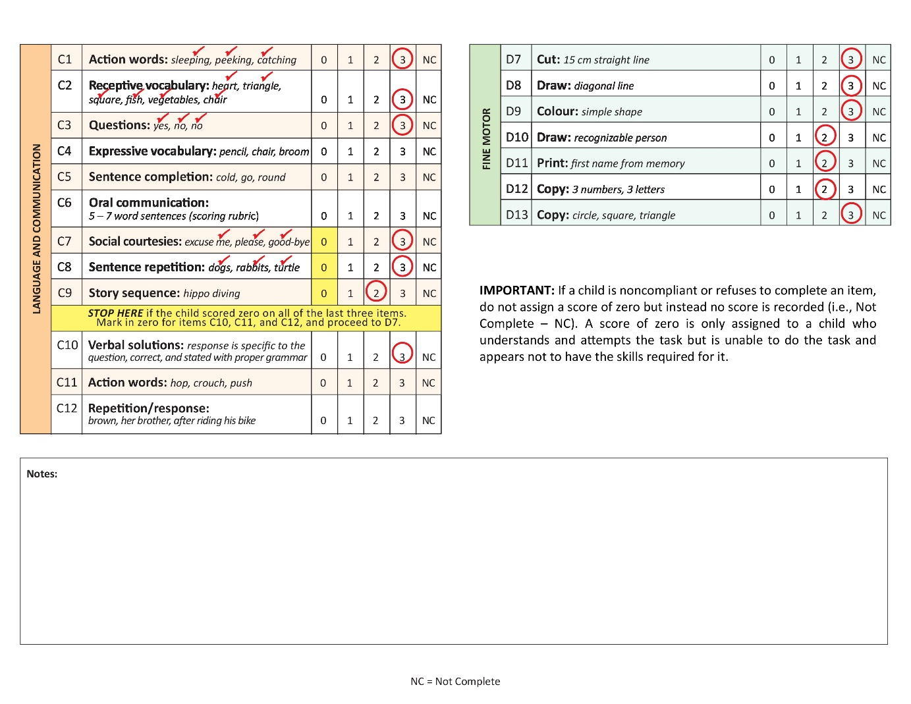
Example: Using the Scoring Protocol
Notes:
On the back of the Scoring Protocol Sheet, you’ll see that there is a section at the bottom to record any observations or notes from the assessment.
The information you’ve gathered and recorded on this sheet can later be entered into the online data entry site.

Slide 13
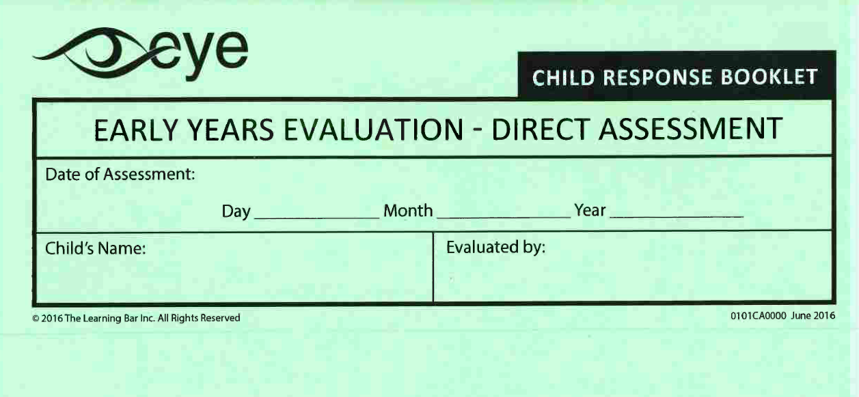
Child Response Booklet
Notes:
Each child will need a Child Response Booklet in order to complete the Fine Motor skills section of the EYE‐DA. Please ensure that the child’s name is recorded on the front of the Child Response Booklet and that it stays with the Scoring Protocol in case questions arise or a teacher would like to view it.
Instructions on how the child uses the Child Response Booklet are included in the flipbook and in Appendix A of the ASG. Samples for scoring these items are also located in the flipbook as well as in Appendix B.

Slide 14
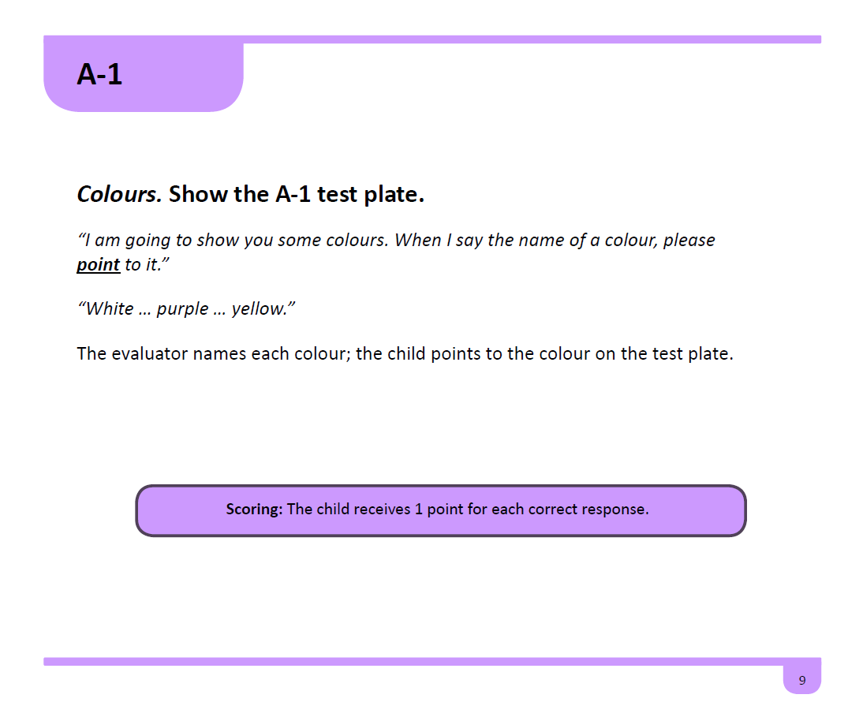
Using the EYE-DA Flipbook
1
2
5
3
4
Notes:
The flipbook is designed to correspond to the Scoring Protocol Sheet.
1 ) CLICK The top-left corner denotes the domain and item number.
2 ) CLICK Domain colours match those found on the Scoring Protocol Sheet.
3 ) CLICK The scripted text for the assessor is included in italics.
4) CLICK The scoring criteria are included at the bottom of the page.
5) CLICK The materials required for this item are listed here. These can include the test plate and/or materials from the EYE-DA kit.

Slide 15

Getting started
Build rapport with the child:​
  Greet them by name
  Chat with them briefly
  Introduce yourself
Complete the ‘warm-up’ item.
Make sure the child understands you and is comfortable working with you.
Ensure the evaluation area is a fairly quiet space with enough room to demonstrate the Gross Motor skills.
Notes:
In some situations, when the child arrives to complete the DA, they are meeting you, the evaluator, for the first time. If this is the case, it is important to ensure that the child feels comfortable working with you.
1. You can build rapport by:
Greeting them by name (Hello Katie! How are you today?)​
Chatting with them briefly (I see a flower on your shirt; do you like flowers?)​
Introduce yourself (I am (facilitator’s name) and we are going to play and have some fun today!)​
2. Complete the ‘warm-up’ item.
3. Make sure the child understands you and is comfortable working with you.
4. Ensure the evaluation area is a fairly quiet space with enough room to demonstrate the Gross Motor skills.
Some suggestions:​
Wear comfortable clothes and shoes that will allow you to move easily. You will be doing some hopping and skipping during the evaluation.​
Avoid flashy jewelry ​and heavy scents or perfumes.
​

Slide 16

Ideal set-up for the assessment
Notes:
Positioning yourself correctly during the evaluation is important. You need to be able to see what the child is doing and also read the script from the flipbook.
Take the materials out of the DA kit and place them beside you so that they are accessible but keep them out of the child’s line of vision.

Slide 17

Encouraging the child
Appropriate feedback​ | Feedback​ to avoid
Thank you Well done! Good job!​ Great work! | You got it right!​ That’s correct!​ Oh, nice try.​ Close, but not quite right. ​ ​
Notes:
It is important to encourage and motivate the child throughout the assessment regardless of the response provided. The child should have no real notion of how well he or she is performing.

Slide 18
Scoring

Slide 19

Scoring
Items increase in difficulty within each domain.
Start at item A1 and proceed according to the order thereafter.
Items are scored on a scale of 0 to 3 points.
There are no ½ point or ¼ point calculations.
Record the scores as you go.
Notes:
Items increase in difficulty within each domain.
Start at item A1 and proceed according to the order thereafter.
Items are scored on a scale of 0 to 3 points.
There are no ½ point or ¼ point calculations.
Record the scores as you go.

Slide 20
Scoring
Scoring
1- Scale of 0 to 3 points
2- Scoring rubric
Notes:
There are two types of scoring – the first one scores the child on a scale from 0 – 3 points and the second one uses a scoring rubric.

Slide 21
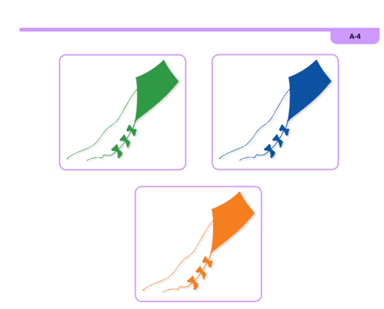
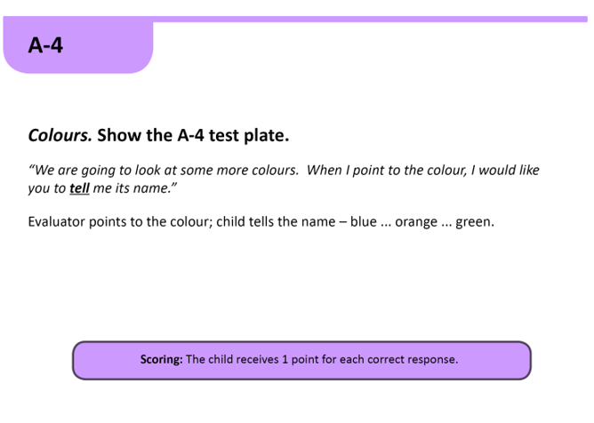
1- Scale of 0 to 3 points
Notes:
This is an example of an item that is scored using the 0-3-point scale. If the child can name all three colours, they receive a score of 3.

Slide 22
2- Scoring rubric
Used for:
C6 (Language and Communication);
D1-D13 (Gross and Fine Motor Skills);
Score 0: Skill is Absent | Score 1: Emerging | Score 2: Almost Mastered | Score 3: Mastered
Child is unable to do this task and appears to not yet have the strength or coordination required for it. | Child appears to have some of the skills required for this task, but could only do it with prompting and/or assistance at this time. | Child can do this task without assistance but does not do it well, confidently or consistently. It appears that the child will soon master this task. | The skills for this task are well developed. It was done confidently and it appears that the child could do it consistently.
Notes:
The scoring rubric is used to score item C6 Language and Communication as well as all of the Physical Development assessment items.
The rubric provides descriptors for each skill level from 0 to 3.

Slide 23
Frequently Asked Questions

Slide 24
General questions
Who administers the EYE-DA?
Teachers and educational support personnel.
How long does it take?
About 45 minutes per child, and data can be entered in the online data entry system in about 5 minutes.
When do I get my reports?
Individual child reports are available immediately!
Notes:
Who administers the EYE-DA? In terms of administering the EYE-DA, typically teachers and educational support personnel who are experienced and enjoy working with young children complete the assessment. The DA is very interactive and requires constant engagement with the child.
How long does it take? It takes approximately 45 minutes per child to administer. Data is easily entered into our online system in about 5 minutes.
When do I get my reports? Reports are available immediately – this is leading indicator data – it can be reviewed by the multidisciplinary team to determine which children have development typical for children of a similar age, who may benefit from additional experiences in a given domain or who may require further assessment and ongoing support.

Slide 25

Zero or “Not Complete”?
  If a child refuses to complete an item or cannot attempt an item, no score is recorded (enter “Not Complete”).
  A score of zero (0) is given when a child attempts an item but does not have the skill set to meet the scoring criteria of 1-3.
Notes:
THIS IS A VERY IMPORTANT POINT -
Read the slide.
An example of a child who would score a Not Complete for an item would be a child who has a broken leg, and he/she cannot do a Gross Motor item.

Slide 26
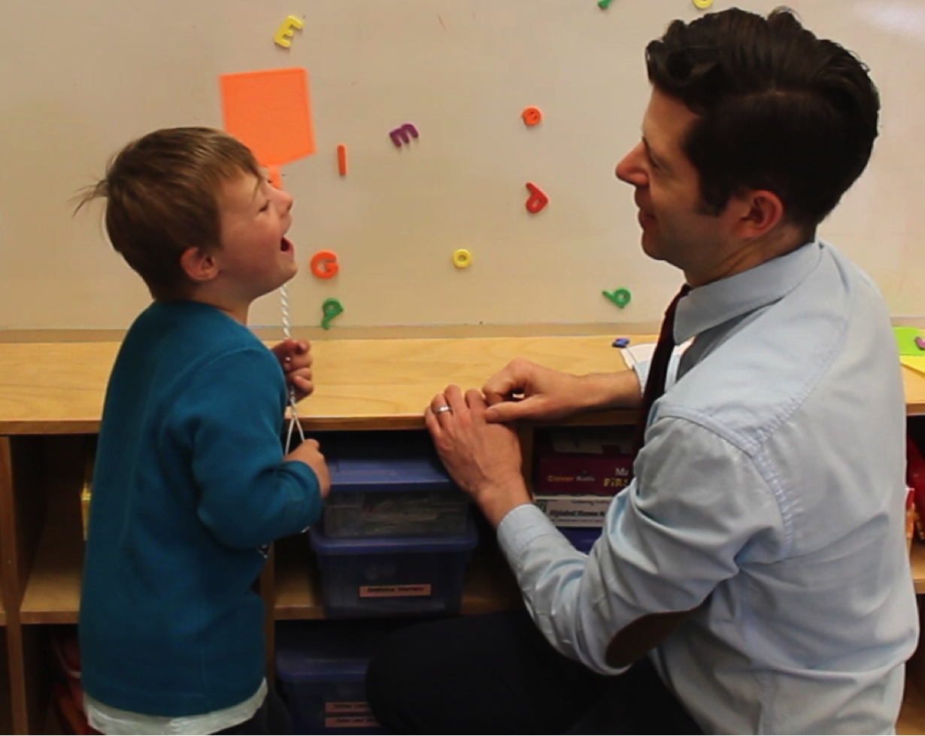
Administering the EYE-DA to children with a disability
We advocate that all children complete as much of the EYE-DA as they are able to.
Notes:
We advocate for all children to complete as much of the EYE-DA as they are able to. If an evaluator is unable to complete a sufficient number of items for a child in one of the domains, the result for that domain will appear on the report as Not Complete. In this sense, we are saying that we do not have sufficient data to evaluate and provide a result for this child in this domain.
In the case of a child with a severe disability – who has already been diagnosed and has specialists in place - we rely on your professional judgment, the wishes of the families/guardians, and your school’s practices and policies when deciding if it would be in the child’s best interest to be assessed with the EYE-DA.

Slide 27

Language of administration
Try to assess as many items as you can in English.
Assess the child’s ability to complete the skill rather than his or her ability to understand the language.
Translators are not allowed.
Notes:
If the child’s first language differs from the language being used in the assessment, the evaluator can recommend that the child be assessed at a later date or assessed in another language.
If the EYE-DA is administered to a child who does not have the language skills necessary to complete all the items in the assessment, record NC (not complete) for all items they were unable to attempt due to the language barrier. We want to make sure we are assessing the child’s true skills and not their language acquisition.
We don’t recommend the use of an interpreter as translations may deviate from the intent of the item thus affecting the internal reliability and validity of the evaluation.

Slide 28

Families and the EYE-DA
Indicate that you and the child will have fun playing and answering questions and that it will take approximately 45 minutes to complete.
Some questions that you might get from families/guardians:
“Can I stay for the assessment?”
“How did my child do?”
“Will I get to see the results?”
Notes:
If you are in a situation where you are meeting the child and family for the evaluation for the first time, you can indicate that it will take approximately 45 minutes to complete. As the evaluator, you might be asked these questions by families.
Can I stay for the assessment? While it is recommended that families are not in the room during an assessment, this is not always possible. If a family member must stay in the room with the child, evaluators may suggest that the family member sits in a location out of the child’s line of sight. It’s also essential that the evaluator remind the family member /guardian that they should not interact with their child during the evaluation.
How did my child do? Resist the temptation of guessing the final results. Make a general comment, for example, “We had fun together and everything went well”.
When will I get the results? This is something that is decided at a school or jurisdiction level and so it is important to connect with your EYE coordinator to answer this question.

Slide 29
Remember…
The evaluation should be a positive experience for the child.
Practice the evaluation several times before you actually administer one.
This is a snapshot of the child’s skills and abilities. Make sure the child is at ease in order to get an accurate snapshot of their skills.
The data from the EYE-DA gives us a holistic picture of where the child is and where we need to support them in their learning.
Notes:
The evaluation should be a positive experience for the child.
Practice the evaluation several times before you actually administer one.
This is a snapshot of the child’s skills and abilities. Make sure the child is at ease in order to get an accurate snapshot of their skills.
The data from the EYE-DA gives us a holistic picture of where the child is and where we need to support them in their learning.

Slide 30


Thank You!
Any questions?
eye-support@thelearningbar.com
506 458 9311
1 877 840 2424

